Slide 1
Tietze syndrome or costochondritis
Tietze syndrome
Ph.D Mahmudov Mahir
Azerbaijan Medical University
I Surgical Diseases Department

Slide 2
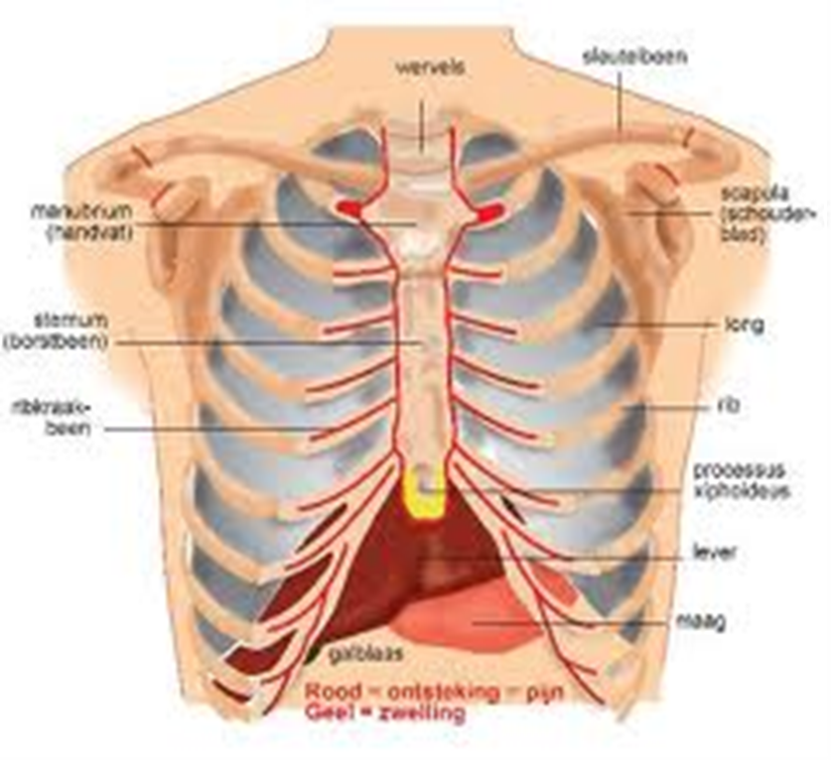
Definition
Tietze syndrome
It is a form of chondropathy, characterized by aseptic inflammation of the sternoclavicular and upper sternocostal joints.

Slide 3
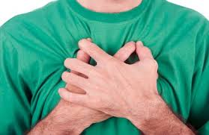
Localization
Tietze syndrome
The process usually occurs in II-III, and in rare cases in I and IV costosternal joints. Morphologically, occurs hypertrophy of cartilage.

Slide 4
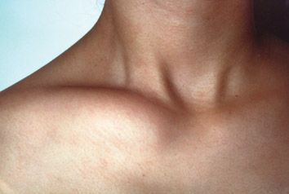
Etiology
Tietze syndrome
The etiology is unknown.
There are 3 theories that explain its origin:
Trauma theory
Infectious-allergic theory
Alimentary-dystrophic theory

Slide 5
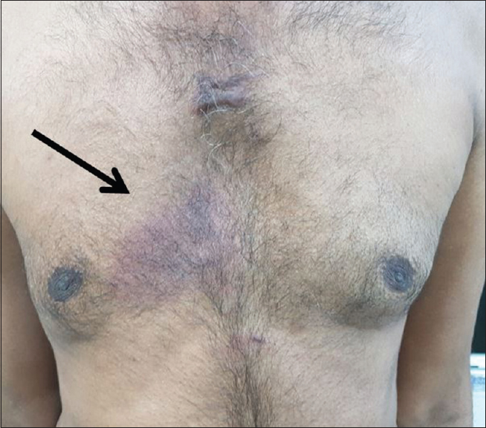
Clinical presentation
Tietze syndrome
local pain
hyperemia
hard swelling
shortness of breath
cough
The pain often begins after a blow or compression to the anterior wall of the chest.

Slide 6
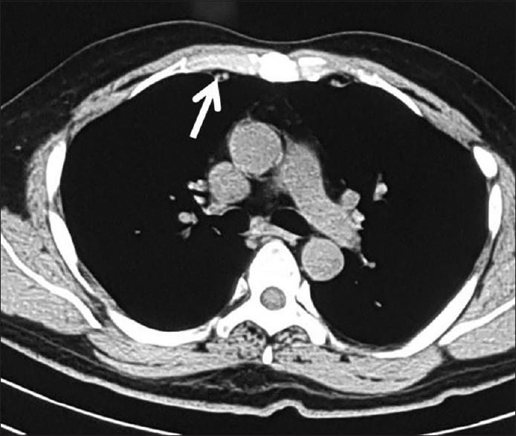
Diagnosis
Tietze syndrome
Anamnesis
Xray
ECG
USG
CT

Slide 7
Diagnostic criteria
Tietze syndrome
local pain in the anterior wall of the chest
hyperemia in the area of pain (acute phase)
solid, immobile swelling in the area of pain (40-70%)
ECG (EchCG) is a normal

Slide 8

Treatment
Tietze syndrome
Rest restriction
NSAID (per os)
Steroids (injection-3 months)
Surgical treatment

Slide 9
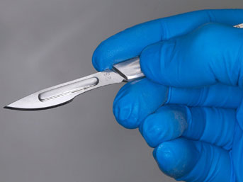
Surgery
Tietze syndrome
Chondrectomy
recurrence– NO.

Slide 10
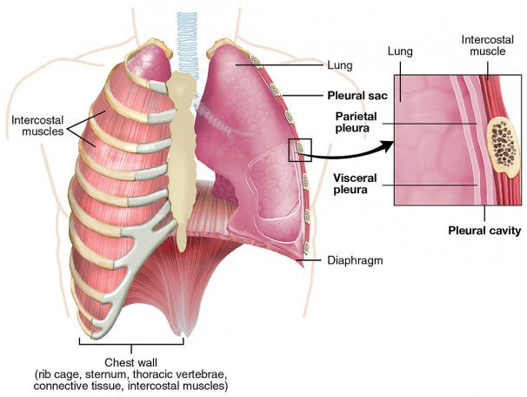
Neoplasms of the chest wall
Neoplasms of the
chest wall
With the exception of breast and parietal pleural neoplasms, benign and malignant tumors from ribs, muscles and other tissues are considered

Slide 11
Classification
Neoplasms of the
chest wall
Primary: benign and malignant
Secondary(metastatic): sarcomas, carcinoma
Other: cysts

Slide 12
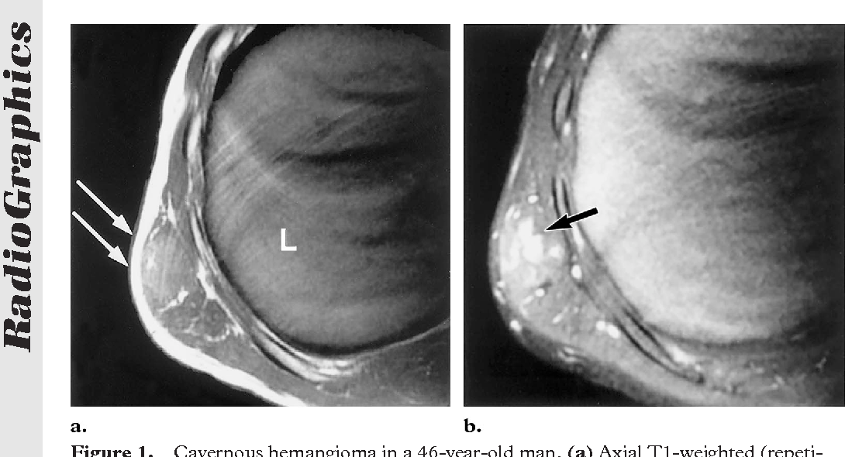
Benign tumors
Neoplasms of the
chest wall
lipoma
cavernous lymphangioma
hemangioma
chondroma
osteoma
eosinophilic granuloma
osteoblastoclastoma

Slide 13
Clinical presentation
Neoplasms of the
chest wall
Asymptomatic
Symptomatic
Swelling (derivative)
pain when infecting adjacent structures or squeezing the intercostal nerves
cough, shortness of breath, hemoptysis, weight loss as a result of growth of the tumor and damage to internal structures
Diagnosis-- Xray, USG, CT, biopsy, angiography and bronchoscopy as directed
Radical treatment --- excision, rib and sternal resection

Slide 14
Malignant tumors
Neoplasms of the
chest wall
Primary and secondary
primary malignancies – sarcomas
45% of them develops from soft tissues, and 55% from cartilage and bone tissue.
According to the histological structure:
Fibrosarcoma
Ewing sarcoma
Osteosarcoma
Chondrosarcoma
Reticulosarcoma
Angioleyomyosarcoma
hemangiopericytar sarcoma

Slide 15
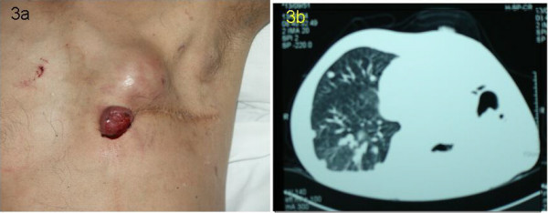
Secondary tumors
Neoplasms of the
chest wall
Lung
Mediastinum
metastasis of malignant tumors of other organs

Slide 16
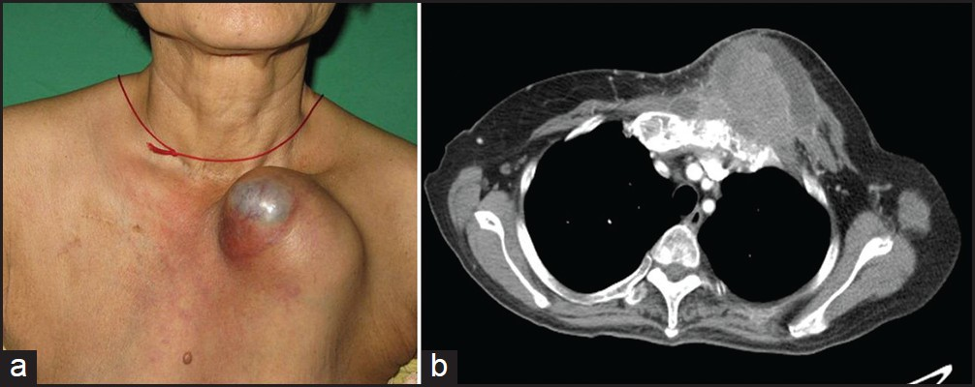
Metastatic chest wall tumors
Neoplasms of the
chest wall
A 67-year-old woman with cervical SCC metastasis to the left half of the chest

Slide 17
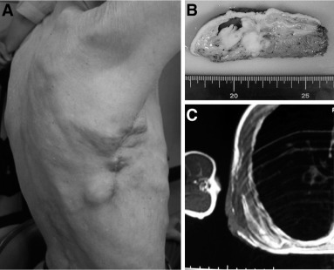
Clinical presentation
Neoplasms of the
chest wall
Asymptomatic in the early stages
Regarding tumor growth:
in the chest discomfort
Pain
Fever
Anorexia
weight loss
deformation of the thorax

Slide 18
Diagnosis
Neoplasms of the
chest wall
X-ray, CT, MRI, PET, biopsy, bone scintigraphy

Slide 19
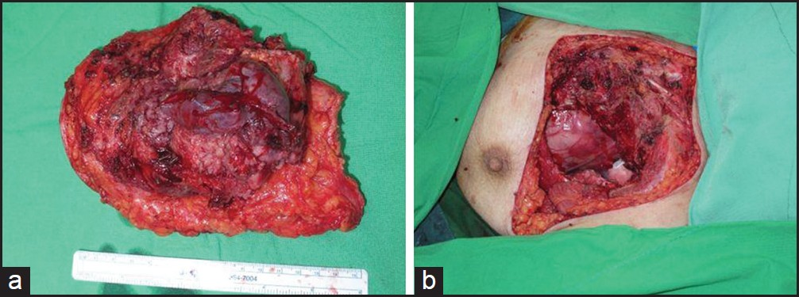
Treatment
Neoplasms of the
chest wall
Radical resection (malignant pleural exudate is contraindicated)
Chemotherapy
Radiotherapy

Slide 20
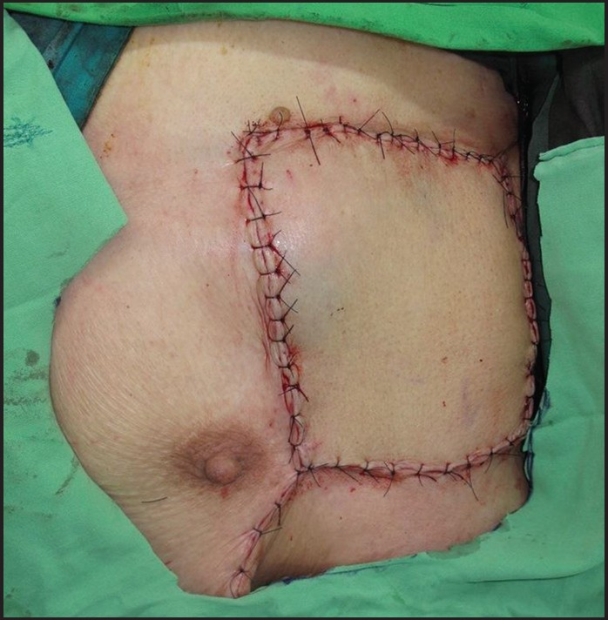
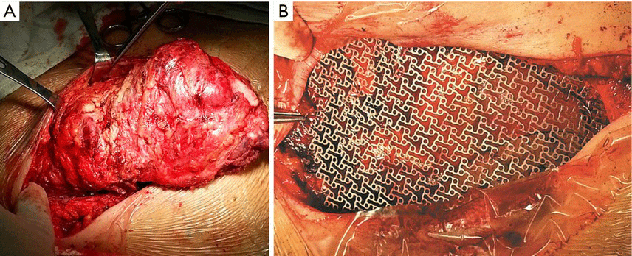
Surgery
Neoplasms of the
chest wall
Chest defects formed during the operation are repaired with skin and muscle locks, synthetic mesh.

Slide 21
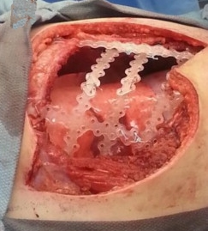
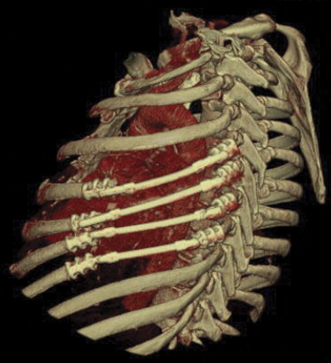
Synthetic ribs
Neoplasms of the
chest wall
Polylactic acid rib complex
Titanium synthetic ribs

Slide 22
Prognosis
Neoplasms of the
chest wall
The 5-year survival after radical treatment is 16.8%.

Slide 23
THANK YOU FOR ATTENTION

Slide 24


www.bck.az
Azərbaycan Tibb Universitetinin I-Cərrahi Xəstəliklər kafedrası

