Slide 1
Esophageal Perforation
Esophageal Perforation
PhD Salahova Sevinj
PhD Mahmudov Mahir
Azerbaijan Medical University
I Surgical Diseases Department

Slide 2
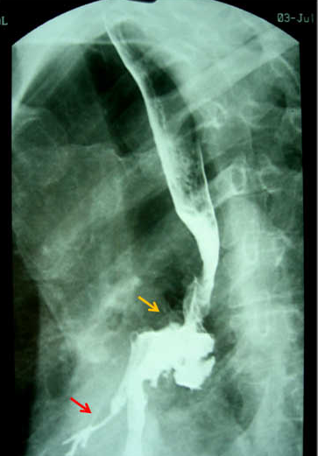
Definition
Esophageal Perforation
- It is a perforation of the wall of the esophagus
- It is usually severe, with an increased risk of death if not treated adequately at an early stage

Slide 3
Classification
Təsnifatı
Esophageal Perforation
By the Reason | Iatrogenic (damage with medical endoscopic instruments or metal (stents), etc.) Barotrauma By cause of Esophagus disease Foreign body Post-traumatic
By the Mechanism | Internal (iatrogenic, barotrauma associated with hypertension, foreign body) External (trauma)
By the Term | Early (first 24 hours) Late (more than 24 hours)

Slide 4
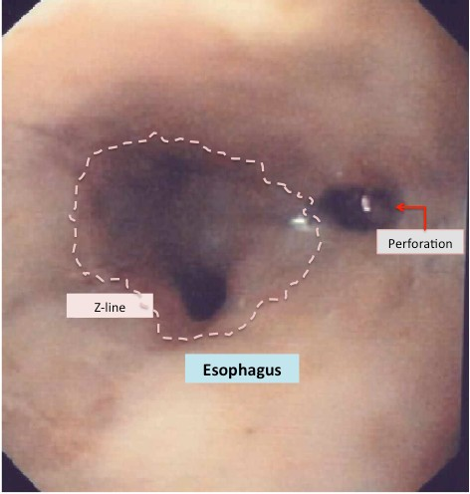
Frequency
Esophageal Perforation
In the cervical part - 40-60%
In the thoracic part - 40-50%
In the abdominal part - 10%.

Slide 5
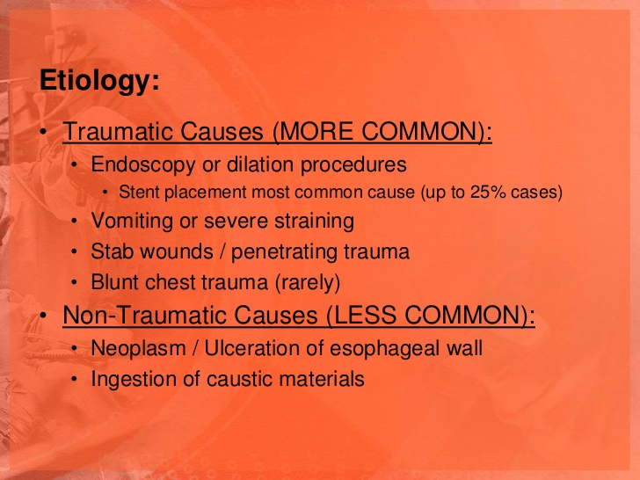
Reasons
Esophageal Perforation

Slide 6
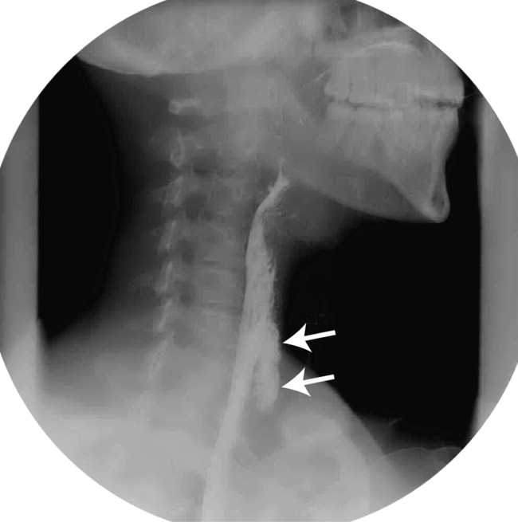
Clinical course and complications
Esophageal Perforation
is progressive
Untimely and inadequate treatment leads to acute inflammation, sepsis and death
Perforation of the neck can be caused phlegmon of that area
Intrathoracic perforation - acute mediastinitis, acute pleurisy and pyopneumothorax
Perforation of the abdominal part - acute peritonitis

Slide 7
Symtoms
Esophageal Perforation
Pains
Dysphagia
Shortness of breath
High temperature
Perforation to the cervical part: swelling, crepitation, pain and tenderness, redness and infiltration
Perforation to the chest: emphysema in the neck, pneumothorax, acute pleurisy, signs of shortness breath
Perforation to the abdomen: signs of acute peritonitis or abscess
Symptoms of sepsis: fever, tachycardia, shortness of breath, and hypotension
In an objective examination

Slide 8
Diagnosis
Esophageal Perforation
SUSPICION
After medical and diagnostic interventions of the Esophagus
Factors that increase intra-abdominal pressure
Pain in the neck, chest or abdomen
Increased pain after swallowing
Create suspicions of perforation
If symptoms of neck swelling, emphysema, acute pleurisy, acute peritonitis, and sepsis appear within 24 hours of these events, the suspicion increases

Slide 9
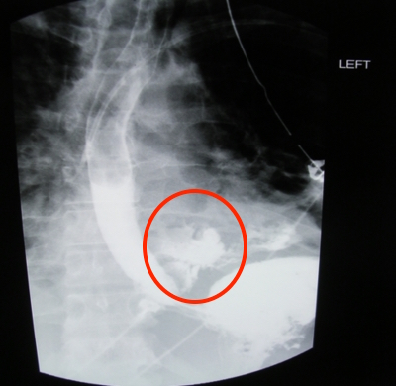
Diagnosis
Esophageal Perforation
Confirmation
contrast radiography or CT
When these examinations are less informative, an endoscopic examination should be performed.

Slide 10
Diagnosis
Esophageal Perforation
Contrast Radiography | It is the first and urgent examination, extravasation of the contrast solution is a pathognomonic symptom. The sensitivity in topical diagnosis of perforation is 90%.
Endoscopy | It is the second examination, determines the location and size of the perforation, diseases of the esophagus, changes around the perforation.
CT | Confirms the diagnosis of perforation and its complications

Slide 11
Diagnostic criteria
Esophageal Perforation
Symptoms of pain, dysphagia, shortness of breath, sepsis
Extravasation in contrast examinations
Fluid or air around the esophagus on CT
Inflammation and perforation in endoscopy

Slide 12
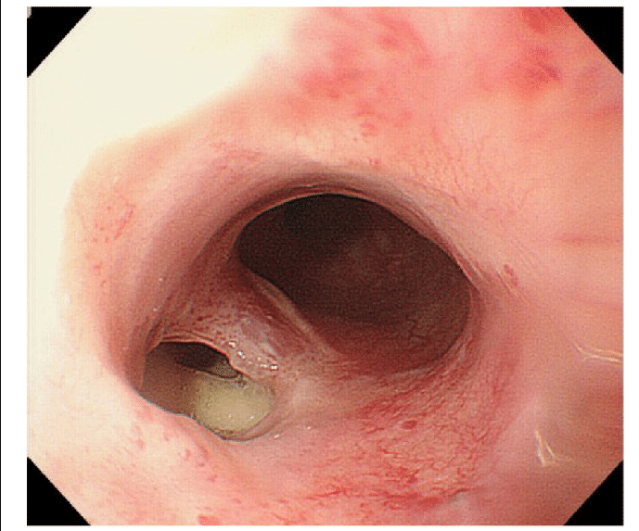
Esophageal Perforation
Anamnestic data and endoscopic examination results are considered to determine esophageal disease

Slide 13
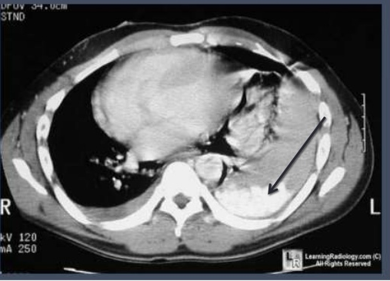
Complications
Esophageal Perforation
To diagnose complications of perforation and sepsis, the perforation time, clinical data and CT results are taken into account

Slide 14
Treatment methods
Esophageal Perforation
Esophageal perforation
Eliminate oral nutrition
Infusion
Antibiotics
Cardiovascular support
Has esophageal disease
No esophageal disease
The patient is not operabel
Less than 24 hours later,
no severe inflammation
More than 24 hours later,
there is severe inflammation
Stent
Percutaneous drainage
Resection
Primary suturing
and drainage
Isolation or resection

Slide 15
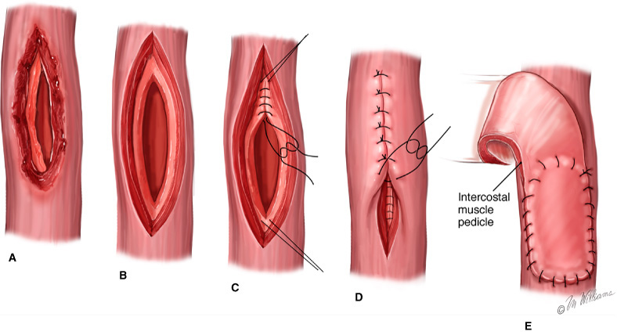
Treatment methods
Esophageal Perforation
Construction of perforation hole | It is performed in a healthy Esophagus and in the early period (within 24 hours). The mucous membrane and muscle layer are constructed with double-spaced sutures, additionally strengthen with pleura, peritoneal sheet, or diaphragm.
Drainage | The area around the perforation is drained. It is used for small perforations that cannot be detected.

Slide 16
Treatment Methods
Esophageal Perforation
Resection | The perforated part is resected in healthy areas, the proximal tip is removed from the neck, an esophagostomy is placed, the distal end is closed and an Jejunostomy is placed, and esophagioplasty is performed after the condition has stabilized. Resection is more appropriate in cases of advanced perforation that cannot be repaired, is more than 48 hours, and is due to esophagus disease. Esophagoplasty may be performed immediately after resection for early perforation due to esophagus disease.

Slide 17
Treatment
Esophageal Perforation
Isolation (diversion, defusion) | The proximal part of the perforation is removed along the neck and an esophagostomy is placed, the distal end is closed, the jejunostoma is placed and the perforation area is drained. T-drainage can be placed in the perforation area to prevent reflux of gastric contents. An esophagostomy may form in the left breast through the subcutaneous tunnel.
Stent | It is placed when the operation is impossible
Konservative | Perioperative is performed: -Stop oral feeding, parenteral nutrition only -Broad-spectrum antibiotics -Correction of water-electrolyte balance -Cardiorespiratory support therapy

Slide 18
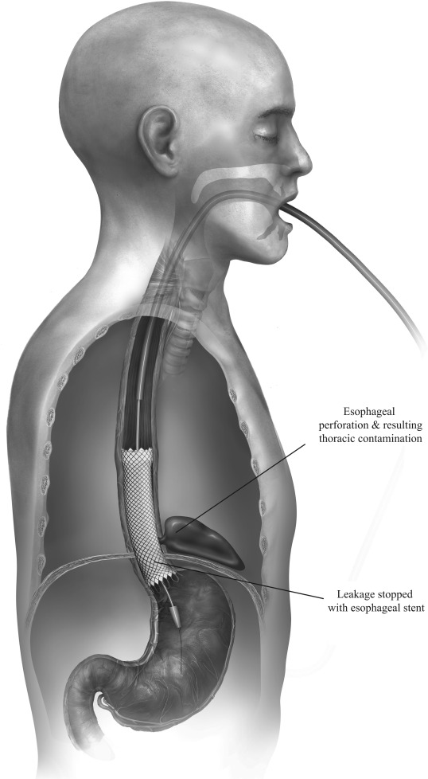
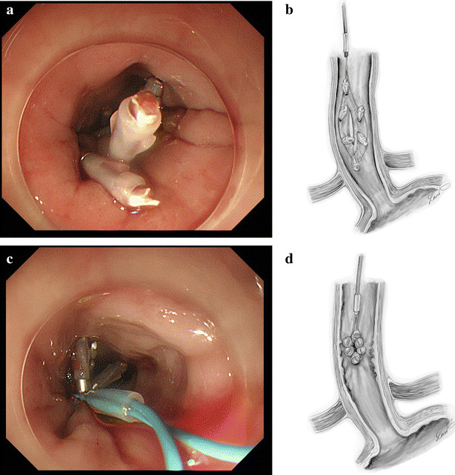
Treatment
Esophageal Perforation
Endoscopic stenting and clipping

Slide 19
Foreign bodies

