Slide 1
GERD
Gastroesophageal Reflux Disease (GERD),
Ph.D Mahir Mahmudov
AZERBAIJAN MEDICAL UNIVERSITY

Slide 2
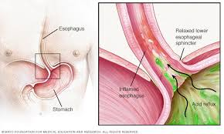
Definition
GERD
Reflux - is the event that the content returns to a previous anatomical region.
Returning content is called refluxate
Regurgitation - is the return of gastric contents to the esophagus and mouth.
Ph. D Mahir Mahmudov

Slide 3
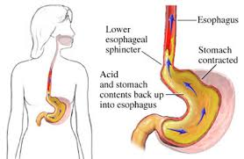
Definition - continued
GERD
Peflux esophagitis ‒ It is a chemical inflammatory process involving the distal part of the esophagus as a result of reflux of gastric or gastroduodenal contents and visible endoscopically
GERD‒ It is a chemical inflammatory process in the distal part as a result of reflux of gastric or gastroduodenal contents, presented with symptoms but may not be visible endoscopically..
Ph. D Mahir Mahmudov

Slide 4
Frequency
GERD
Accounts for 75% of esophageal diseases.
20-30% of the population has persistent or recurrent reflux disease.
Ph. D Mahir Mahmudov

Slide 5
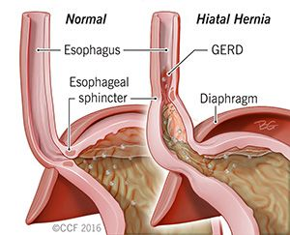
Aetiology-risk factors
GERD
Hiatal hernia
Obesity
Anticholinergic medications, caffeine, nicotine intake
Scleroderma, collagen, vascular diseases, etc.
Esophageal trauma
Pregnancy.
Ph. D Mahir Mahmudov

Slide 6
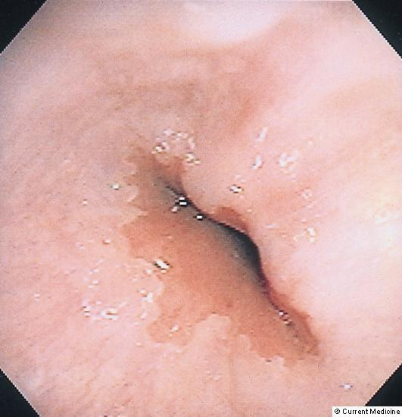
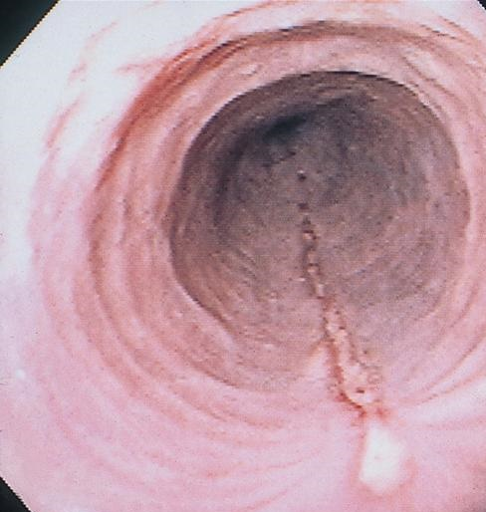
Classification
Təsnifatı
GERD
According to the course | Erosive Non erosive
According to the clinical presentation | Typical symptoms Atipical symptoms
Ph. D Mahir Mahmudov

Slide 7
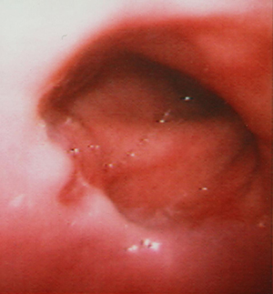
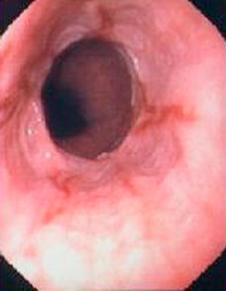
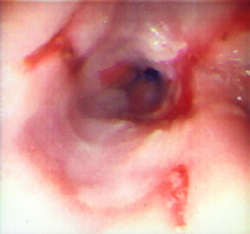
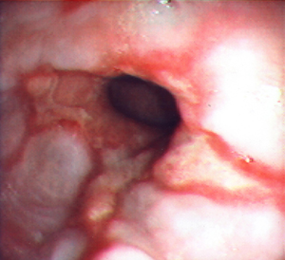
Classification-continuation (by severity)
GERD
According to the Los Angeles classification, there are 4 degrees of severity of erosive GERD:
Grade A (I degree) there is erythema and edema, one or more lines, <5 mm in size, unconnected erosions;
Grade B (II degree) there is > 5mm size linear erosions that circular covered <75% of esophageal wall
Grade C (III degree) diffuse and linear erosions that circular covered >75% of esophageal wall
Grade D (IV degree) chronic mucosal lesions, ulcers, strictures , Barrett's esophagus
Ph. D Mahir Mahmudov

Slide 8
Pathogenesis
GERD
Weakening of the gastroesophageal barrier:
  Weakening of the lower esophageal sphincter (the main pathological mechanism)
  Relaxation of diaphragmatic crurs-legs(enlargement of hiatus)
  Opening the angle of His
Weakening of physiological clearance of GB:
Weakening of peristalsis of GB
Increase of intragastric pressure
Ph. D Mahir Mahmudov

Slide 9
Clinical course
GERD
Non erosive
There are no endoscopic changes
It is found in 60% of cases
Erosive
Erosions are visible in the distal part of the during endoscopically
Eliminates with conservative treatment
Eliminates with conservative treatment
Recurrence occurs in 25% of cases
Occurs in 35% of cases
Recurrence occurs in 75% of cases
Ph. D Mahir Mahmudov

Slide 10
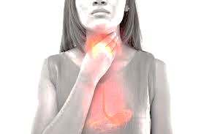
Clinical presentation
GERD
QERD is presented by typical and atypical symptoms
Typical symptoms - common in most patients
heartburn
Reguritation
Atypical symptoms occur when there are complications..
non-cardiac retrosternal pain in the thorax;
shortness of breath, asthma, chronic cough;
voice changes
hematemesis
odynophagia
dysphagia.
Ph. D Mahir Mahmudov

Slide 11
Complications
GERD
Barrett’s esophagus
Ulcer
Stricure of esophagus
Aspiration pneumonia
Pharyngitis
Asthma
Fe deficiency anemia
Ph. D Mahir Mahmudov

Slide 12
Diagnosis
GERD
Any of the below symptoms may indicate reflux:
Typical symptoms
Atypical symptoms
Hiatal hernia
Ph. D Mahir Mahmudov

Slide 13
Diagnosis
GERD
If the symptoms of reflux recur at least 2-3 times a day or week
If reflux symptoms persist for the last 2-3 months
Endoscopic examination should be performed
Ph. D Mahir Mahmudov

Slide 14
Diagnosis
GERD
X ray with contrast-esophagography
Endoscopy
24-hour pH-meter
Manometry
PPI test
Ph. D Mahir Mahmudov

Slide 15
Diagnostic criteria for erosive GERD
GERD
Symptoms of reflux recur at least 2-3 times a day or week and goes on for the last 2-3 months;
Detection of esophagitis on endoscopic examination(biopsy);
Denial of other diseases that cause erosions in the QB (next slide)
Ph. D Mahir Mahmudov

Slide 16
Diseases that cause erosive esophagitis
GERD
QERD İnfections Candidas Viruses (CMV, herpes, AIDS) Bacterias(Nocardia Sifilis, Micobacterium (TBS, type A) | Systemic diseases Skin (epidermolisis, pemphiqus) Behcet disease Rejection of transplant Inflamatory bowel diseases Sarcoidosis Metastatic cancer Collagen diseases Iatrogenic medication (tetraciclin, KCl, NSAD) chemotherapy Scleroterapy Long-term nasogastric tube Zollinger-Ellison syndrome
Ph. D Mahir Mahmudov

Slide 17
Principles of treatment
GERD
Eliminate the cause
Reduction of reflux or reflucat aggression.
Ph. D Mahir Mahmudov

Slide 18
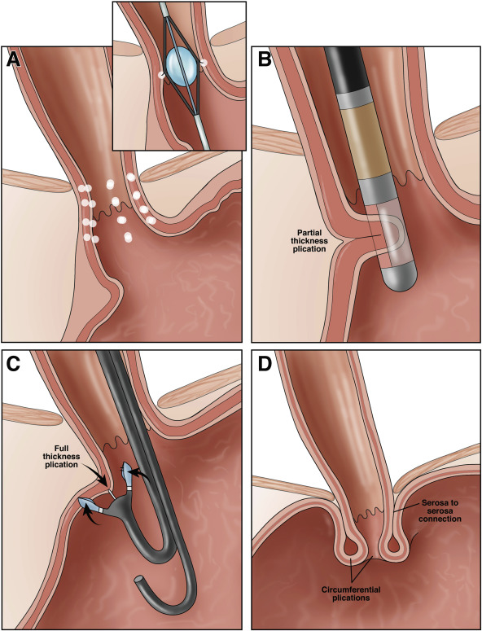
Principles of treatment
GERD
Therapeutic (healthy) lifestyle | Prevention of factors affecting the mechanism of reflux, diet, avoidance of harmful habits.
Medication | Medications that reduce gastric acidity. Medications that increase the tonus of LES.
Endoscopic | Endoscopic plication
Ph. D Mahir Mahmudov

Slide 19
Treatment tactics
GERD
Conservative treatment is prescribed (2 months);
In patients with a positive response, regular treatment - medication or surgery - is recommended;
In the absence of a positive response to conservative treatment, the reflux is extensively reassessed and a high-dose PPI is prescribed;
During complications, PPI and appropriate treatment - control, more surgical treatment is preferred..
Ph. D Mahir Mahmudov

Slide 20
Indication for surgery
GERD
Ineffectiveness of conservative treatment
young patients;
Hiatal hernia
Barrets esophagus;
Complications: stricture, bleeding, perforation
Ph. D Mahir Mahmudov

Slide 21
Typs of surgery
GERD
Fundoplication – Nissen (360°), Toupet (180-270°);
Resection of esophagus: in severe displasia
Ph. D Mahir Mahmudov

Slide 22
Typs of surgery
GERD
Nissen fundoplication Toupet fundoplication
Ph. D Mahir Mahmudov

Slide 23
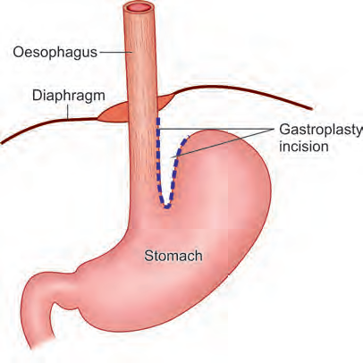
Collis gastroplasty
GERD
Ph. D Mahir Mahmudov

Slide 24
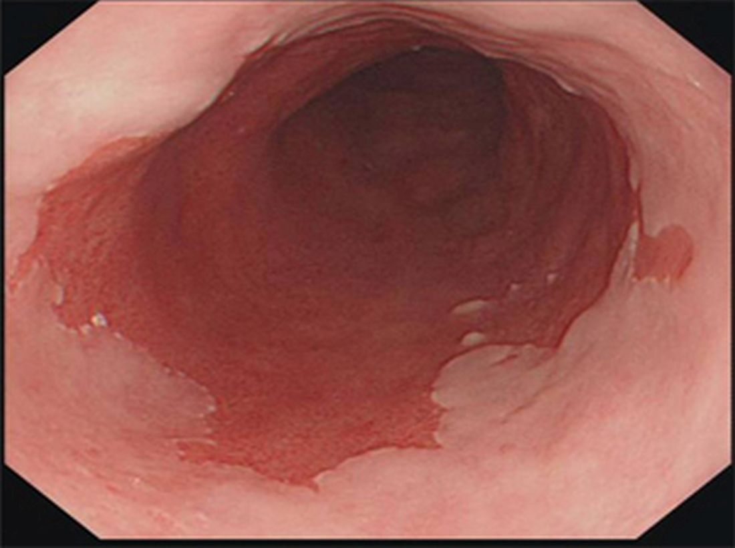
Barrett's oesophagus
Barrett's oesophagus
It is the metaplastic changes in the mucosa of the oesophagus as the result of GORD.
Ph. D Mahir Mahmudov

Slide 25
Types (Based on Length)
Barrett's oesophagus
1. long segment Barrett’s oesophagus—classic Barrett type.
2. short segment Barrett’s oesophagus.
Ph. D Mahir Mahmudov

Slide 26
Histological Types
Barrett's oesophagus
a. Gastric type:
b. Intestinal type:
c. Junctional type:
Ph. D Mahir Mahmudov

Slide 27
Clinical Features
Barrett's oesophagus
Features of GORD.
Haematemesis.of Barrett’s oesophagus
. Ulcerations and stricture
. Dysphagia
. Bleeding
. Perforation
Common in men; common in whites.mplications
Ph. D Mahir Mahmudov

Slide 28
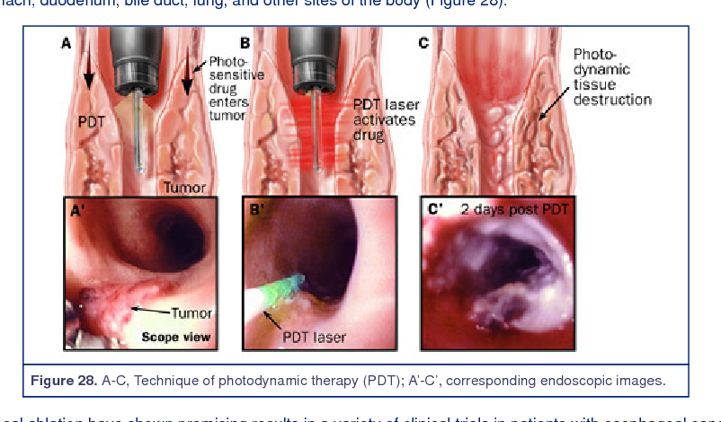
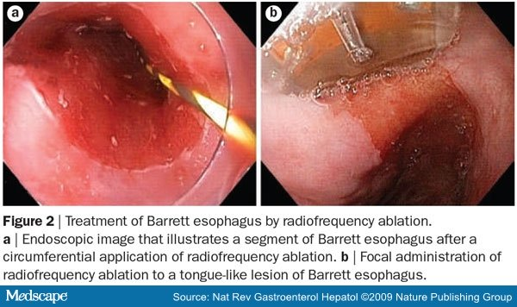
Management
Barrett's oesophagus
Regular endoscopic biopsy and surveillance for low-grade dysplasia.
Ablation of Barrett’s oesophagus by laser.
Photodynamic therapy—through endoscopy.
Argon beam coagulation.
Proton pump inhibitors—high dose for 3–6 months.
Antireflux treatment by surgery.
Resection—Always better choice—for high-grade dysplasia.
Endoscopic mucosal resection.
Ph. D Mahir Mahmudov

Slide 29
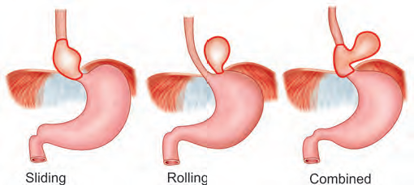
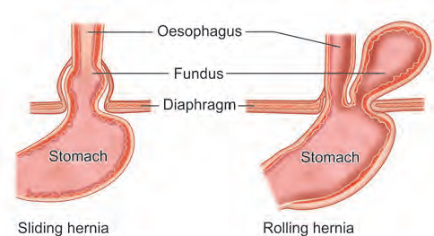
Hiatus hernia
Hiatus hernia
Ph. D Mahir Mahmudov

Slide 30
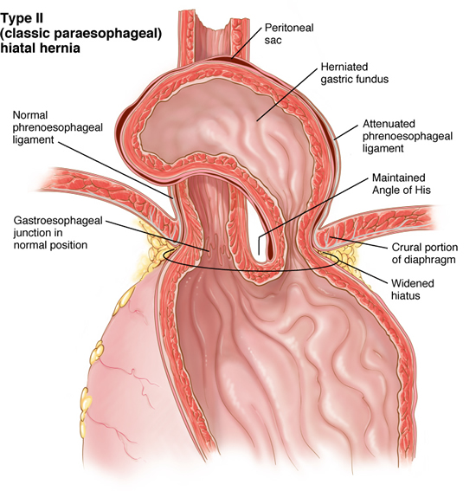
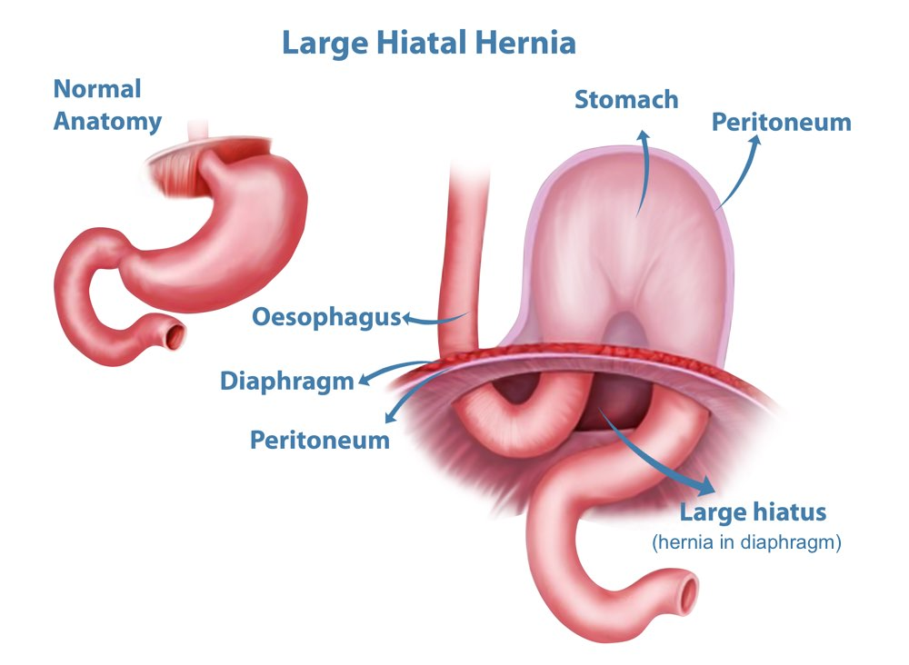
Paraesophageal hernia
Hiatus hernia
Ph. D Mahir Mahmudov

Slide 31
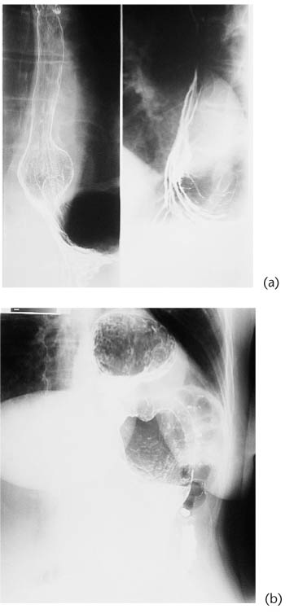
X ray
Hiatus hernia
Ph. D Mahir Mahmudov

Slide 32
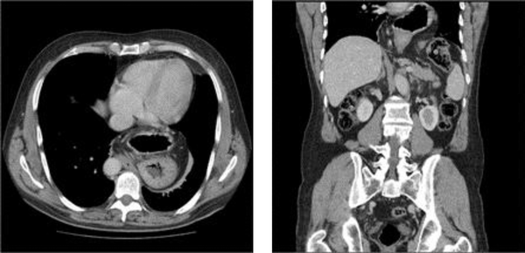
CT
Hiatus hernia
Ph. D Mahir Mahmudov

Slide 33
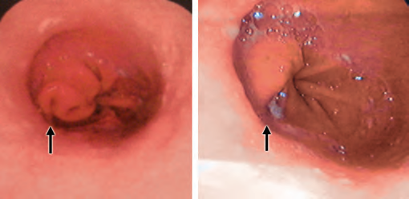
Endoscopic view
Hiatus hernia
Ph. D Mahir Mahmudov

Slide 34
THANK YOU FOR ATTENTION

