Slide 1
Ulcers, complications and stress ulcers
Ulcer disease and complications
Ph.D
Mahir Gümrah oğlu Mahmudov
Sevinj Salahova Shahin
AMU, Departament of I Surgical Diseases

Slide 2
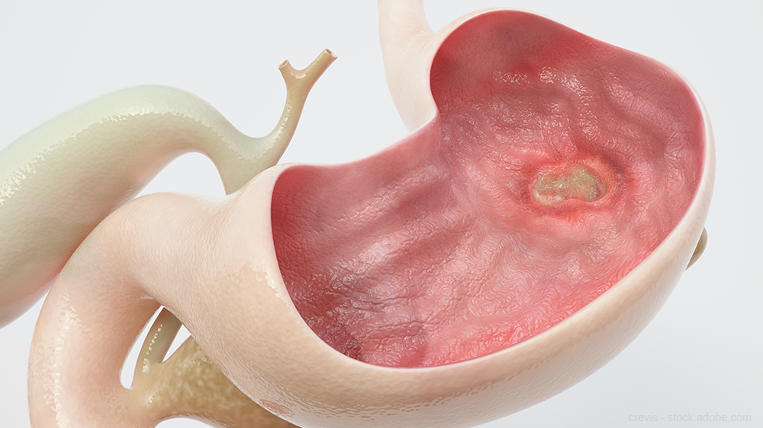
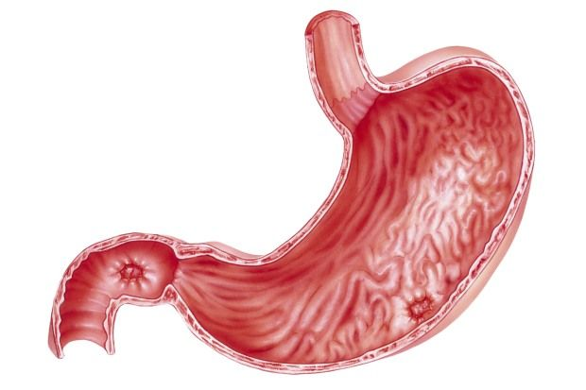
Defination
Ulcer disease and complications
Ulcer is a non-traumatic defect that occurs in the epithelium and deep layers as a result of trophic disorders.
Erosion is a defect in the epithelial layer.
A peptic ulcer is an ulcer formed under the influence of gastric acid.
Primary ulcer or ulcer disease – characterized by forming ulcers on the gastric or duodenal wall.
Secondary or symptomatic ulcers are stomach and duodenal ulcers that occur as a symptom or complication of other diseases.

Slide 3
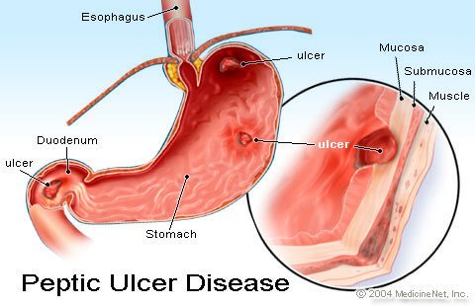
Classification
Ulcer disease and complications
By Location
Gastric ulcer
Duodenal ulcer
Another location
By Cause
primary
secondary
By disease progresses
Heals without complications
Recurrence
Refracter
With complications (bleeding, per-foration, gastric outlet obstruction)

Slide 4
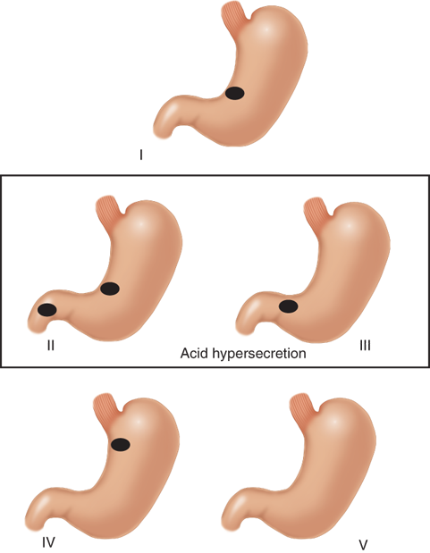
Modified Johnson classification
Ulcer disease and complications
Type I: Ulcer along the body of the stomach, most often along the lesser curve at incisura angularis Not associated with acid hypersecretion.
Type II: Combined gastric and duodenal ulcer. Associated with acid oversecretion.
Type III: Isolated duodenal or pyloric ulcer. Associated with acid oversecretion.
Type IV: Proximal gastroesophageal ulcer.
Type V: Diffuse ulcer. Associated with the chronic use of NSAIDs (such as ibuprofen).

Slide 5
Etiology and pathogenesis
Ulcer disease and complications
Etiological factors
Increased aggression
Increased acidity
Bile acids
Toxic factors
other
Weakening of defense
Reduction or change in mucus
Reduction of regeneration
Reduction of bleeding
Reduction of antioxidants
other
Peptic hypothesis
Acid hypothesis
Helicobacter pilory hypothesis
Damage of the mucous membrane
Gastritis
Metaplasia
Ulcer

Slide 6
Course of the disease
Ulcer disease and complications
Ulcer
70%
10%
20%
Recovery
Refractory course
(incurable ulcer)
Complication
  Bleeding
  Perforation
  Penetration
  Stenosis
The reason disappears
The reason does not disappear
Recurrence less 10%
Recurrence 80%

Slide 7

Clinical Presentation
Ulcer disease and complications
1. History of GERD.
2. Retrosternal or epigastric burning pain.
3. Nausea, vomiting.
4. Water brash.
5. Loss of appetite and weight (alarming symptom).
6. Hematemesis and melena (alarming symptom).
7. Gastric or Duodenal perforation leading to acute peritonitis.

Slide 8

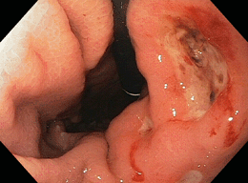
Diagnosis
Ulcer disease and complications
suspicion
presentation of clinic symptoms
confirmation
endoscopy

Slide 9


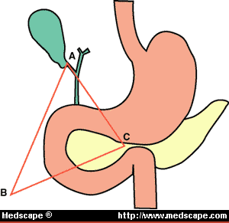
Diagnosis
Ulcer disease and complications
Find the reason:
NSAID
H. pilory (ureas test in breath , antybody in blood, Histological of gastric mucosal biopsy, emergency urease test in gastric mucosal biopsy - CLO test)
Gastrin level (Zollinger-Ellison syndrome)
Endoscopic biopsy of ulcers

Slide 10
Treatment
Ulcer disease and complications
Ulcer Disease
Uncomplicated
Complicated
  Bleeding
  Perforation
  Stenosis
H.pilory pozitive
H.pilory neqative
PPI +
Anti-H.pilory treatment
PPI or H2B +
Find and eliminate other causes
Surgical treatment
TV + piloroplasty
Selective vagotomy
TV + antrumectomy
Resection
+
Eliminate the cause
If there is repetition
or incurable ulcer
The cause is not found or eliminated
The ulcer heals
The ulcer heals, but soon recurs
The ulcer does not heal
Observation
Regular PPI treatment
Ass. Mahir Mahmudov, Sevinj Salahova

Slide 11
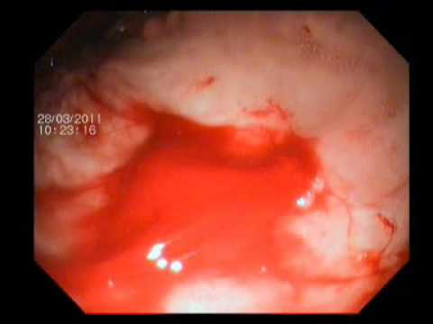
Bleeding
Ulcer disease and complications
Definition:
It is bleeding that occurs as a result of vascular erosion in the wall of the stomach or duodenum ulcers, can cause occult blood positivity, anemia, and even severe hemorrhagic shock

Slide 12
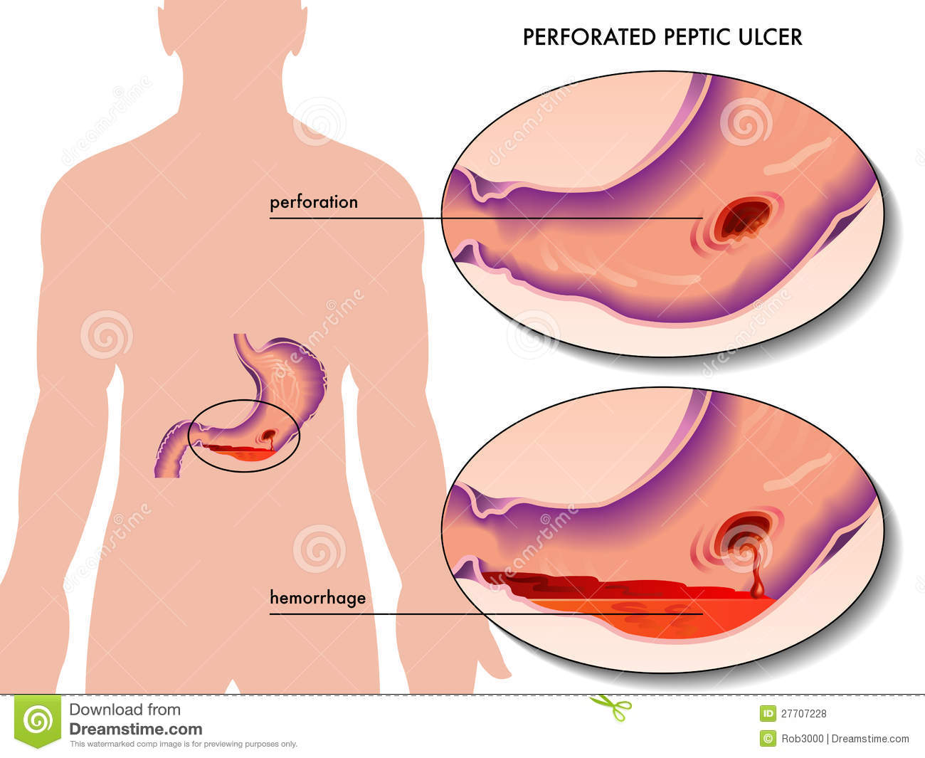
Risk factors
Ulcer disease and complications
Risk faktorları:
Callous ulcer (A chronic, slowly healing ulcer with indurated, elevated edges but no granulation)
Deep ulcer
Ulcer on the posterior wall of duodenum
Stomach ulcer
Ulcer caused by aspirin
Gastric ulcer
bleeding

Slide 13
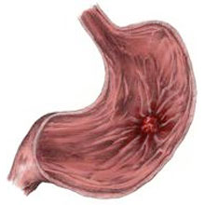
Classification
Ulcer disease and complications
localisation
Stomach ulcer
Duodenal ulcer
clinical presentation
Chronic (occult)
Acute
(overt)
severity
mild (no anemia and shock)
moderate (with anemia)
massive (with shock)

Slide 14
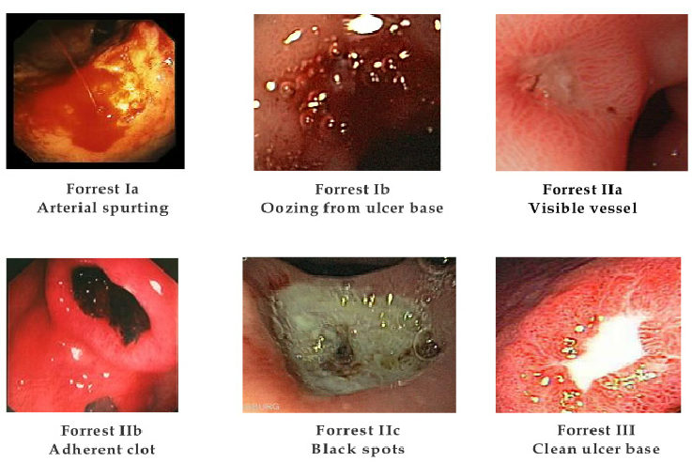
Classification
Ulcer disease and complications
Forrest, JA.; Finlayson, ND.; Shearman, DJ. (Aug 1974). "Endoscopy in gastrointestinal bleeding.". Lancet 2 (7877): 394–7.

Slide 15
Сlinical course and complication
Ulcer disease and complications
anemia
death
shock

Slide 16
Symptoms
Ulcer disease and complications
Local symptoms– painful or painless bleeding, melena, bloody defecation, positive blood test in stool
Symptoms of bleeding– anemia, shock

Slide 17
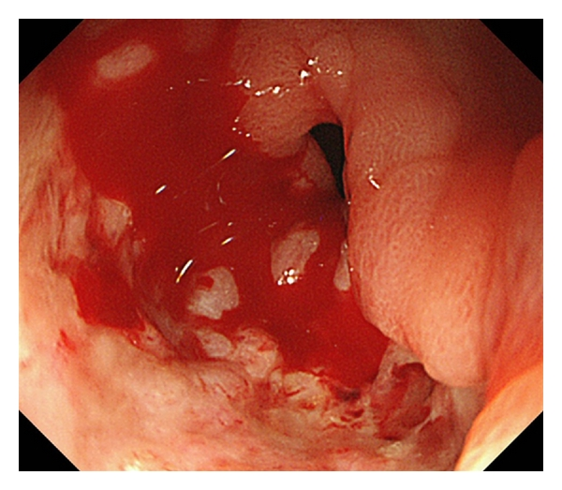
Diagnosis
Ulcer disease and complications
Confirmation
Endoscopy ( during fist 6-12 hour)
History
Melena
Hematemesis
Hematochezia
Obscure blood test in feces
Anemia, shock
Suspicion

Slide 18
Treatment
Ulcer disease and complications
Ulcer bleeding
Preliminary measures
Support (infusion and other)
Medical hemostasis
Emergency endoscopy
Ongoing bleeding
Stopped, but high risk of recurrent bleeding
Stopped bleeding
Endoscopic hemostasis
There is repetition
No repetition
The bleeding does not stop or recurs after it has stopped
The bleeding has stopped and does not recur
Ulcer treatment
Surgical hemostasis
Prof.Dr. NYBay

Slide 19
Indications for surgery
Ulcer disease and complications
10% of patients are needed
  Callous ulcer
  Suspicion of malignancy
  Pyloric deformity
  Continuous bleeding
  Recurrent bleeding
  Profuse bleeding

Slide 20
Ulcer disease and complications
Choice of surgical method
Duodenal ulcer
Stomach ulcer
Ligation of the gastroduodenal artery, duodenotomy and suturing of the vessel inside the ulcer with 3 sutures, pyloroplasty and trunkal vagotomy.
If the patient is hemodynamically stable in callous, stenotic ulcer bleeding, resection or antrumectomy + vagotomy may be performed.
If the patient is hemodynamically stable, resection is performed: antrumectomy + vagotomy, 2/3 or subtotal resection of the stomach.
If the patient is hemodynamically unstable, excision or suturing of the ulcer is performed.

Slide 21
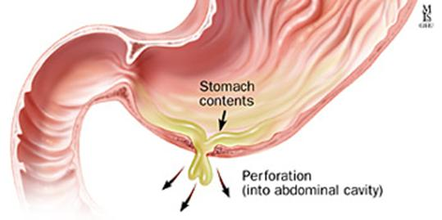
Perforation of ulcer
Ulcer disease and complications
Cause: destroying peptic ulcer wall by gastric acid
Frequency: about 5-10 %
Gastric or duodenal content leak into abdominal cavity.
Acut inflamatory complication
Few hours later occur diffuse peritonitis or absces

Slide 22
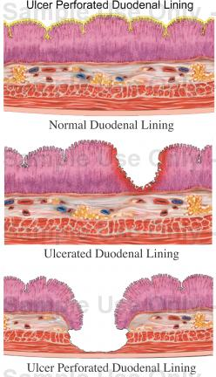
Risk factors
Ulcer disease and complications
Localisation of ulcer on the anterior wall of duodenum
Callous chronic ulcers
Not treated ulcer
Use of ulcerogenic drugs

Slide 23
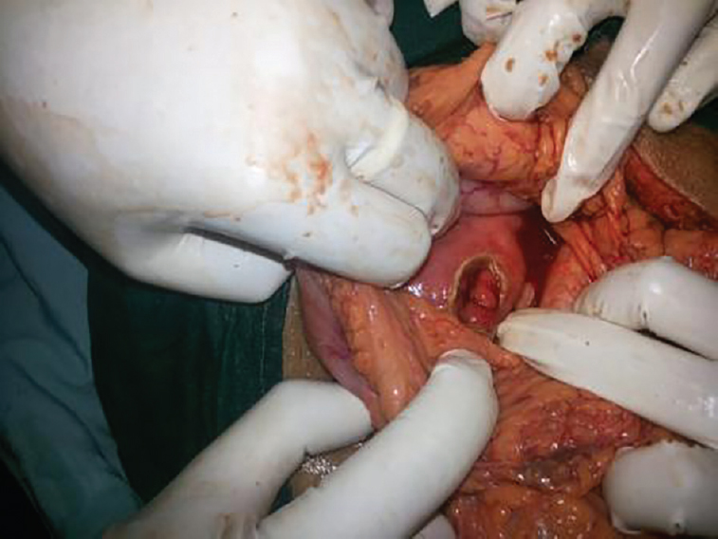
Classification
Ulcer disease and complications
By Course
Perforation to peritoneum–peritonitis
Clinical stages
Stage of shock (chemical peri-tonitis or severe pain-shock)
Limited perforation (abscess)
Perforation to organs (penetration) - fistulas
Covered perforation
Poor pain phase
Purulent peritonitis stage

Slide 24

Clinical presentation
Ulcer disease and complications
"Wooden belly" symptom complex:
Severe pain that started a few minutes ago
Still and pulled abdomen
Palpation is painful and tense
Bowel sounds are weak or inaudible
Liver percutor sound can be lost
signs of shock

Slide 25
Complications
Ulcer disease and complications
Peritonitis
Abscess
Fistulas
Pancreatitis
Trombosis of Portal vein, pylephlebitis
Mortality - 15%

Slide 26
Diagnosis
Ulcer disease and complications
Suspicion
Confirmation
Severe abdominal pain
Symptomatic complex "wooden belly"
Symptoms of diffuse and local peritonitis
Intra-abdominal abscess (subhepatic, diaphragmatic, small fat pocket, etc.)
Epigastric persistent pain
Fistulas
Pancreatitis
CT with contrast– is the first choice (localization, clinic form)
X ray– 80% can detected air under diaphragm
USG – not specific (can detected fluid in the abdominal cavity)
Endoscopy– is not initial examination, can be use when need differential diagnosis (be carefully).

Slide 27
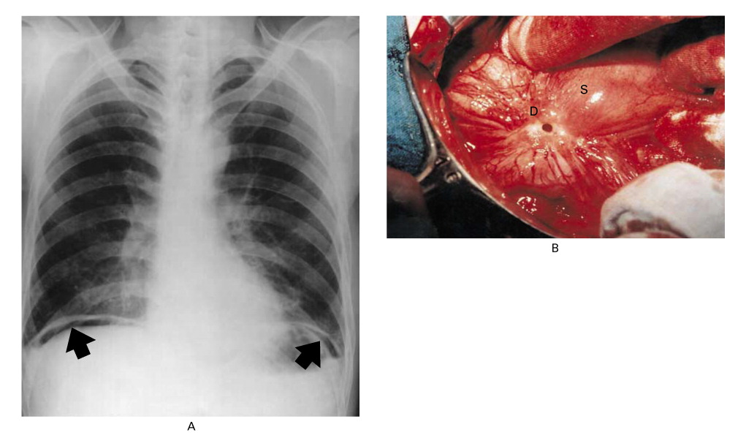
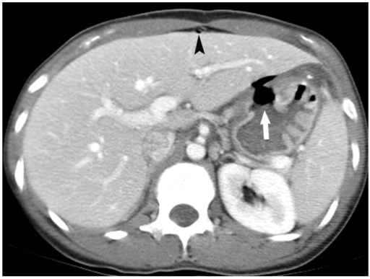
Diagnosis
Ulcer disease and complications
Free gas in the abdominal cavity
Extravasation of contrast from stomach

Slide 28
Treatment
Ulcer disease and complications
Ulcer perforation
According to clinical and CT results
Free perforation
Absces
Penetration
Covered perforation
Conservative treatment and planned resection
Control
Emergency surgery
Percutaneous drainage
Doudenal ulcer perforation
  Omental coverage + peritoneal sanation
  Ulcer excision + pyloroplasty + vagotomy
Gastric ulcer perforation
  Margine resection + peritoneal sanation
  Biopsy + omental coverage + peritoneal sanation
  Gastric resection
Prof.Dr. NYBay

Slide 29
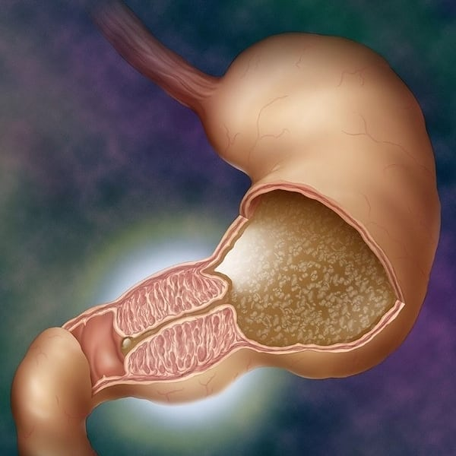
Pylorostenosis
Ulcer disease and complications
The resulting peptic ulcer disease (5%) – Fibrotic and inflammatory contraction, often of increasing nature, leading to obstruction and complications (vomiting, malnutrition, electrolyte disturbances, etc.).

Slide 30
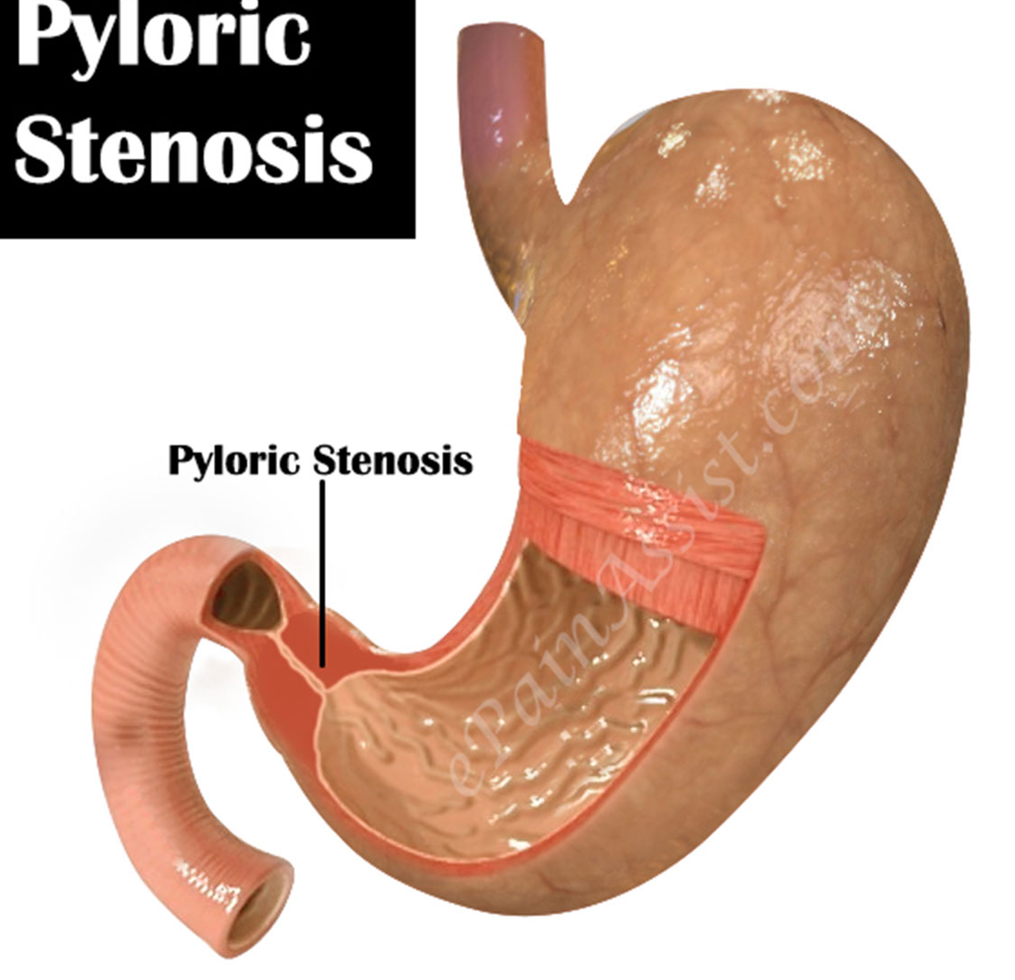
Mechanism
Ulcer disease and complications
fibrotic narrowing and deformation
Inflammation around the scar or ulcer
Gastric atony
Pylorostenosis

Slide 31
Classification
Ulcer disease and complications
By mechanism
fibrotic narrowing
By degree
compensasion
By course
progressive
inflammatory infiltration in the background of fibrosis
subcompensasion
decompensasion
recurrence
stable

Slide 32


Course and complications
Ulcer disease and complications
complications
progressive
recurrence
stable
fluid-electrolytes disorder
malnutrition

Slide 33
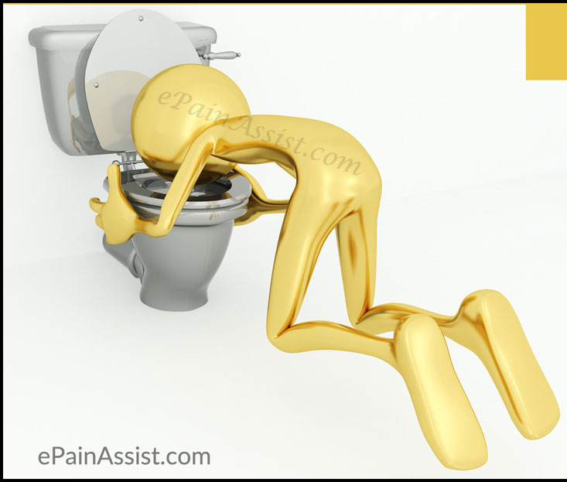
Clinical presentation
Ulcer disease and complications
Signs of gastric obstruction:
vomiting
weight loss
epigastric pain
meteorism
rapid ate fullness

Slide 34
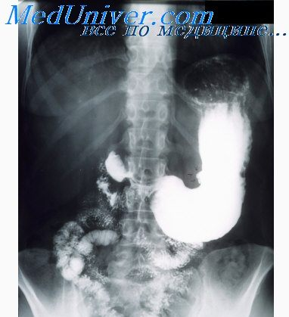
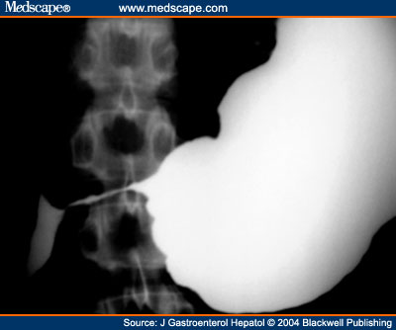
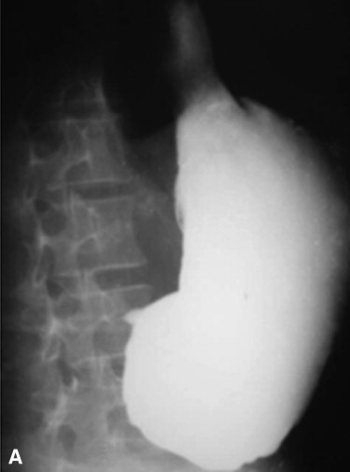
Diagnosis
Ulcer disease and complications
suspicion
confirmation
clinical symptoms
anamnesis (ulcer disease, calleous ulcer, perforation)
Contrast CT
Xray
Endoscopy
Biopsy

Slide 35
Treatment
Ulcer disease and complications
Stenosis
Water-electrolyte correction
Nutrition
Decompression
Conservative and endoscopic dilatation
Effective (85%)
Noneffective (15%)
Surgery
  Resection
  Vaotomy + drainage operations
  For laparoscopy - vagotomy + gastroenteroanastomosis)
Repetition (45%)
Prof.Dr. NYBay

Slide 36
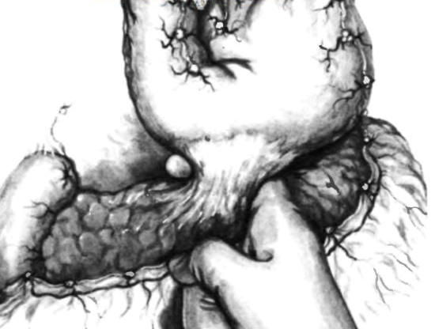
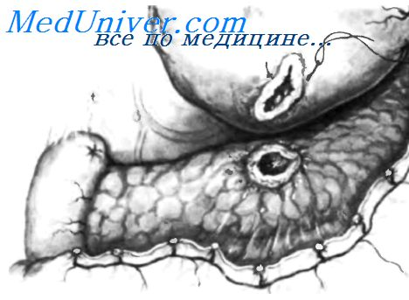
Penetration
Ulcer disease and complications
The penetration of a destructive ulcer into neighboring organs by damaging the wall of the stomach or duodenum is called ulcer penetration
Penetrated organs: lesser omentum, pancreas, liver, greater omentum, rarely diaphragm, pericardium and anterior abdominal wall

Slide 37

Clinical presentation
Ulcer disease and complications
The pain is permanent
Taking antacids does not reduce pain
Belt pain and pain in the lower back during penetration into the pancreas
After penetrating to head of pancreas and lig. hepatoduodenale - obstructive juandice

Slide 38
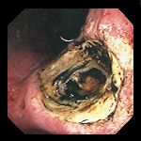
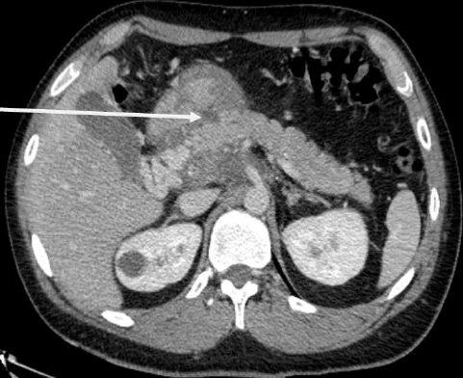
Diagnosis
Ulcer disease and complications
CT with contrast
Endoscopy

Slide 39
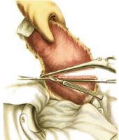
Treatment
Ulcer disease and complications
Conservative treatment is ineffective
Surgical treatment:
Stomach ulcer– resection of 2/3 part of stomach
Duodenal ulcer- truncal vagotomy + pyloroantrumectomy

Slide 40
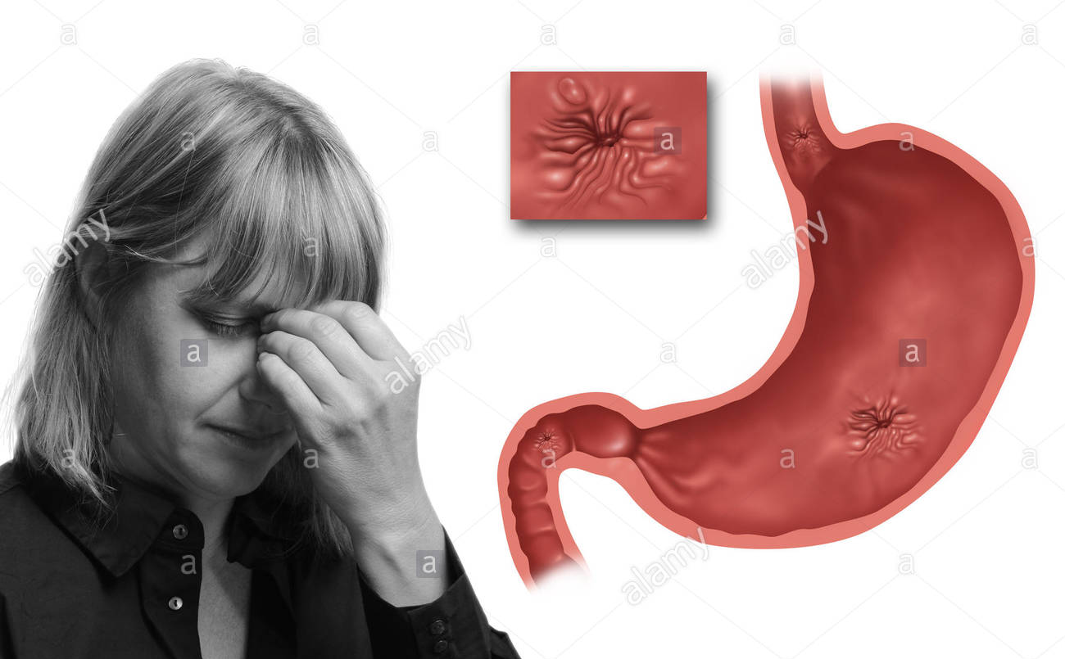
Stress ulcers
Stress ulcers
Acute ulcers forming in the stomach and duodenum as a result of stressful situations in the body named as acute stress ulcers. This ulcers usually presented with bleeding, but some times cause of perforation or pain.

Slide 41
Causes
Stress ulcers
After big operations (abdominal, cardiovascul-ar and ..)
Shock and severe trauma
sepsis
burns
Brain injuries and tumors

Slide 42
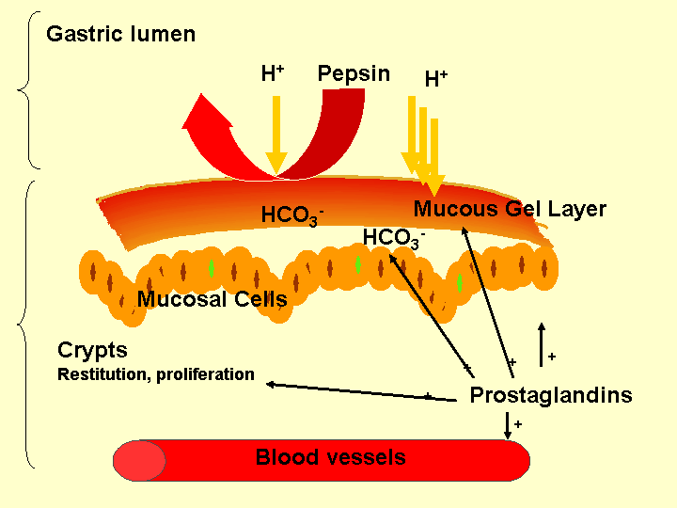
Patogenesis
Stress ulcers

Slide 43
Course
Stress ulcers
Mucosal ulcer
72 hour after stress
Bleeding
20%
Perforation
10%

Slide 44
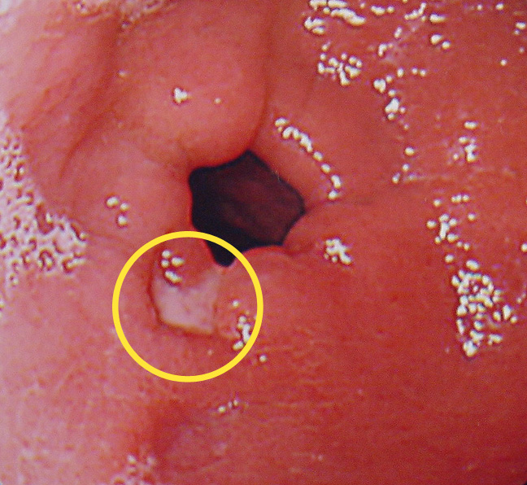
Clinical presentation and diagnosis
Stress ulcers
Asymptomatic (subclinic form – usually revealed during endos-copy),
when complicated with bleeding or perforation can be clinically detected.

Slide 45
Prophylaxis
Stress ulcers
In stress situations (big surgery (operations), trauma, shock, sepsis, burn, brain injuries and tumors ) recommended to use this actions:
Early elimination of shock
H2 blokers or PPI or sucralfat
Early oral feeding in the absence of shock

Slide 46
Treatment
Stress ulcers
Subclinik stress ulcers – profilactic treatment
Stress ulcer complicated with bleeding: antisecretory drugs, vasopressors, endoscopic haemostasis.
If medical and endoscopic treatments are not enough –indication for surgery :
  Stitch of ulcer, vagotomy, pyloroplasty
  Total gastrectomy
  Ligation of gastric vessels
If stress ulcer complicated with perforation– stitch of hole, omentopexy or total gastrectomy (numerous stress ulcers complicated with perforation).

