Slide 1
Diseases of the spleen
Diseases of the spleen
assistant professor
Tarverdi Mirzali oglu RZAYEV,
ATU, Department of Surgical Diseases I

Slide 2
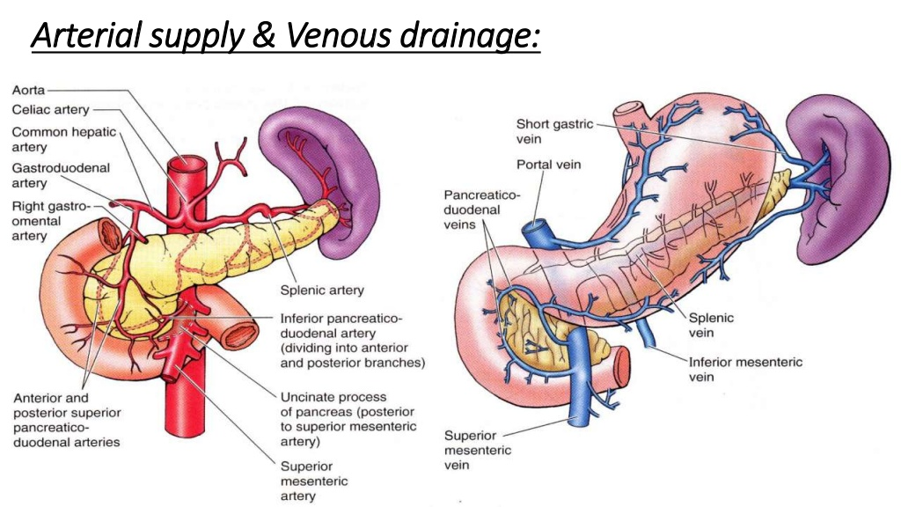
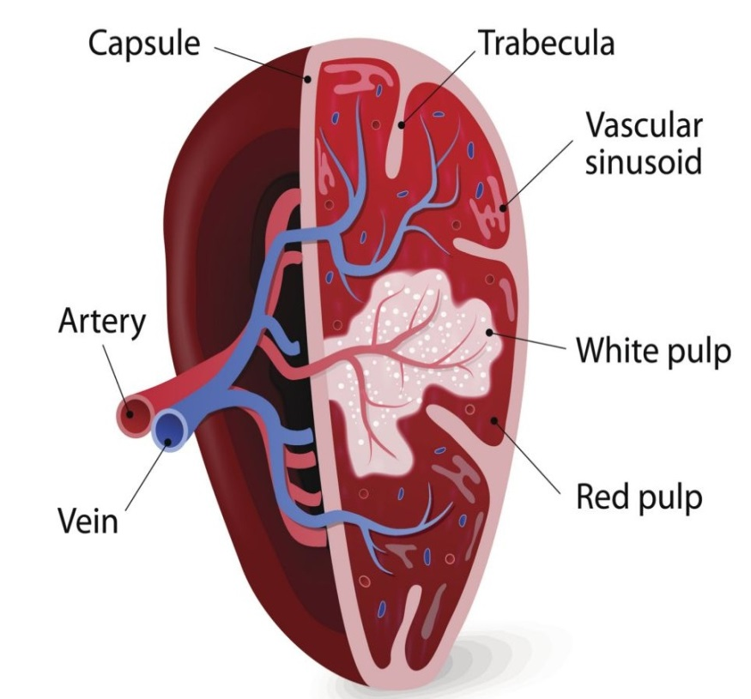
Anatomy
Diseases of the spleen
Notes:
Dalaqdan 1 dəqiqədə təxminən 300 ml qan keçir
Dalağın arterial təchizatı dalaq arteriyasından və kiçik mədə arteriyasından alınır.
Dalaq arteriyası günəş kötüyünün şaxəsidir
Venoz qan axını dalaq venası ilə həyata keçirilir.
Dalaq venası yuxarı çöz venası ilə birləşərək qapı venasını əmələ gətirir.

Slide 3
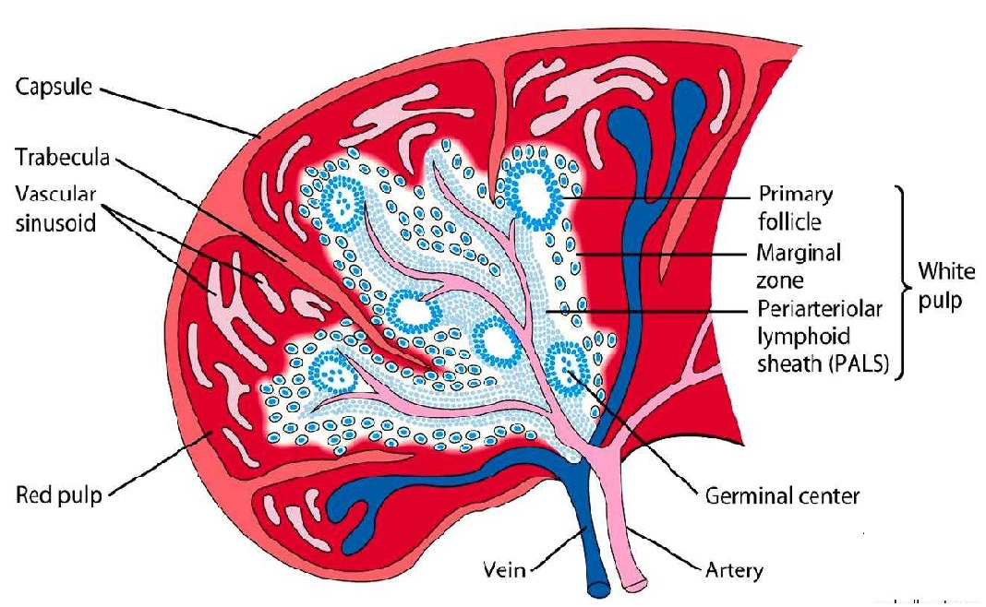
Physiology
Diseases of the spleen
Cleaning-filter function
Immune function
Synthesis of opsonins
Synthesis of antibodies
Phytocytosis
Storage function

Slide 4
DIAGNOSTIC APPROACH TO SPLEEN DISEASES
Diseases of the spleen
suspected spleen disease
Emergency illness
Spleen trauma
Spontaneous explosion
Spleen abs
other
First stage examinations
Clinical, hemogram, US
Diffuse
splenomegaly
Spleen
Lesions
The spleen is out of place
The spleen is normal, there is cytopenia
The spleen is normal, there is no cytopenia
CT or MRI
Hematological examination
the diagnosis is confirmed
the diagnosis is not confirmed
Next examinations

Slide 5
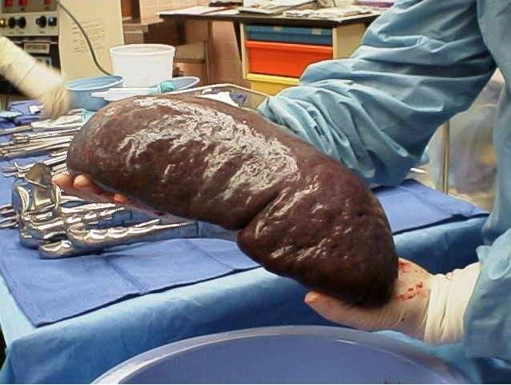
SPLENOMEGALY
Diseases of the spleen
Definition
Splenomegaly - spleen volume growth
Hypersplenism is an increase in spleen size and function
Splenomegaly
Cytopenia (mono-, di-, trisitopenia)
Bone marrow reactive hyperplasia

Slide 6
The etiology
Diseases of the spleen
Splenomegaly 95%
is secondary
• Hematology (40%)
•Infectious diseases
(15%)
•Liver diseases
(35%)
• Other reasons
(10%)

Slide 7
Classification of SPLENOMEGALY
Diseases of the spleen
Etio-pathogenetic
Functional
By size
• Stagnation (portal hypertension)
• Hypertrophy, hyperplasia (hematological)
• Reactive (infections)
• Neoplastic (hematological and metastatic neoplasia)
• Accumulation (metabolic)
• Hypersplenism (with cytopenia)
• Normosplenism (no cytopenia)
• Hyposplenism (with thrombocytosis, erythrocytosis, leukemia, etc.)
• Normal spleen - 7-12 cm
• Medium - 14-20 cm
• Large - 21-30 cm
• Giant spleen - more than 30 cm

Slide 8
ETIO-PATHOGENESIS
Diseases of the spleen
Cirrhosis
PVT
DVT
Baddi Kiari
Hemolytic
anemia
Inflammation
Infection
Sepsis
Myeloproliferative
Lymphoproliferative
Metastasis
Metabolic
diseases
Primary tumor
Metastasis
Cysts
Absces
Hematoma
Portal hypertension
Stagnation
Hypertrophy
Hyperplasia
Hyperreactive
Neoplastic
Effusion
Diffuse growth
Local growth
SPLENOMEGALY
Cytopenia
Portal hypertension
Intracranial compression

Slide 9
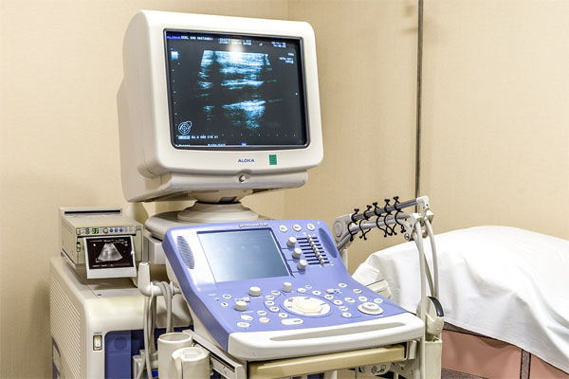
DIAGNOSTIC APPROACH TO SPLENOMEGALY
Diseases of the spleen
Hematological examination
Hemogram, PY
Electrophoresis of Hb
Enzyme deficit
Autoimmin Tests
Biopsy
other
In preliminary examination
no reason can be found
DİFFUSION
SPLENOMEGALY
No hematological disease was found
Hepato-portal examination
USM, CT / MRT
QcFT
Endoscopy
Liver biopsy
Laparoscopy
Diagnostic Splenectomy
Hepato-portal desiases has not been diagnosed
Infections
AIDS
Tuberculosis
Brusella
Malaria
Leishmania
other
Səbəb tapılmır
İltihabi və digər xəstəlikləri axtar
Tapılmadı

Slide 10
Diseases of the spleen
thrombocytopenia and bleeding
anaemia
portal hypertension and varicose bleeding
COMPLICATIONS OF SPLENOMEGALY
leukopenia and infections
compression of intra-abdominal organs
Liver damage (Banti syndrome) and heart failure in giant splenomegaly

Slide 11
Diseases of the spleen
Closure of the spleen artery
splenectomy
These palliative measures are being implemented to treat complications of Splenomegaly
Use of growth factor
(thrombopoietin, granulocyte - monocyte stimulation, etc.)
Partial splenic embolization

Slide 12
DIAGNOSTIC APPROACH TO THE SPLEEN SYSTS
Diseases of the spleen
SPLEEN SYST IN ULTRASOUND
Contrast CT or MRT
Abscess
Exinococcus cyst
Other
Dermoid syst
Metastatic
The nature of the cystic by clinical and imaging is not defined
Large (less than 5 cm) or symptomatic
Small (less than 5 cm) or asymptomatic
SPLENECTOMY
FOLLOWING

Slide 13
SPLENIC ABSCESS
Diseases of the spleen
Clinic
Etiology
Pain in the left ribs
Hematogenous spread from distant focus of infection
Stomach ache
Direct transmission from the surrounding infectious area
Temperature
Palpable spleen
Cysts, infections of splenic infarction or hematoma infected
uscle tension associated with peritonitis

Slide 14
SPLENIC ABSCESS
Diseases of the spleen
Diagnostics
• Laboratory - increased CRP and leukocytosis
• Hypodensity area, fluid and gas levels on CT
Complication
• Spontaneous opening of abscess and peritonitis
• Sepsis and complications
Treatment
Splenectomy
Drainage - Percutaneous or laparoscopic
Partial resection of the spleen (open or laparoscopic)

Slide 15
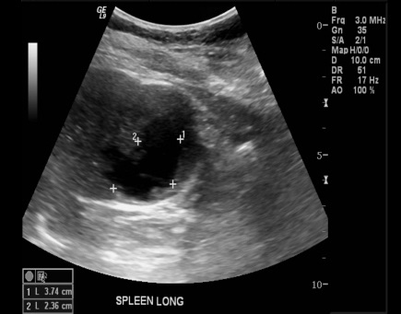
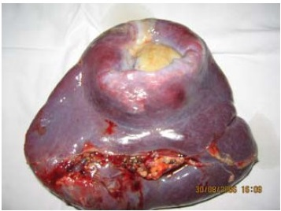
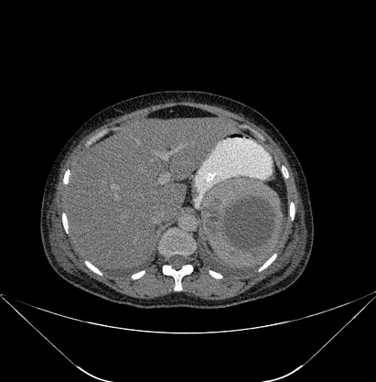
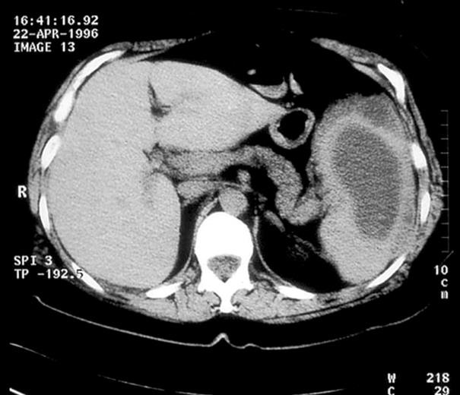
Diseases of the spleen

Slide 16
Diseases of the spleen
Elimination of complications of splenomegaly
Correction of cytopenia, treatment of varicose bleeding, elimination mechanical factors
For diagnostic purposes
Unknown cause of splenomegaly, lymphomas, unknown masses in the spleen
Indications for splenectomy
Surgical diseases of the spleen
Thrombotic thrombocytopenic purpura, thalassemia, sickle cell
Stop bleeding in trauma
Extend life of sick blood cells
Spherocytosis, autoimmune hemolytic anemia, Idiopathic thrombocytopenic purpura
Remove the source of the disease and the masses in the spleen
Leishmania, Tumors, Cysts, Abses, Hematoma, Malaria

Slide 17
Diseases of the spleen
COMPLICATIONS OF SPLENECTOMY
Left-sided pleural fluid and pulmonary atelectasis
Hyposplenizm
Splenosis
Injury to the neighboring organ
Thrombocytosis
Spleen vein thrombosis
Bleeding
Subdiafraqmatik abscess

Slide 18
SPLEEN INJURIES
Diseases of the spleen
Spleen injuries Severity (American Society of Trauma Surgery at AIS-90 classification)
Degree | Morphology | Explanation | Mortality
I | Hematoma | subcapsular, less than 10% of the surface area | 1-2%
 | Injury | capsule wound, no bleeding, less than 1 cm deep | 1-2%
II | Hematoma | ubcapsular, in the area of 10-50% of the surface | 1-2%
 | Injury | capsule injury, depth of parenchyma 1-3 cm, trabecular veins not damaged | 1-2%

Slide 19
SPLEEN INJURIES
Diseases of the spleen
Dalaq travmalarının ağırlıq dərəcələri (Amerika Travma Cərrahiyyəsi Cəmiyyətininin və AİS-90 təsnifatı)
Degree | Morphology | Explanation | Mortality
III | Hematoma | subcapsular, covering more than 50% of the surface, or expanding or extending more than 5 cm with subcapsular or intraparenchymal opening | 8-10%
 | Injury | Damage to the trabecular veins with a depth of more than 3 cm | 8-10%
IV | Injury | segmental or vascular injury that causes devascularization of more than 25% of spleen | 5-50%
V | Injury | hilus injury that completely devascularizes the spleen | 5-50%

Slide 20
Diagnosis of spleen trauma
Diseases of the spleen
Left-sided rib fractures
Intraabdominal bleeding
Symptoms of shock
spleen injury suspicion
The diagnosis of open injuries usually determined during operation.
Diagnosis of severe injuries is determined by CT scan or in operation

Slide 21
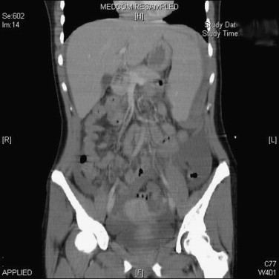
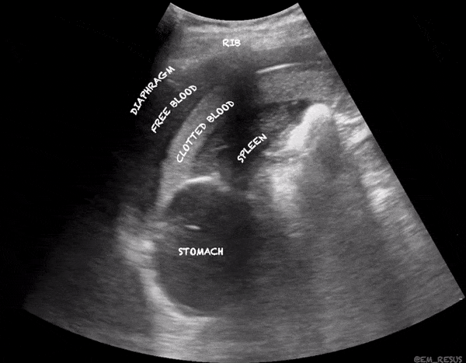
SPLEEN TRAUMAS
Diseases of the spleen

Slide 22
Diseases of the spleen
The main principle in spleen injuries is chemostasis
waiting for spontaneous hemostasis
Surgical methods– splenectomy, synthetic patches and bags, tamponads and etc
embolization of the spleen artery

Slide 23
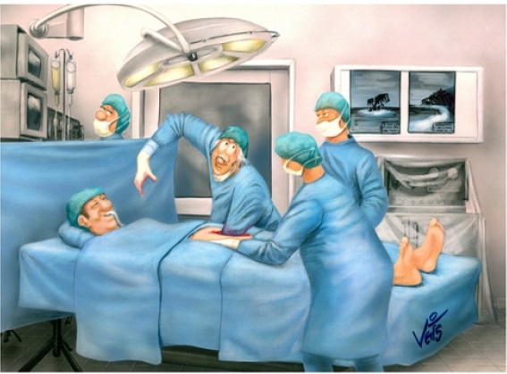
TREATMENT
Diseases of the spleen
Urgent operation in open trauma and patients with instability
hemodynamic

Slide 24
TREATMENT
Diseases of the spleen
Most of the closed trauma
non-operative (50-80%)
Observation in the absence of other injuries that are stable with hemodynamics and do not require surgery (hemodynamics, CT).
Operation if bleeding occurs during observation (hemoglobin descent, extravasation in CT angiography), or if hemodynamics are unstable

Slide 25
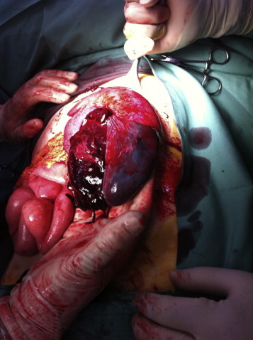
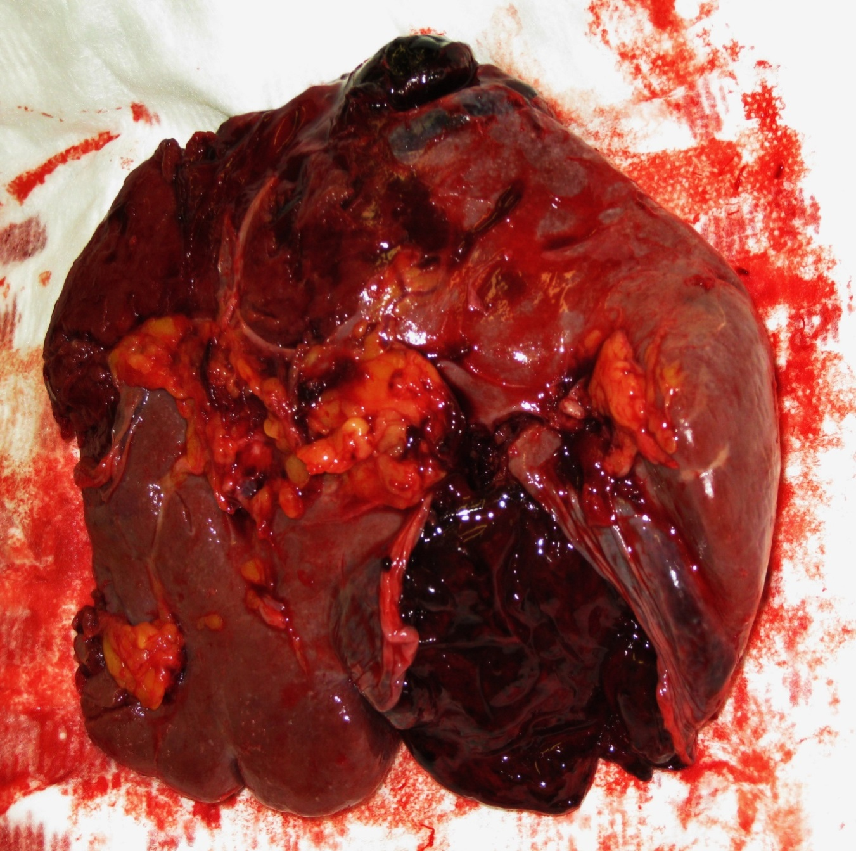
SPLEEN TRAUMA
Diseases of the spleen

