Slide 1
Surgical Diseases and Diagnostic Approach of colon
Surgical Diseases and Diagnostic Approach of colon
Prof.Dr. Eldar Aliyev
Phd. Parvana Aydınova
AMU, department of I surgical diseases

Slide 2
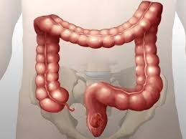
Anatomy
Surgical Diseases and Diagnostic Approach of colon
The borders begin from the iliac intestine and end in the anus.
It is 1.5 m long and 4-6 cm in diameter
Transverse Colon
descending
colon
Sigmoid colon
( the narrowest d = 4 cm)
Ascending
Colon
Rectum
(the widest d = 8 cm)
Cecum

Slide 3
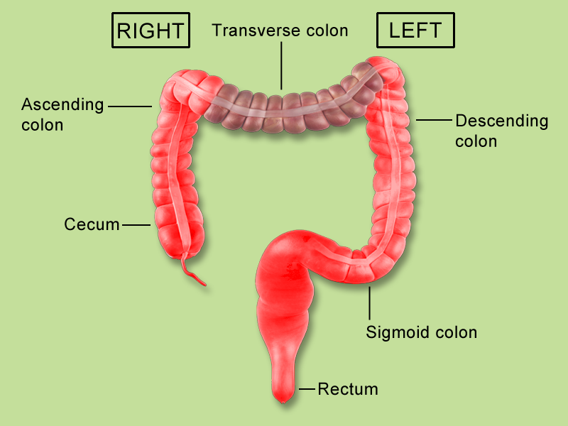
ANATOMY
In Surgical Practice
Surgical Diseases and Diagnostic Approach of colon
The left distal of Transverse Colon
The proximal of
Transverse Colon
Left colon
Descending
colon
Ascending
Colon
Right Colon
Sigmoid colon
Cecum

Slide 4
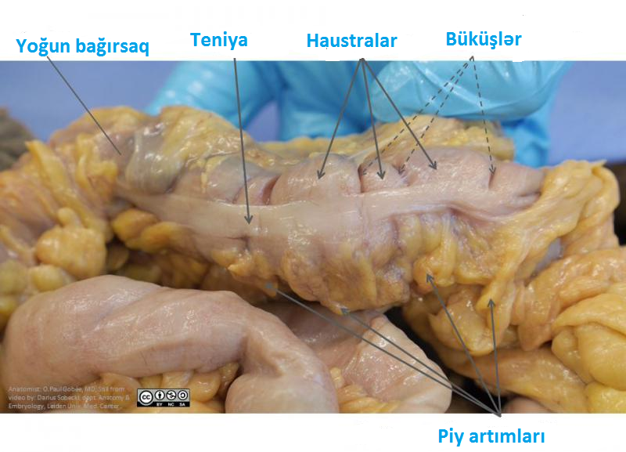
Anantomy
External elements
Surgical Diseases and Diagnostic Approach of colon

Slide 5
Anatomy
ARTERIES
Surgical Diseases and Diagnostic Approach of colon
Upper mesentery artery
Internal iliak artery
Low mesentery artery

Slide 6
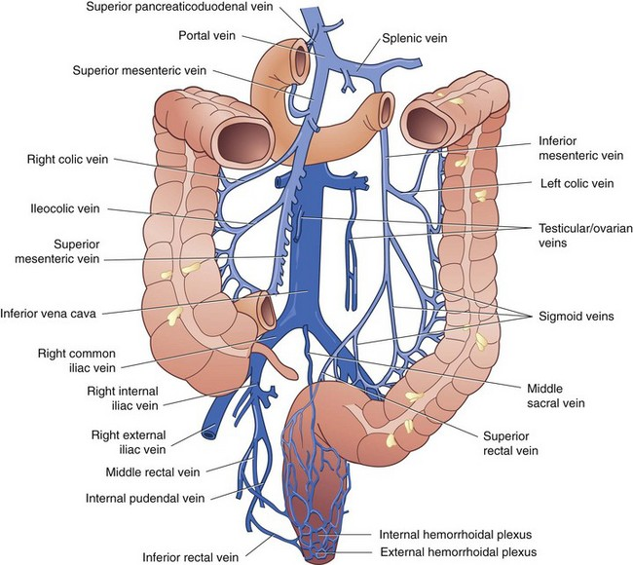
Anatomy
VEINS
Surgical Diseases and Diagnostic Approach of colon
Upper mesentery vein
Low mesentery vein
Middle and lower rectal veins

Slide 7
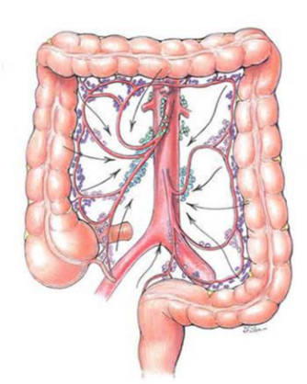
ANATOMİYASI
Surgical Diseases and Diagnostic Approach of colon
Lymphatic flow
Mesentery
Paracolik
Lymphatic nodes

Slide 8
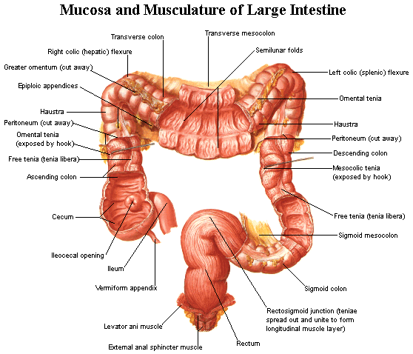
Surgical Diseases and Diagnostic Approach of colon
Anatomy
Stages
Mucosa
Submucosa
Muscle
serosa

Slide 9
Functions
Surgical Diseases and Diagnostic Approach of colon
Physiology
Absorption
Moveable
Endocrine
Protection

Slide 10
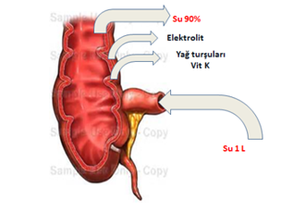
Physiology
ABSORBSION
Surgical Diseases and Diagnostic Approach of colon
Only 100-200 ml of liquid is excreted in the feces. The right colon can absorb up to 6 liters of fluid a day, and diarrhea occurs when daily absorption is below 2000 ml.
Na and Cl are actively absorbed and K and HCO3 secreted instead.
Fatty acids are essential for the nutrition of the intestinal epithelium. In the absence of intestinal flora (proximal stomas), the feeding of enterocytes is disrupted and diversion colitis are created.

Slide 11
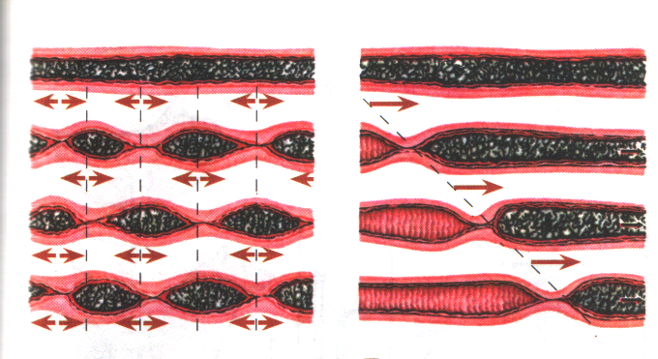
Physiology
Moveable
Surgical Diseases and Diagnostic Approach of colon
ANTIPERTISTICS
In the right colon, it creates conditions for mixing the condition and absorbing water from the small intestine.
SEQMENTAR ASSEMBLY
It is the most common act and have a role in the formation of the stool.
PERISTAlSIS
occur 3 to 4 times a day, and play an important role in the transfer of gas and feces to the intestine.

Slide 12
Physiology
Surgical Diseases and Diagnostic Approach of colon
PROTECTION
EPİTELİAL BARRIER
MICROFLORA
İMMUN (MALT)
There are 400 different bacterias in the intestine. 99% of normal bacterial flora are anaerobes, most of which are Bacteroids (1011 / ml). There are also more Lactobacillis and Clostridia. Coliforms and cocci are the main ones. Among colibacteria, E. coli (107 / ml) is dominant, and protein, klebsiella, and Enterobacter are also numerous. Enterococc (Streptococcus fecalis) is the main flora among the coccs.

Slide 13
Syndromes
Surgical Diseases and Diagnostic Approach of colon
Diarrhea
Constipation
Intestinal obstruction
Bleeding

Slide 14
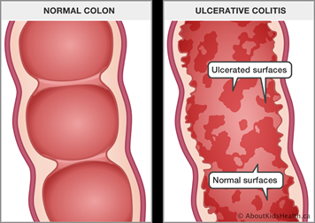
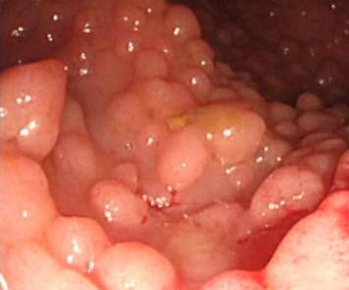
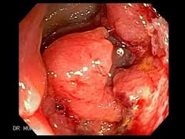
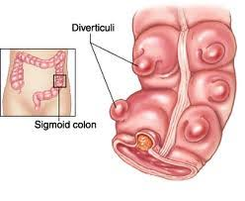
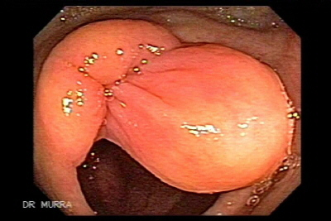
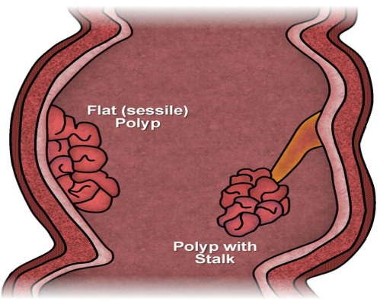
Diseases
Surgical Diseases and Diagnostic Approach of colon
Ulcerative colitis
Polyposis
Diverticulum
Cancer
Polyp
Benign tumors

Slide 15
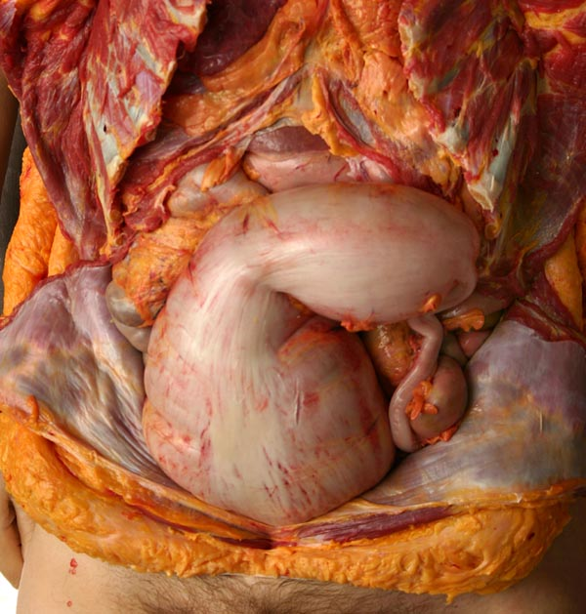
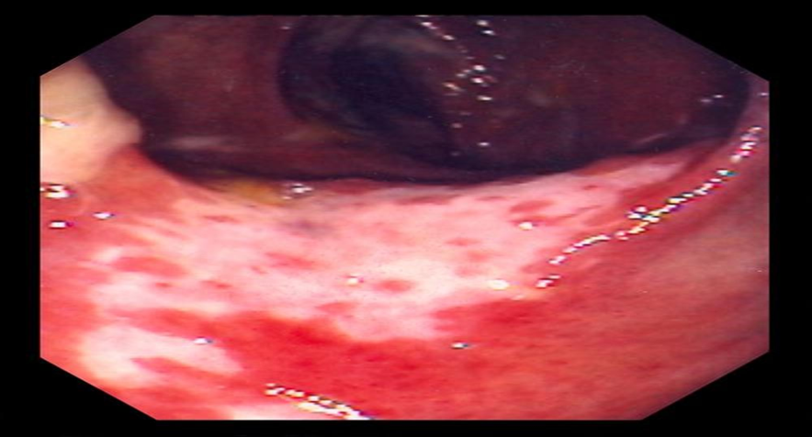
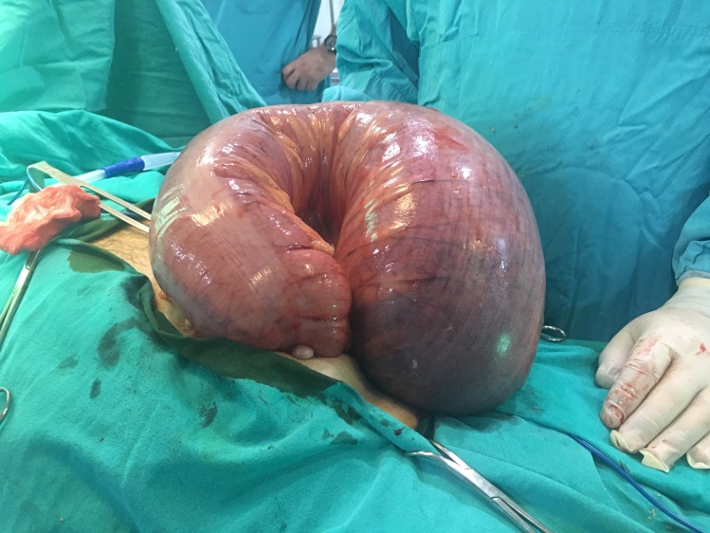
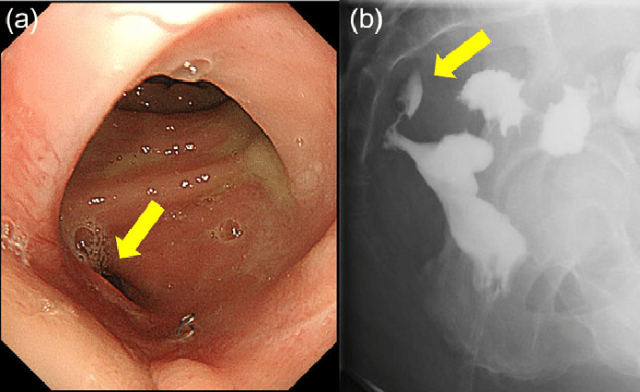
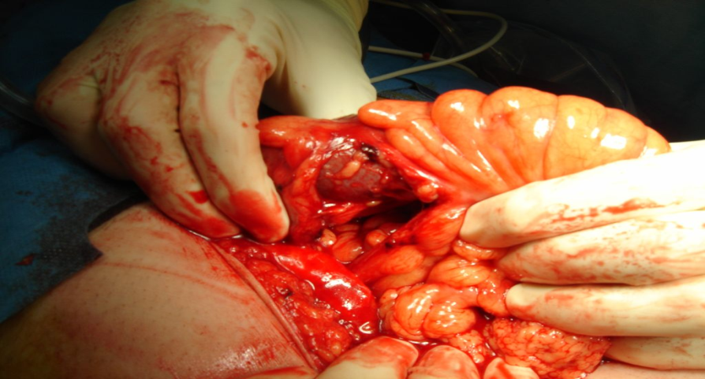
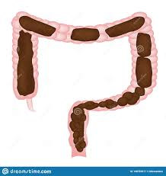
Diseases
Surgical Diseases and Diagnostic Approach of colon
Megakolon
Ischemic colitis
Torsion
Fistulas
Chronic constipation
Injuries

Slide 16
Examines
Surgical Diseases and Diagnostic Approach of colon
Radiography
Defecography
CT
Virtual colonoscopy
MRT
Colonoscopy
Fecal analysis
Tumor markers
Pain
Diarrhea
Constipation
Flatulence
Bleeding
Palpator mass
other
Biopsy

Slide 17
Diagnostic Algorithm of Intestinal Diseases
PRINCIPLE
Surgical Diseases and Diagnostic Approach of colon
Emergency and organic diseases are first in planning
Suspicion
FİRST STAGE EXAMİNES
Extensive clinical examination, CT, colonoscopy + biopsy, hemogram, fecal analysis
There is an emergency surgical disease və the reason is being cleared
There is no organic change, but there is clinic suspicion
Oganic change was found but diagnosis or severity cant be cleared
There is an organic change and the diagnosis is being cleared

Slide 18
Diagnosis of colon diseases
Surgical Diseases and Diagnostic Approach of colon
FIRST RESULT
Acute surgical disease with a large intestinal origin is found and the cause is identified. For example, acute intestinal obstruction (edema, twisting), intestinal bleeding (edema, diverticulum, angiodysplasia, ulcerative colitis, etc.), inflammatory complications (tumor perforation, diverticulitis, Crohn's abscess, toxic megacol).
SECOND RESULT
The colon is diagnosed with organic disease and its diagnosis is identified. For example, intestinal diseases, inflammatory diseases, diverticulum, vascular diseases, etc. In this case, further tests may be needed to determine the severity.
THIRD RESULT
The patient has a large intestinal pathology, but the nature and severity of the disease (for example, mesenteric thrombosis is high, mucosa-related tumors, etc.). In this case, a second step is needed.
FOURTH RESULT
There is no pathology in the large intestine, but there is a high clinical suspicion (eg constipation, pseudo-obstruction, etc.). In this case, a second step is needed.

Slide 19
Diagnosis of colon diseases
Surgical Diseases and Diagnostic Approach of colon
Second stage
MRT
Third stage
Angiography
EdoUSM
During the transition of the colon
Defecography
Laparoscopy
Laparotomy
Genetic testing
other

Slide 20
Surgery in colon diseases
Surgical Diseases and Diagnostic Approach of colon
Resection
  Right hemicolonectomy
  Left hemicolonectomy
  Trasversectomy
  Cheekomyectomy
  Sigmoidectomy
  Total colectomy
  Subtotal colectomy
  Coloprocectectomy
  Front and lower anterior resection
Ileal Posh
Hartman operation
Colostomy
Colopex

Slide 21
Postoperative complications
Surgical Diseases and Diagnostic Approach of colon
Anastomotic leak
Bleeding
Fistulas
Parastomal hernia

