Slide 1
Malignant and benign tumors of colon
Malignant and benign tumors of colon
Prof.Dr. Eldar Aliyev
Phd. Parvana Aydınova
AMU, department of I surgical diseases

Slide 2
Benign tumors of colon
Malignant and benign tumors of colon

Slide 3

Definition
Malignant and benign tumors of colon
The polyp is called the derivative of the epithelial surface in the cavity organs towards the forearm.
Polyposis is called multiple polyps.
The most common place is the colorectum.

Slide 4
Confirmation
Malignant and benign tumors of colon
On average, 25% (9-60%) cases occur.
More and more are observed with age.
The polyps are most commonly found in the intestine and S-variants (50% in rectosigmoid).

Slide 5
DESCRIPTION
Malignant and benign tumors of colon
According to the histology
Non-neoplastic
Neoplastic
Hyperplastic
Sporadic adenoma (tubular, tubulovillosis, villous)
Family colon polyposis syndrome
Adenocarcinoma
Other (lipoma, leukomyoma, carcinoid)
Hamartoma
A sporadic juvenile polyp
Family Juvenile Polyposis Syndrome
Peutz-Jegher syndrome
Inflammation
Psevdopolip
Limfoid polip

Slide 6
DESCRIPTION
Malignant and benign tumors of colon
According to the anatomy
Sparky
According to the number
Single (50%)
According to the place
Shield
Without shoes
(basic, flat)
Number Two (35%)
Very few (15%)
Inferior sheath gut
S-variant
Rectum

Slide 7
PROSESSING
Malignant and benign tumors of colon
Polyps do not exhibit clinical signs when they are small in size.
Complications such as bleeding, obstruction, and malignancy in necrosis
Histological type, size and duration of polyps are important in the onset of complications, especially in malignancy.
The risk of malignancy of adenomatous polyps, polyposis syndromes is very high, while inflammation is very low in hyperplastic polyps.

Slide 8
Complications
Malignant and benign tumors of colon
Bleeding
Inactivity
Maliqnification
Haggit Klassification
I degree
invasion of the polyp peak
II degree
polypine collar invasion
III degree
invasion of polyps edge
IV degree
invasion by polyp base
Polyp by width: refers to grade IV

Slide 9
CLINICAL
Malignant and benign tumors of colon
In most cases, measurements of polyps are in the range of 0.5-1 cm and do not cause symptoms.
Polyps are present with symptoms when they grow up and cause complications
The most common symptom of rectal polyps is rectal bleeding
Villas may have diarrhea in adenomas (mucus secretion)
Most often there is no sign of objective examination, but fingerprints may be used for fingerprints in distal rectum polyps.
rectal bleeding
pains
constipation
diarrhea

Slide 10
Suspicion
Malignant and benign tumors of colon
Changes in intestinal function (constipation, diarrhea)
The mass in rheumatic examination
Intestinal bleeding
Intestinal obstruction
Positive blood test
Intra-abdominal mass finding on CT or X-ray.

Slide 11
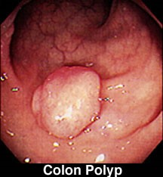
DIAGNOSTICS
Malignant and benign tumors of colon
Specification :
Colonoscopy is required to confirm or deny polyp.
Colonoscopy is a key examination to determine the location, number, size, footprint of the polyp, and even some complications.
A colonoscopic biopsy should be performed to determine the histological type of polyp.
Diagnostic symptoms:
Asymptomatic
Symptoms of aggravation (rectal bleeding, pains, constipation, diarrhea, etc.)
Polyps in colonoscopy

Slide 12
Principle
Malignant and benign tumors of colon
LOOK OUT
First, colonoscopic polypectomy and / or biopsy are performed
The second stage is decided by histology.

Slide 13
Methods of treatment
Malignant and benign tumors of colon
A two-stage "look out" approach in the colonic polyps
POLYP
Endoscopic polypectomy and biopsy
Simple polypectomy or resection of mucosa
No malignant, completely gone
There is malignant
Didn't go radically
Endoscopic can be removed
There is malignant, Radical is released
No invasions
Obsevation
Surgical resection

Slide 14
Malignant and benign tumors of colon
Methods of treatment
Endoscopic polypectomy
Endoscopic mucosa resection
Surgical - intestinal resection
Polypectomy methods

Slide 15
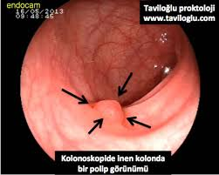

Specific properties of polyps
Malignant and benign tumors of colon
Hyperplastic polyps
It is caused by hyperplasia of the colon epithelium, not neoplastic.
The most common is the colon polyp.
The potential for malignant transformation is very low, but at polyps greater than 1 cm this risk increases. Sometimes adenomatosis can be mixed with polyp.
Observation in hyperplastic polyps less than 0.5 cm and radical exclusion in those with a component greater than 1 cm or with an adenomatous component.

Slide 16
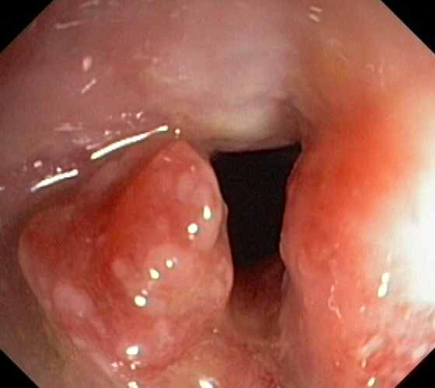
Specific properties of polyps
Malignant and benign tumors of colon
Inflammatory polyps
Mucosa may be caused by local inflammatory infiltration (pseudopolyphs) or hyperplasia of lymphatic tissue (lymphoid polyp).
These polyps can be found in inflammatory bowel diseases (Crohn's, ulcerative colitis, etc.). Usually they can regress once the inflammation is gone.
The risk of inflammation of malignancy polyps is low.
It is advisible to follow these polyps.
Adenamatosis should be colonoscopically removed when polyps are difficult to distinguish.

Slide 17

Specific properties of polyps
Malignant and benign tumors of colon
Polyps of hamartomosis
Hamartoma is a derivative caused by uneven and mixed growth of normal tissue elements (The tissues are normal, in place, but the texture of the tissue elements is impaired).
The two most common types of hamartomic polyps in the colon are:
Juvenile polyp
Peutz-Jegher syndrome

Slide 18
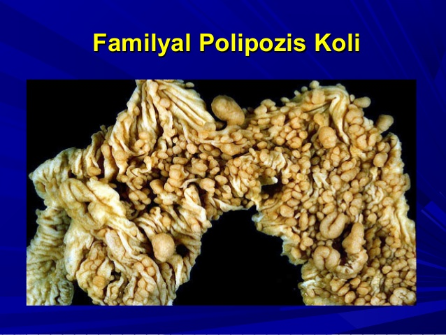
Specific properties of polyps
Malignant and benign tumors of colon
Adenotomous polyps
This Polyp is a benign derivative derived from proliferation of the gland epithelium and does not invade the basal membrane.
Adenomatous polyps are classically observed in two forms:
Sporadic shape - single and several polyps are found.
Family adenomataosis polyposis is a genetic disease characterized by the presence of multiple (more than 100) polyps in the colon and a high risk of cancer.

Slide 19
Malignant tumors of colon
Malignant and benign tumors of colon

Slide 20
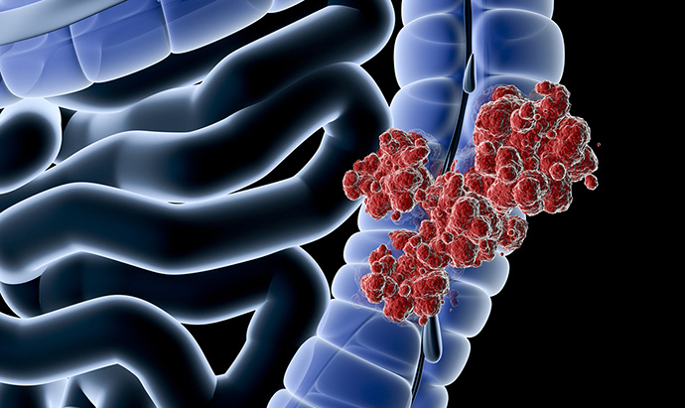
Definition
Malignant and benign tumors of colon
The majority of the malignant tumors of the colon (more than 90%) developed from the mucous membrane adenocarcinomas. Carcinoids and other mesenchymal tumors are rare.

Slide 21

Confirmation
Malignant and benign tumors of colon
3rd place after prostate and lung cancer
2nd place after breast cancer
Till 40 years - 5-8%
And after 50, the frequency increases.

Slide 22
DESCRIPTION
Malignant and benign tumors of colon
By position
Colon (blind gut, shield, transverse, descending, S-variant intestine)
Rectum (proximal, middle and distal)
According to the stages
TNM (Stages I-IV)
Duke (A, B, C, D), Astler-Coller
According to the degree of differentiation
Down
Medium
High
Macroscopic
Polypoid
Infiltrative
Mixed
According to the number
In one place
In several places (simultaneous)

Slide 23
DESCRIPTION
Malignant and benign tumors of colon
According to clinical manifestations
Asymptomatic
Symptomatic
With signs of aggravation
Because of the aggravation
Non-aggavation
Aggravated (bleeding, failure, perforation, etc.)
According to the risk factors
Heritage
Earning
Polyp malignancy
Growing in the background of intestinal disease
Depending on the diet
other
According to development time and place
First
Synchronous (two or more places at the same time)
Metachron (found elsewhere)
Residual (repeating in the same place)

Slide 24
Malignant and benign tumors of colon
Etiology
Risk Factors
Hereditary diseases
Polyposis syndromes
Non-polyposis syndrome
Earned
Polyps
Inflammatory diseases
Fatty foods

Slide 25
Etiology
Malignant and benign tumors of colon
Factors that reduce risk
Fiber foods
Physical activity
Non-steroidal anti-inflammatory drugs

Slide 26
Pathogenesis
Malignant and benign tumors of colon
Mutations in oncogens and tumor-suppressor genes
causes colon cancer.
Genetic mutations
Heritage (10-15%)
Earnings (80 -85%)
Causes polyp
Cancer
Family adenomatous polyposis syndrome
Non-congenital non-polyposis colorectal cancers
(MSH2 and MLH1, MSH6 mutations)
Peutz-Jegher syndrome (LKB1 / STK1 mutation)
Family juvenile polyposis (SMAD4 / DPC mutation)
after 35-40 years 15-100%
colorectal cancer develops
Colon polyps
Inflammatory bowel disease
(Crohn's disease and ulcerative colitis for more than 10 years increases the risk of cancer)
Fat diet (presumed to be due to fatty acids directly to mucosa or to the effect of fats on colonic flora).

Slide 27
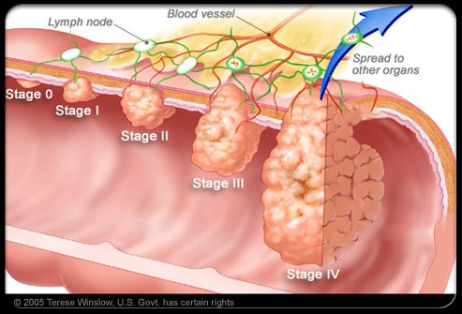
PROGRESSING AND COMPILATIONS
Malignant and benign tumors of colon
Locally along the wall
Lymphatic and hematogenous
Folds and tissues
It is considered a progressive disease. The process begins with the mucous membrane in 3 ways

Slide 28
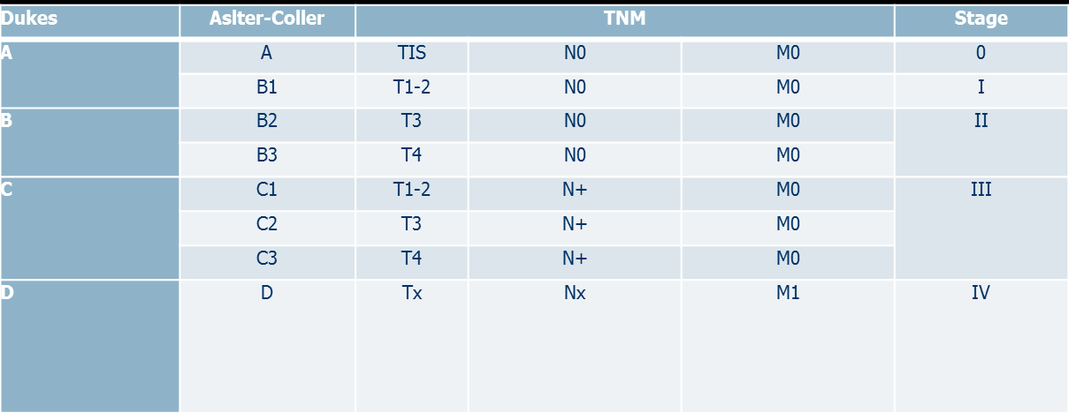
STAGES
Malignant and benign tumors of colon
There is Duke, Astler-Coller, and TNM classifications for stage identification.

Slide 29
STAGES
Malignant and benign tumors of colon
The TNM classification is based on the invasion of the dermis (T), the spread of the lymph nodes (N) and the distant metastases (M).
In the 1st stage tumor does not pass the derivative muscle layer - T1-2, N0, M0 (90% for 5-year life)
In the 2nd stage, the tumor transmits the muscle layer and can penetrate into surrounding tissues, but has no lymph nodes - T3-4, N0, M0 (5-year life 60-80%)
In the 3rd Stage spreads to lymph nodes - T1-4, N1-3, M0 (5-year life 60%)
At the 4th stage, it produces distant metastases - T1-4, N1-3, M1 (5-year life 10-40%).

Slide 30
COMPLICATIONS
Malignant and benign tumors of colon
BLEEDING
FAILURE
PERFORATION

Slide 31
CLINICAL
Malignant and benign tumors of colon
Asymptomatic
Rutin is found in colonoscopy. This is most common in early stage tumors.
With intestine and abdominal symptoms
Different symptoms of intestinal function (constipation, diarrhea, fever, discomfort, etc.), abdominal pain and mass in the abdomen.
Signs of aggravation
Bleeding, Anemia, Failure, Absence and Peritonitis.
Bleeding In the right-sided tumor, (hematopoiesis, anemia), and in the left-sided tumor it is more common. The left column is less prone to failure because it has a smaller surface area and is more stable.

Slide 32
SUSPICION
Malignant and benign tumors of colon
People over 50 (need colonoscopy once a year)
Those who have a secret blood positive in the stool
Change in intestinal function (diarrhea, constipation)
Intestinal bleeding
Intestinal obstruction
Perforation of the intestine
Colon Cancer in the Family
Previously colon cancer
Those with intestinal polyps, polyposis, Crohn's and ulcerative colitis
Patients with intra-abdominal CT, wall thickening
Other.

Slide 33
DIAGNOSTICS
Malignant and benign tumors of colon
Specification
It is colonoscopy and biopsy
Diagnostic symptoms:
Asymptomatic or pain, diarrhea, obstruction, bleeding etc.
Mass in colonoscopy
Malignant tumor in biopsy
Definition of the stage
Endoscopic - USM, CT / MRT and PET-CT according to instructions
The most sensitive method for determining the invasion of the wall is the endoscopic USM.
MRT in straight bowel cancers to determine spread to lymphatic nodes and MRT or CT in colon cancers
The abdominal cavity and chest CT are the standard for the diagnosis of distant metastases.
In some cases, positron emission tomography (PET)
The diagnosis of the surgical phase (intraoperative and pathologic) is performed by examination of the intestine and lymph nodes produced after surgery.

Slide 34
PRINCIPLE OF THE TREATMENT
Malignant and benign tumors of colon
In both colon and rectum cancers, radical removal of the tumor is the main principle (complete mesochonic and mesorectal excision).
Chemotherapy and radiotherapy are being performed to reduce the incidence and reduce tumor.
No chemotherapy or radiotherapy correction of malignant surgical treatment, and the best treatment for malignant neoplasms of the colon and rectum is the radical removal of the tumor. !!!!!

Slide 35
Malignant and benign tumors of colon
METHODS OF TREATMENT
Radical methods
Surgical resection (open and laparoscopic)
Assistive methods
Chemotherapy (FOLFOX, FOLFRI, targeted treatments, etc.)
Palliative methods
Cerebral Anastomoses
Endoscopic mucosal resection
Radiotherapy
Stent

Slide 36
Malignant and benign tumors of colon
The choice of treatment
The choice of treatment method and sequence is based on the localization of the tumor (rectum and colon), stage and risk factors.
In colon cancer - based on the principle of "resection first and then chemotherapy for indications":
If the tumor is resectable, then resection should be performed first, and then chemotherapy as indicated;
If the tumor is not resectable, doing chemotherapy for making resectable
Palliative intervention and chemotherapy may be performed if the tumor is not resectable and aggravates.

Slide 37
Malignant and benign tumors of colon
The choice of treatment
In rectum cancer “first Chemo radiotherapy, then surgery, then chemotherapy”
Stage I - T1 – T2 → first resection → chemotherapy
If there is an invasion of the intestinal wall and tissues, or spread to lymphatic nodes (Stages II to III), first chemo radiothrepy, then resection, and then chemotherapy.
In the presence of metastasis (stage IV) or non-resectable, first, neoadjuvant chemo - radiotherapy, then if it is resectable then resection, if it is not then palliative treatment (stoma, laser dysentery, stent, etc.)

Slide 38
Malignant and benign tumors of colon
The choice of treatment
Resection
Chemotherapy
Chemo radiotherapy
Stagee I - T1 – T2
Stages II - III

Slide 39
Lymphoma
Malignant and benign tumors of colon
Firstly (10%)
Metastatic
Suspicion
Clinical symptoms are similar to adenocarcinomas.
Endoscopic biopsy is not helpful in the diagnosis
Lymphomas are usually submucosal located.
The diagnosis is usually confirmed by histological examination of the drug at the post-resection stage.
Radical rezection
Bone marrow biopsy
Neck, mediastinal and
full abdominal CT scan-
we can't take them
Hodkin lymphoma
to confirm or deny
Chemotherapy
Non-resectable lymphomas require palliative interventions (conjunctival anastomoses, stomas), biopsy, and chemotherapy.

Slide 40
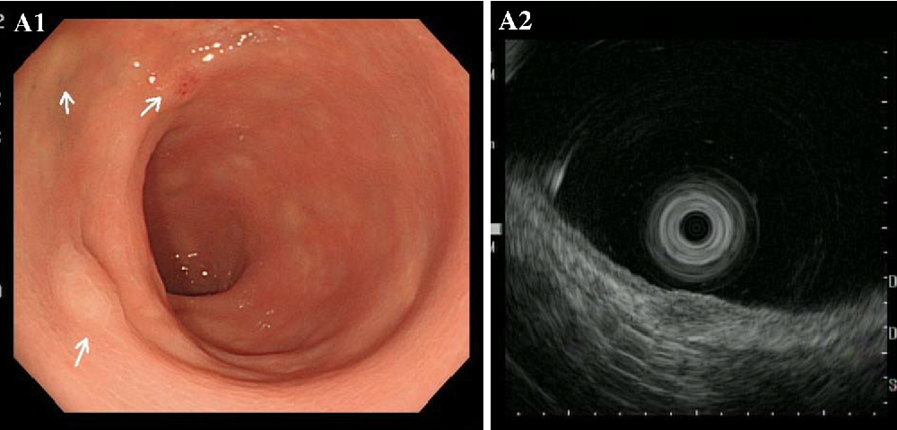
Carcinoid tumors
Malignant and benign tumors of colon
In colon – 2%
In rectum– 15%
Serotonin is not secreted
They do not cause carcinoid syndrome

Slide 41
Carcinoid tumors
Malignant and benign tumors of colon
Less than 2 cm
Larger than 2 cm
NOT
90% is malignant
Malignant
Local excision
Rezection

