Slide 1

Obesity. Bariatric and metabolic surgery.
Obesity. Bariatric and metabolic surgery
PhD Taryel Omarov Iskender
Mehriban Huseynova Rafael
AMU, Department of I surgical diseases

Slide 2
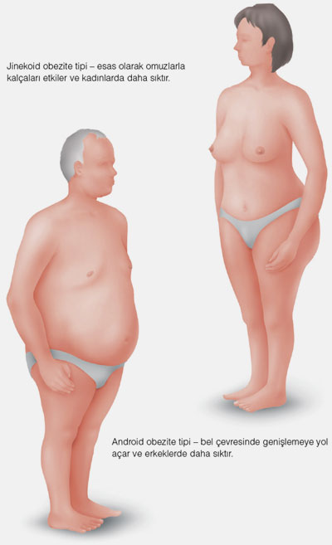
Definition
Obesity
Obesity is a disease with an increased body mass index more than 30 kg/m², which is characterized by excessive accumulation of fat in the body and causes a number of complications.
Gynecoid=Peripheral=
Pear shaped
Android=Abdominal=Central=Apple shaped

Slide 3
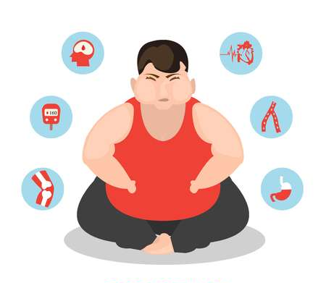
Definition
Obesity
Metabolic syndrome is a pathological condition characterized by insulin resistance, in which, first of all, increases the risk of developing cardiovascular diseases and diabetes. The diagnosis is made with abdominal obesity and the presence of at least two of the following symptoms:
  Triglycerides ≥150 mg/dL;
  HDL cholesterol <40 mg/dL (1.03 mmol/L);
  Blood pressure ≥130/85;
  Blood sugar ≥100 mg/dL (5.6 mmol/L);
  Type 2 Diabetes mellitus.

Slide 4

Classification
Obesity
BMI
Underweight < 18,5
Normal weight - 18,5-24,9
Overweight - 25,0-29,9
Class I obesity - 30,0-34,9
Class II obesity - 35,0-39,9
Class III obesity ≥ 40

Slide 5
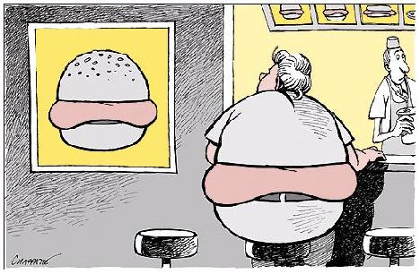
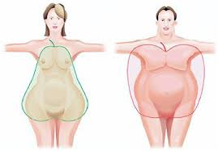
Classification
Obesity
Localization
Central obesity
Peripheral obesity
Complications
Without
With

Slide 6
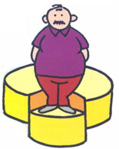
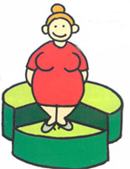
Prevalence
Obesity
MEN
21.2 %
WOMEN
41.5 %

Slide 7
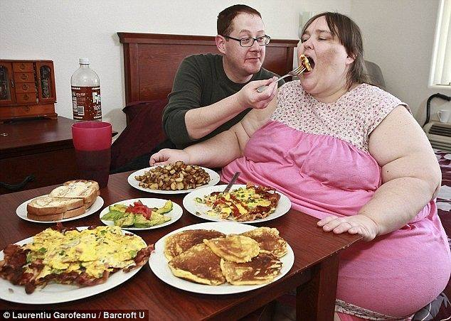
Etiology
Obesity
Nutritional imbalance
Basal metabolic disorder

Slide 8
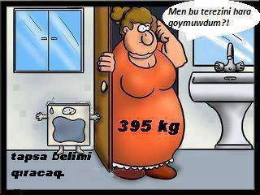
Pathogenesis
Obesity
Adipose tissue, which plays a key role in obesity, acts as an endocrine organ, secreting the following protein-containing hormones:
  Adipogens
  Leptin
  Resistin
  Estrogens
  TNF
Where did I put this scale?
If she find me, she will broke me!

Slide 9
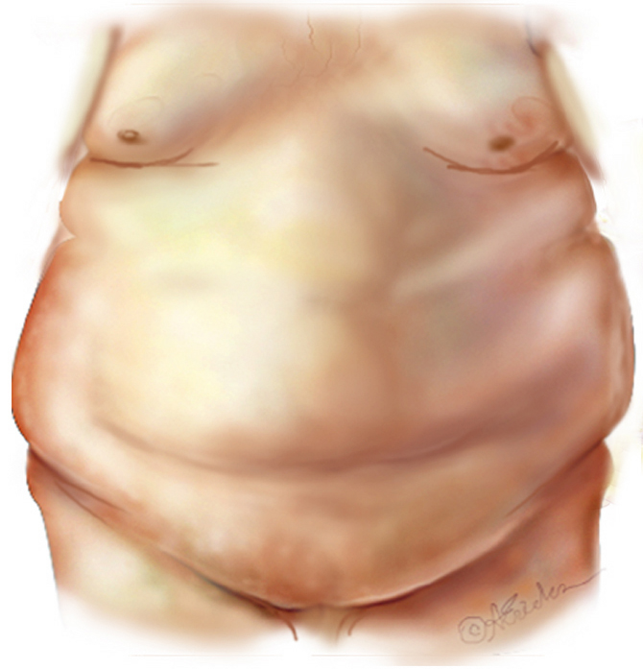
Symptoms
Obesity
Syndrome “X”
Insulin resistance
Syndrome Reaven
Deadly four
CHAOS
  C oronary Artery Disease
  H ypertension
  A dult Onset Diabetes
  O besity
  S troke
Metabolic
Mechanic
Degenerative
Neoplastic
Psychological

Slide 10
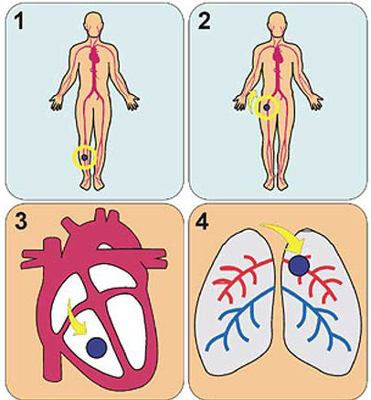
Complications
Obesity
The cardiovascular system
Hypertension
Coronary artery disease
Heart failure
Arrhythmias
Phlebeurysm
Pulmonary embolism

Slide 11
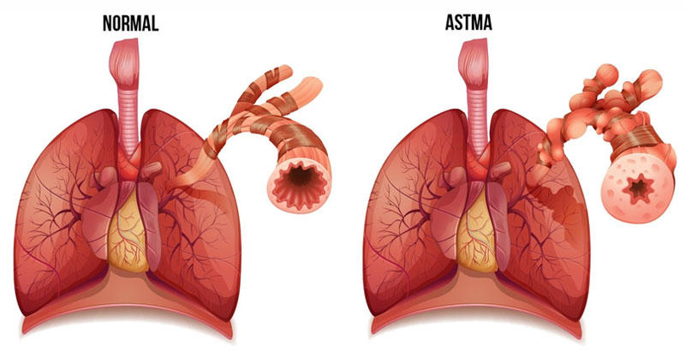
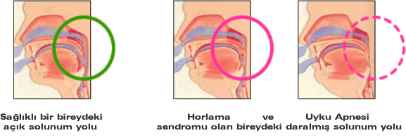
Complications
Obesity
Respiratory system
Dyspnea
Obstructive Sleep Apnea Syndrome
Hypoventilation syndrome
Respiratory failure associated with obesity (Pickwick syndrome)
Bronchial asthma
Normal
Obstructive sleep apnea syndrome

Slide 12
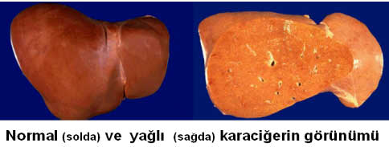
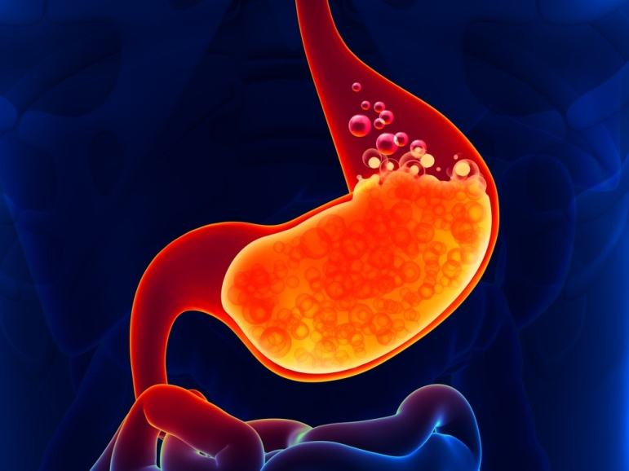
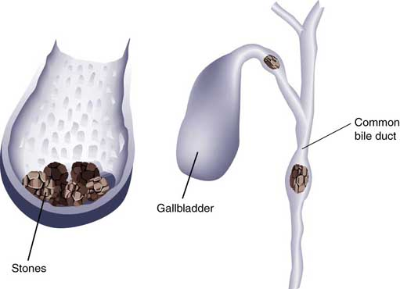
Complications
Obesity
Digestive system
Gastroesophageal Reflux Disease
Non-alcoholic fatty liver disease
Cholelithiasis
Hernias
Colon cancer
Normal liver and fatty liver

Slide 13
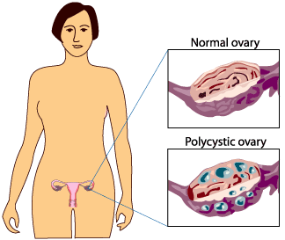
Complications
Obesity
Genitourinary System
Urinary incontinence
Obesity-related glomerulopathy
Male hypogonadism
Breast and uterine cancer
Polycystic Ovary Syndrome
Pregnancy Complications

Slide 14
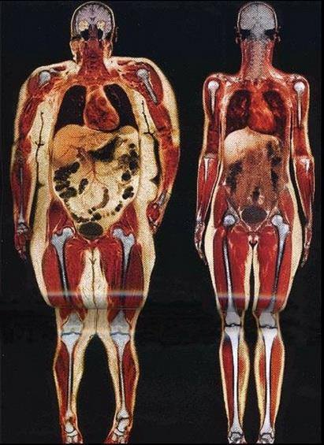
Complications
Obesity
Endocrine system
Metabolic syndrome
Type 2 Diabetes mellitus
Dyslipidemia
Steatohepatitis

Slide 15
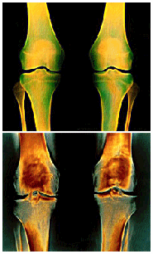
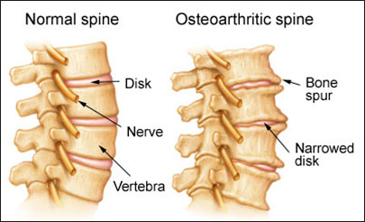
Complications
Obesity
Musculoskeletal system
Osteoarthritis (knee and hip joints)
Intervertebral disc disease
Carpal tunnel syndrome

Slide 16
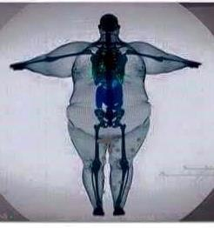
Complications
Obesity
Neurological and psychological
Paralysis
Idiopathic intracranial hypertension
Sciatic nerve paresis
Dementia
Depression and reduced self-esteem
Social pressure

Slide 17
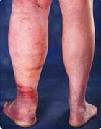
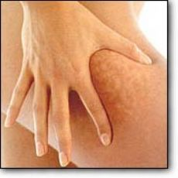
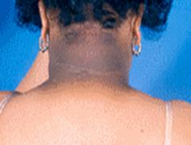
Complications
Obesity
Skin diseases
Striae
Congestive pigmentation of the lower extremities
Lymphedema
Cellulite
Intertrigo carbuncle
Black acanthosis
Acrochordon (skin neoplasms)
Hydradenitis

Slide 18

Diagnostics
Obesity
Suspicion
BMI > 30 kg/m²

Slide 19

Differentiation
Obesity
Hypothyroidism (↓ sT3, ↓ sT4, ↑ TSH)
Hypercorticism (steroid therapy, increased cortisol in the blood and a positive dexamethasone test)
Diseases with the development of edema - heart, kidney and liver diseases
Athletes with muscle hypertrophy

Slide 20

Treatment
Obesity
Treatment | Weight Loss Average (%) | Weight loss for 5 years (%)
Placebo | 4-6% | 0%
Diet, sport | 8-12% | 1,6% (10 years)
Medicine | <10% | 10%
Surgery | 65-85% | More than 100%
Eliosoff 1997; Sjostrom NEJM 2004,
Obrien J Laparoendosc Adv Surg Tech A.
2003 Aug;13(4):265-70.

Slide 21
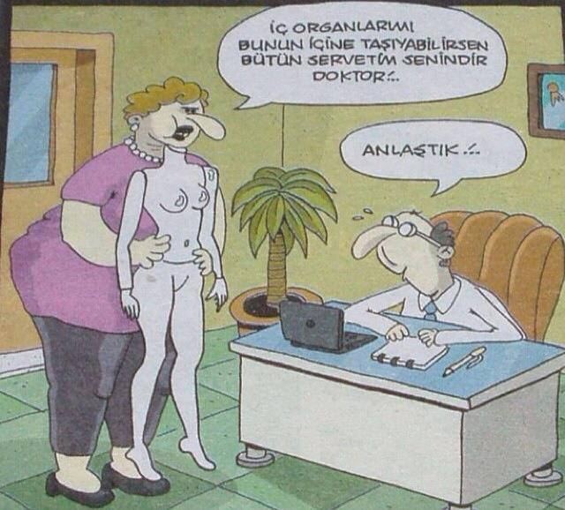
Definition
Bariatric surgery
Bariatric surgery is an operation performed on the gastrointestinal tract in order to lose excess weight.
If you gather all my internal organs into this body, all my wealth is yours!
Deal!

Slide 22

Concepts
Bariatric surgery
Classic mechanical concept
Endocrine concept
Metabolic surgery is an operation performed on the gastrointestinal tract to treat diabetes and metabolic dysfunctions (including obesity).
The essence of metabolic surgery is correction of the metabolism by acting on endocrine processes in the gastrointestinal tract.

Slide 23
Bariatric surgery
Bariatric surgery
Indications
Contraindications
The impossibility of losing weight despite conservative methods in patients with a BMI of more than 40;
The impossibility of losing weight despite conservative methods in patients with a BMI of more than 35 and the presence of a concomitant disease.
Bulimia
Psychiatric illness
Contraindications associated with concomitant diseases: cardiovascular, pulmonary failure, etc.

Slide 24
Metabolic surgery
Metabolic surgery
Indications
Contraindications
Patients with class II and III obesity with type 2 diabetes mellitus.
Class I obese patients with type 2 diabetes mellitus, difficult to control with conservative methods.
General contraindications for surgery;
Type 1 diabetes mellitus;
Non-obese patients with conservatively controlled diabetes mellitus.

Slide 25
Surgeries
Bariatric surgery
Restrictive
Sleeve gastrectomy
Gastroplication
Gastric band (regulated and unregulated)
Vertical-banded gastroplasty
Endoluminal gastroplasty
Malabsorption
Jejunoileal bypass
Biliopancreatic diversion
Biliopancreatic diversion with duodenal switch
Endoluminal Gastric Bypass
Mixed
Roux-en-Y Gastric Bypass
Mini-gastric bypass

Slide 26
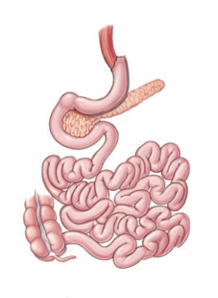
Sleeve Gastrectomy
Bariatric surgery
  Duration 60-120 minutes;
  Intensive care - 1 or 0 days;
  In-patient observation - 1-3 days;
  Return to work - in 7-12 days;
  Weight loss - within 12 months.
Benefits:
No anastomosis
Technical simplicity
Fewer malabsorption complications

Slide 27
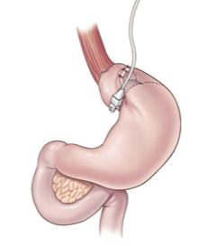
Gastric Band
Bariatric surgery
It looks like gastroplasty; the stomach is divided into the proximal and distal parts through a narrow channel;
Separation occurs through a special bandage.
Benefits :
Reversibility;
Regulation;
Non-damage to the wall and integrity of the stomach.

Slide 28
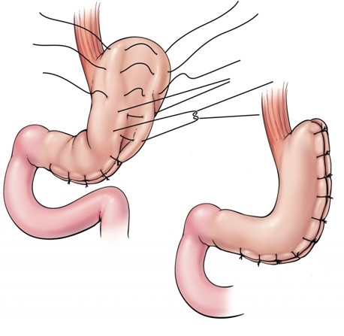
Gastroplication
Bariatric surgery
The greater curvature of the stomach is mobilized;
The wall of the stomach is sutured inward by intussusception, thereby reducing its volume.
Benefits:
Less trauma;
No risk of insolvency;
Reversibility.

Slide 29
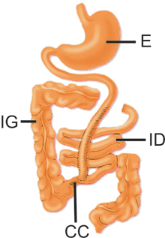
Jejunoileal bypass
Bariatric surgery
An end-to-side bypass is made between the jejunum and ileum;
Most of the ileum is eliminated from the digestive process;
While maintaining the ileocecal angle, 14 inches of jejunum and 4 inches of ileum are used.

Slide 30
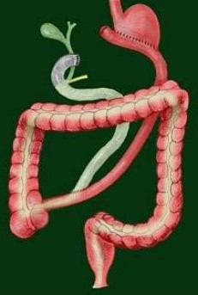
Biliopancreatic diversion
Bariatric surgery
Distal gastric resection is performed;
The duodenum is sutured;
The small intestine is separated at a distance of 250 cm from the ileocecal angle;
The distal part of the small intestine (Ru loop) is sutured to the stomach, the proximal part (bilio-pancreatic loop) is sewn to the ileum at a distance of 50 cm from the ileocecal angle.
This operation is performed in patients with morbid obesity and if weight loss is not possible through other operations.

Slide 31
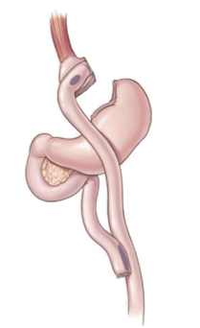
Roux-en-Y Gastric Bypass
Bariatric surgery
  Duration 90-180 minutes;
  Intensive care - 1-2 days;
  Inpatient monitoring - 2-4 days;
  Return to work - in 7-12 days;
  Weight loss - within 12-16 months.

Slide 32
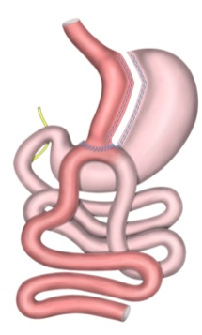
Mini-gastric bypass
Bariatric surgery
  An option for gastric bypass surgery;
  Distal gastric resection is performed;
  The pyloric stomach remains;
  A bypass is created between the stomach and small intestine end to side.

Slide 33
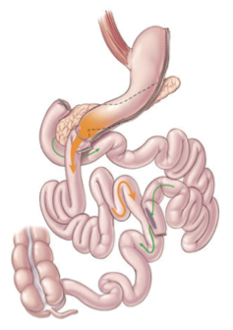
Biliopancreatic diversion with duodenal switch
Bariatric surgery
  t is a modification of bilio-pancreatic diversion;
  A distinctive feature is that they produce a longitudinal resection of the stomach while preserving the pyloric department;
  A detour is created between the Py loop 150 cm long (alimentary canal) and the pyloric section, the proximal bilio-pancreatic loop is sewn to the ileum at a distance of 75-100 cm;
  The purpose of this modification is to eliminate anastomotic ulcers and dumping syndrome.

