Slide 1
Pancreatic islet cell tumors. Insulinoma. Gastrinoma.
Pancreatic islet cell tumors
PhD Taryel Omarov Iskender
Mehriban Huseynova Rafael
AMU, Department of I surgical diseases

Slide 2
Classification
Pancreatic islet cell tumors
Primary
Epithelial
Metastatic
Breast
Ductal adenocarcinomas
Acinar adenocarcinomas
Cystadenocarcinomas
Adenomas
Cystadenomas
İslet cell tumors
Malignant
Benign
Hormonally active
Mesenchymal
Lymphomas
Lipomas
Lungs
Melanoma
Ovaries
Hormonally inactive

Slide 3
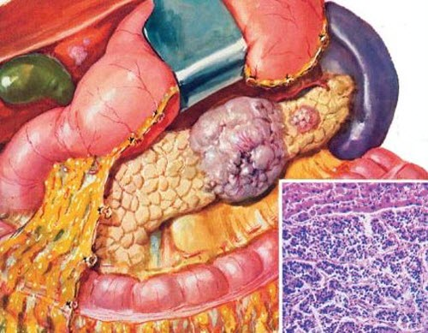
Anatomy, physiology
Pancreatic islet cell tumors
  Pancreatic islands are a collection of neuroendocrine cells, diffusely located in the parenchyma of the gland, amount to 1 g.
  Cells of the pancreatic islet:
    A cells – glucagon.
    B cells – insulin.
    D cells – somatostatin.
    F cells – pancreatic polypeptide.
    D2 cells – vasoactive intestinal peptide.
    EC cells – serotonin.

Slide 4
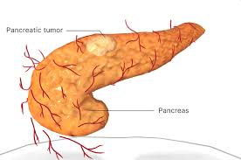
Morphology
Pancreatic islet cell tumors
Insulinoma
Gastrinoma
VIP-oma
Glucagonoma
Somatostatinoma
PP-oma
Islet cell tumors
Functional
Inactive
Whether or not metastasis
Malignant
Active
Benign
Prevalence
Sporadic
MEN1
Tumor
Pancreas
>50-60%
PP-oma (80%)
Gastrinoma (25%)
Insulinoma

Slide 5
Symptoms
Pancreatic islet cell tumors
Insulinoma
Hypoglycemia
Gastrinoma
lcers and gastric acid hypersecretion, diarrhea
Glucagonoma
Diabetes, anemia, necrotic anemia
Somatostatinoma
Diabetes, gallstones, steatorrhea
VIP-oma
Secretory diarrhea
Inactive tumors
Symptoms of сompression

Slide 6

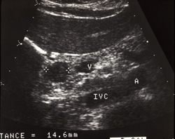
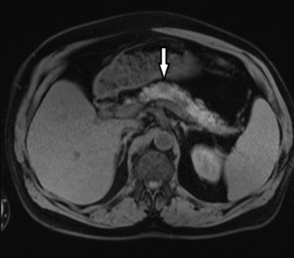
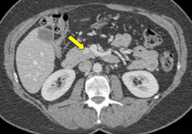
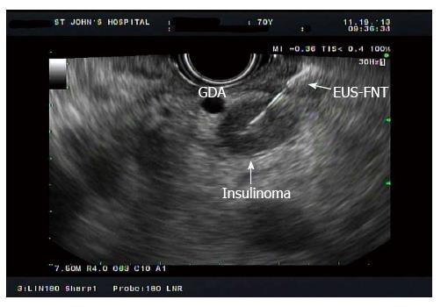
Diagnostics
Pancreatic islet cell tumors
Functional tumors
Type
Localization
Determination of the corresponding hormone in the blood
Stimulating tests - secretin test, secretin-calcium test
Ultrasound
CT or MRI
Endoscopic Ultrasound
Angiography

Slide 7
Treatment
Pancreatic islet cell tumors
Main
Chemothe-rapy
Symptomatic
Radical operation
Surgery to reduce tumor volume
Somatostatin
Diazoxide (insulinoma)
Streptozocin doxorubicin
Interferon
Insulinoma - glucose,
Gastrinoma - proton pump blockers, nasogastric tube,
Glucagonoma - transfusion of amino acids,
VIP-oma - transfusion of water-salt solutions

Slide 8
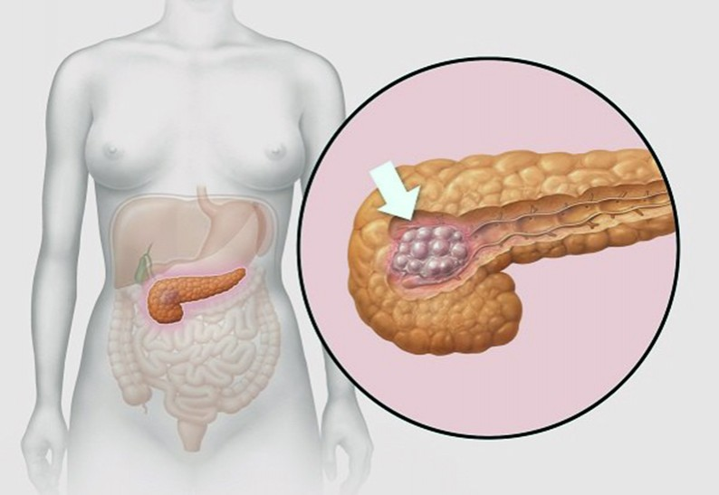
Definition
İnsulinoma
Insulinomas are formed from B cells of the islet apparatus, are hormonally active, secrete excess insulin, leading to hypoglycemia.
90%

Slide 9
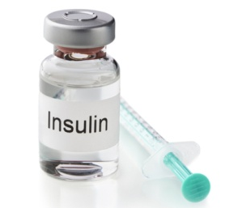
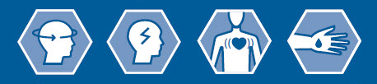

Pathophysiology
İnsulinoma
Insulinoma
Insulin ⇧
Glycogen synthesis ⇧
Hypoglycemia
Neuroglucopenia
Sympathetic hypertonicity
Coma

Slide 10
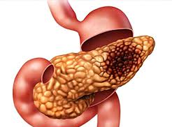
Morphology
İnsulinoma
80%
Benign
10% Malignant
10%
MEN1

Slide 11

Symptoms
İnsulinoma
Cold sweat
Weakness
Dizziness
Nervousness
Hunger
Sleepiness

Slide 12
Diagnostics
İnsulinoma
Exogenous insulin
Diabetic drugs
Autoimmune non-insulinoma
Islet hypertrophy
Suspicion
Clarification
Differentiation
Localization definition
Signs of hypoglycemia
Blood glucose less than 50 mg/dl
Contrast KT/MRI
Endoscopic Ultrasound
PET-CT
Portal Vein Catheterization
Octreotide scintigraphy
Intraoperative palpation and ultrasound
Whipple Triad
High insulin levels (in case of starvation >5 μU/ml)
Non-insulin-related hypoglycemia and insulinemia refutation

Slide 13
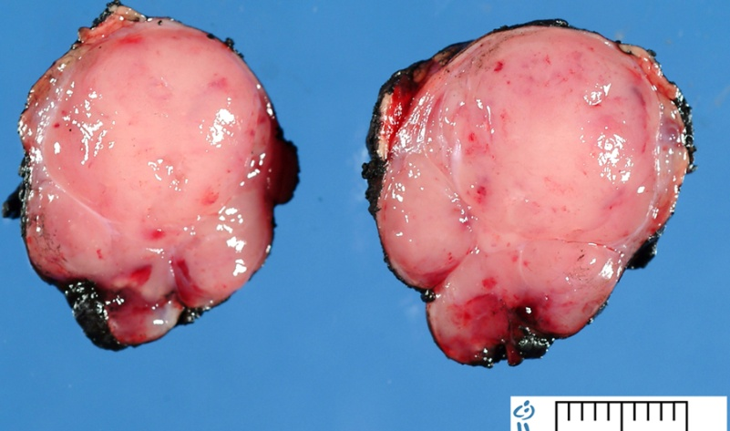
Treatment
İnsulinoma
Prevention
Main
Palliative
Frequent eating
Glucose infusion
Enucleation
Resection
Diazoxide
Streptozocin
Somatostatin

Slide 14
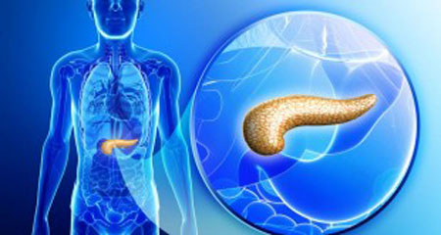
Definition
Gastrinoma
Gastrinoma develops from G cells, secrete excess gastrin, promotes gastric acid hypersecretion and thereby the development of numerous gastric and duodenal ulcers.
It is malignant.

Slide 15
Pathophysiology
Gastrinoma
G celss
Gastrin
Hypersecretion
Peptic ulcers in the stomach, duodenum and even in the proximal jejunum
Secretory diarrhea

Slide 16
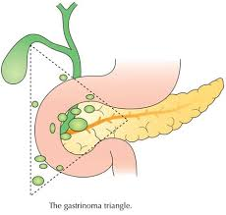
Pathomorphology
Gastrinoma
May be small (microadenoma) or larger than 3 cm
Reddish elastic formations
Localization - Whipple Triad
In 25% of cases, it occurs together with MEN
⅔ gastrinoms are malignant (metastatic)

Slide 17
Symptoms
Gastrinoma
Pain
Peptic ulcers in the stomach, duodenum
Hyperacid gastritis
Secretory diarrhea

Slide 18
Diagnostics
Gastrinoma
Suspicion
- A non-treatable ulcer or recurring immediately after treatment;
- Postbulbar ulcers;
- Anastomotic ulcers;
Clarification
- Pain, peptic ulcers in the duodenum, hyperacid gastritis, secretory diarrhea
- Gastric acid hypersecretion (basal secretion >15 mg/h)
Localization
- Contrast CT,
- MRI,
- Endoscopic ultrasound,
- Secretin receptor isotope assay
- Intraoperative palpation and ultrasound
- Diarrhea;
- Parathyroid adenoma.
- Гипергастринемия (>100 pg/ml)

Slide 19
Treatment
Gastrinoma
Radical treatment
Chemotherapy
Surgery to reduce tumor volume
Gastrectomy
Antisecretory therapy

