Slide 1
Bronchiectasis
Bronchiectasis
Professor Saday Agalar oglu Aliyev
AMU, Department of Surgical Diseases I

Slide 2
Definition
Bronchiectasis
Bronchiectasis is called dilatation of the bronchi. Along with the expansion of the bronchi, the presence of a recurring infection is called bronchiectasis disease.

Slide 3
Classification
Bronchiectasis
By reason of | Congenital Acquired
In form | Saccular Cylindrical Mixed
By localization | Local Diffuse
The course of the disease | True - after eliminating the cause does not pass False - after elimination of the cause passes
Prof.Dr. Saday Ağalar oğlu Əliyev

Slide 4
Etiology
Bronchiectasis
Congenital or acquired change in the elasticity of the wall of the bronchi
Obstruction of the bronchus with a tumor, purulent plug, foreign body, or as a result of swelling of the mucous membrane
Increased intrabronchial pressure (due to prolonged cough)

Slide 5
Pathogenesis
Bronchiectasis
Inflammatory
reaction
Scarring
Dilation
bronchi
Accumulation
sputum
Infection

Slide 6
Progress
Bronchiectasis
The cause of the course of chronic bronchectasia is a vicious cycle of dilatation-infection:
Bronchiectasis
Stagnation and infection
Destruction and fibrosis
Obstruction and Dilation

Slide 7
Diagnostics
Bronchiectasis
Anamnesis - Often recurring chronic cough, sputum production, hemophysis
Objective examination- Extension of expiration, cyanosis, drum fingers
adiology - X-ray of the chest, CT of the chest
Laboratory - Sputum Examination
Tests of other hidden diseases - sweating test, alpha-1 antitrypsin, İg, nasal mucose biopsy, skin tests

Slide 8
Clinic
Bronchiectasis
Clinical forms of bronchiectasis: central, peripheral, atypical
Sputum cough - characterized by the release of a large amount of sputum (500 ml per day, especially in the morning)
Dry cough - may be with granulomatous diseases
Temperature
Hemoptis (40-60%)
Shortness of breath, cyanosis
Объективно могут быть хрипы, при хронической инфекции – гипоксия

Slide 9
Diagnostics
Bronchiectasis
Principle
Clarification of diagnosis - CT
Establishment of the cause – Bronchoscopy
Suspicion
Signs of recurring pneumonia and bronchitis,
Isolation of a large amount of sputum
Clarification
Thin section (1-1.5 mm) CT

Slide 10
Diagnostics
Bronchiectasis
Diagnostic criteria for bronchiectasis:
Recurring infections
On CT, local and diffuse bronchial enlargements
The presence of dilatation after eliminating the cause

Slide 11
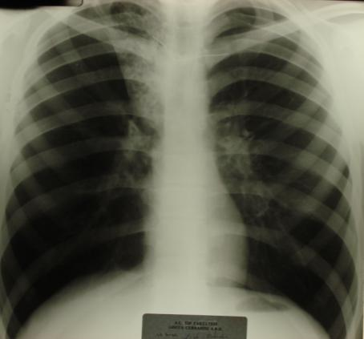
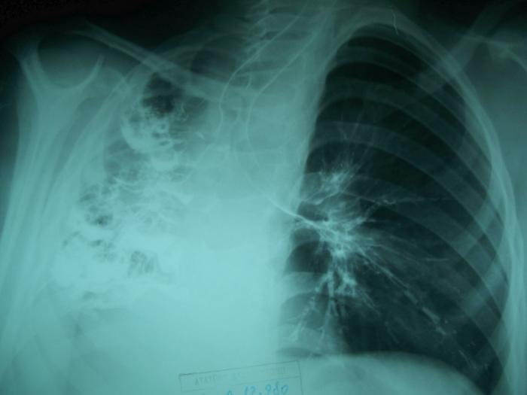
Diagnostics
Bronchiectasis
X-ray

Slide 12
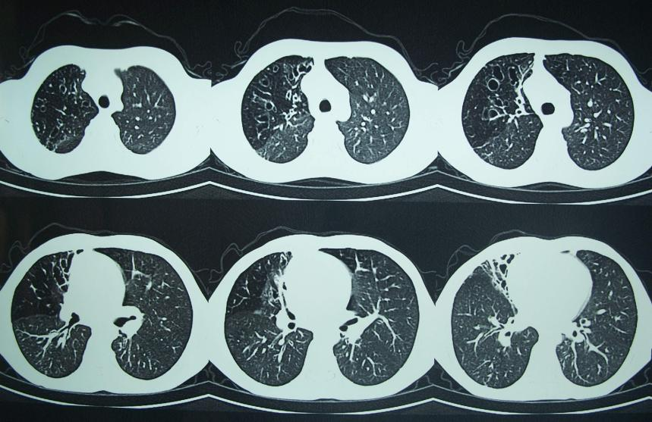
Diagnostics
Bronchiectasis
CT

Slide 13
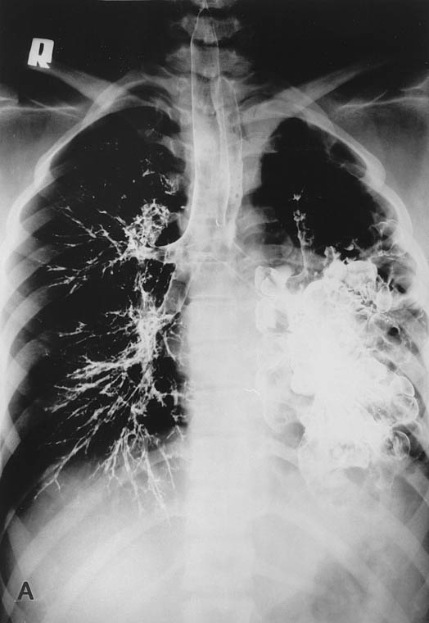
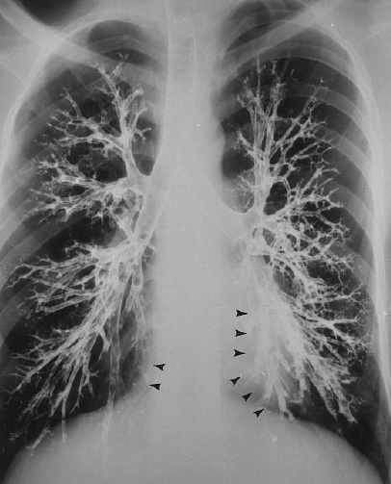
Diagnostics
Bronchiectasis
Bronchography

Slide 14
Treatment
Bronchiectasis
Treatment methods
Conservative
Bronchoscopic events
Surgical
Antibiotic therapy
Mucolytics
Chest Physiotherapy
Bronchodilators
Bronchoscopic sanatation
Lobectomy
Segmentectomy
Pneumectomy
Lung transplantation

Slide 15
Complications
Bronchiectasis
Hemophthysis
Recurring pneumonia
Empyema
Sepsis
Respiratory failure
Pulmonary heart
Amyloidosis

