Slide 1
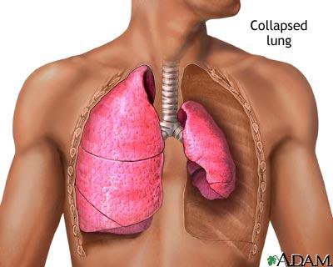
Pnevmotorax

Slide 2
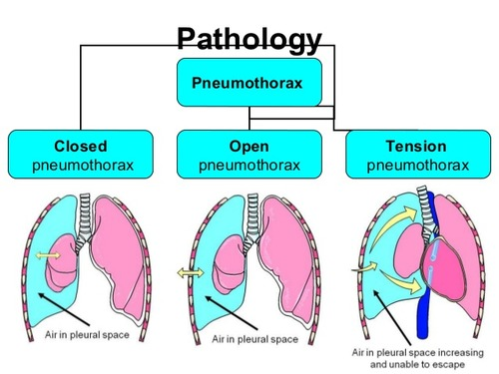
Classification
Due to
• Traumatic
• Spontaneous
Mild
Moderate
Tension

Slide 3
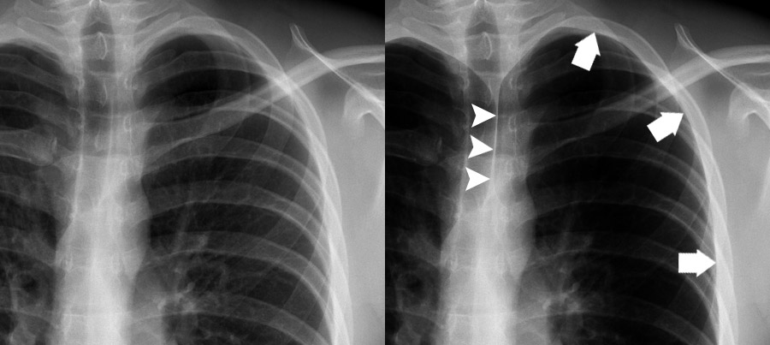
Mild

Slide 4
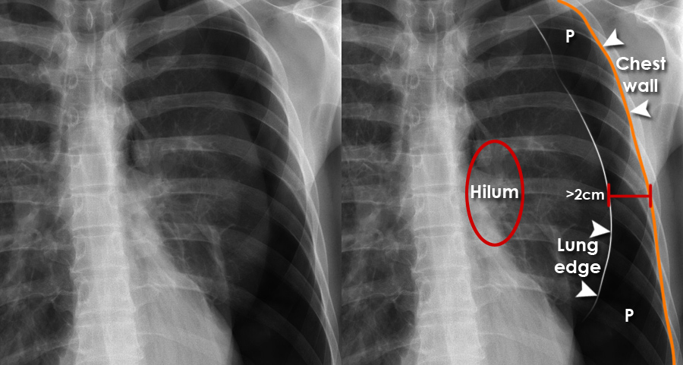
Moderate

Slide 5
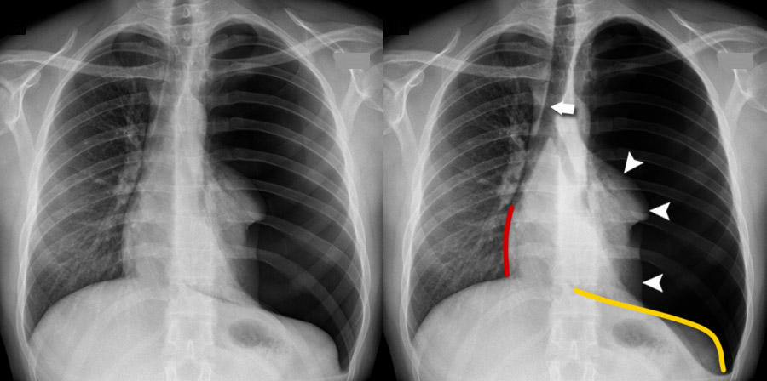
Tension

Slide 6
Iatrogenic pneumothorax
When opening the central vein - subclavian catheterization
Thoracocentesis
During fine needle biopsy
After laparoscopic operations

Slide 7
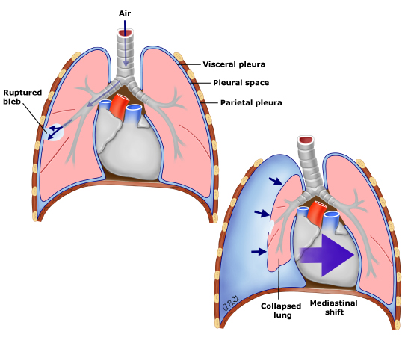
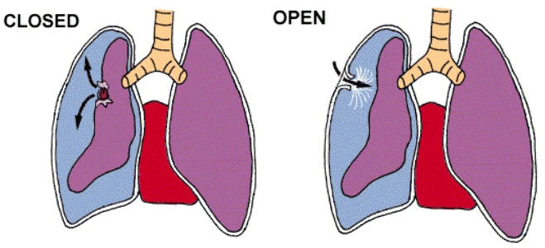
.

Slide 8
Clinical presentation
The pain is noted on the affected side, it gets worse during deep breathing and coughing
Dry cough
Shortness of breath
Cyanosis

Slide 9
Diagnosis
Anamnesis
palpationIn
percussion
auscultation
Chest x-ray
CT

Slide 10
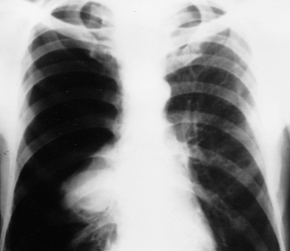
Chest X-ray

Slide 11
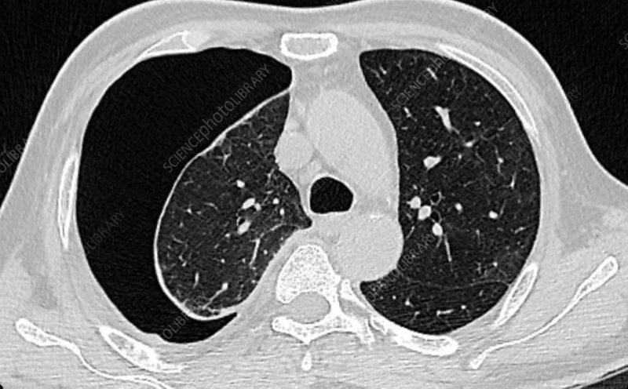
CT

Slide 12
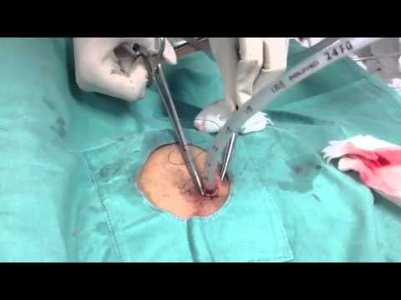
Müalicəsi
Needle aspiration
Drainage of the pleural space
Pleurodesis
Surgical treatment (open or videothoracoscopic)
In traumatic pneumothorax - emergency drainage of the pleural cavity and hermetic closure of the wound.
In tension pneumothorax – urgent needle aspiration and drainage of the pleural space.

Slide 13
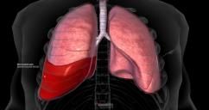
Hemotoraks

Slide 14
Classification
Due to
• Traumatic
• Postoperative
• Malignant tumors
• Lung diseases
severity
Small - at the level of the sinus
Medium –
Large (massive) – causing shock (more than 1500 ml in the first drainage or bleeding more than 200 ml per hour)
\

Slide 15
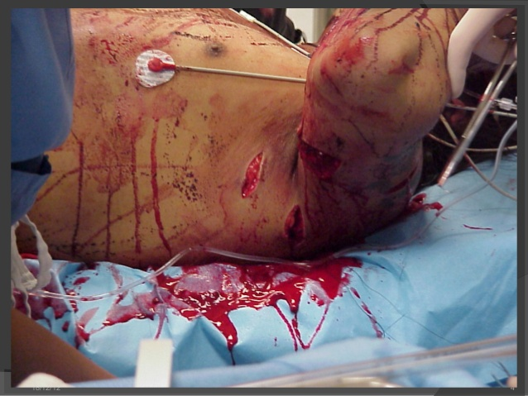
Causes
Traumatic
Open and closed chest injuries
Iatrogenic
Puncture of the subclavian vein
Pleural cavity puncture
During biopsy of pleura and lung
Burst of pulmonary cysts and aneurysm of the aorta

Slide 16
Course
Accumulation of blood in the pleural cavity and its continuation
Lung compression (atelectasis)
Development of shock
Infection of the blood and formation of pyothorax

Slide 17
Clinical presentation
Pain
Shortness of breath
Hemodynamic unstable
Shock
Distended neck veins

Slide 18
Diaqnostikası
X-ray
USG
CT
Tube thoracostomy

Slide 19
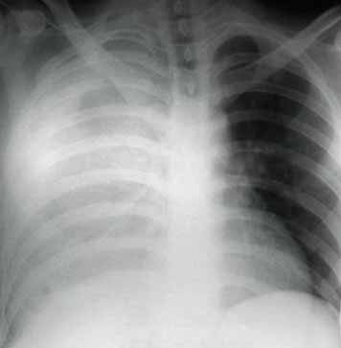
Diagnosis
300-500 ml
1000 ml

Slide 20
Diagnosis

Slide 21
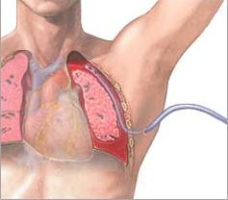
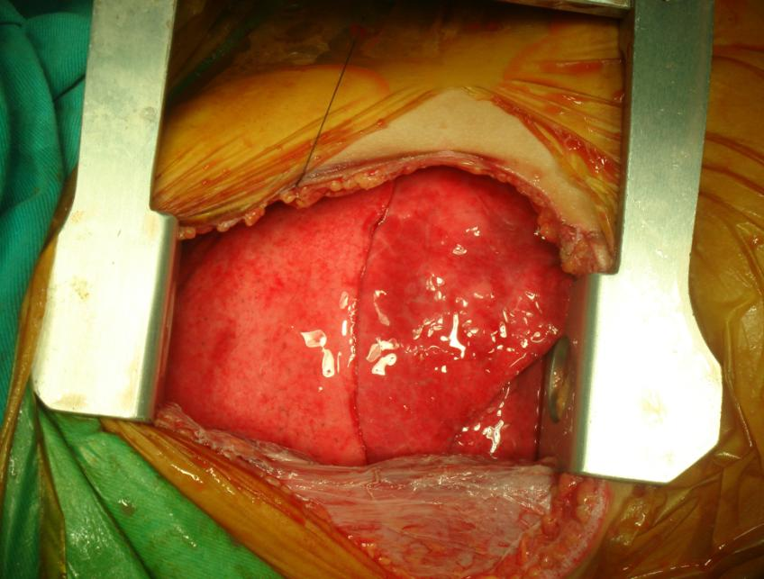
Management
Indication for surgery?
Drenage

Slide 22


www.bck.az
Azərbaycan Tibb Universitetinin I-Cərrahi Xəstəliklər kafedrası

