Slide 1
Pnemothorax, Hemothorax, Chylothorax
Lung abscess
AMU, Department of Surgical Diseases I

Slide 2
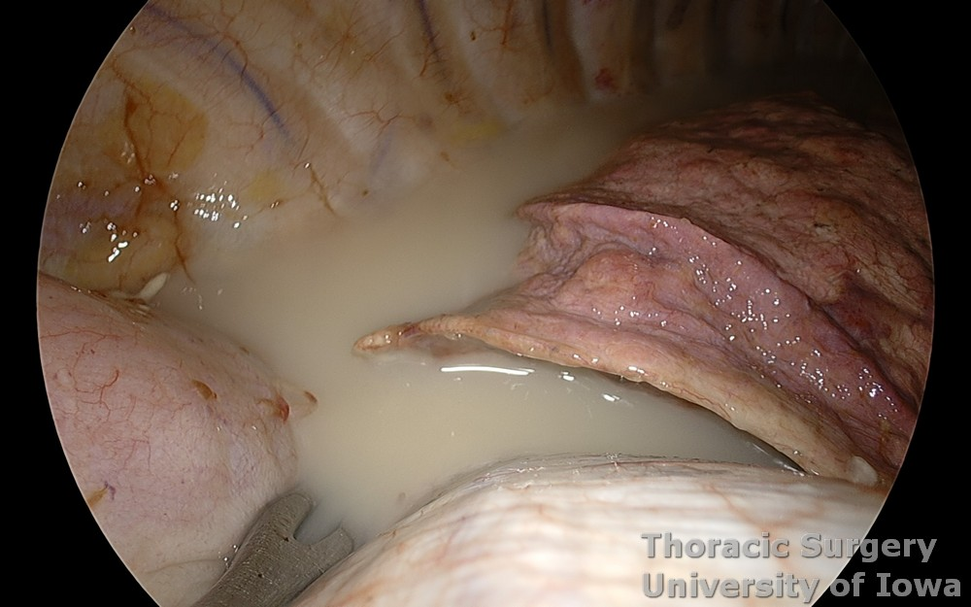
Chylothorax
Lung abscess
A chylothorax is an accumulation of chyle in the pleura. It usually occurs as a result of damage to the lymphatic vessel as a result of trauma or surgery.

Slide 3

Causes
Esophagostomy carries the highest risk of 5% to 10% postoperative chylothorax, followed by lung resection with mediastinal lymph node dissection with 3% to 7% risk. Other surgeries like mediastinal tumor resection, thoracic aneurysm repair, sympathectomy, any surgeries in the lower neck and mediastinum carry a risk of chylothorax

Slide 4
Clinical features
Asymptomatic
Symptomatic
due to mechanical effect of compression on lung expansion
(Progressive breathlessness, decreases exercise capacity; chest pressure)

Slide 5
Evaluation
Chest X-ray-- cannot differentiate chylothorax from other causes of pleural effusion.
USG-- cannot differentiate chylothorax from other causes of pleural effusion.
CT -- scan is more sensitive than chest x-ray and ultrasound for the diagnosis of chylothorax. Routine CT chest can show cisterna chyli in around 2% of cases
MRI-- of the chest can show cisterna chyli in 100% of the cases and can be used for better evaluation of chylothorax

Slide 6
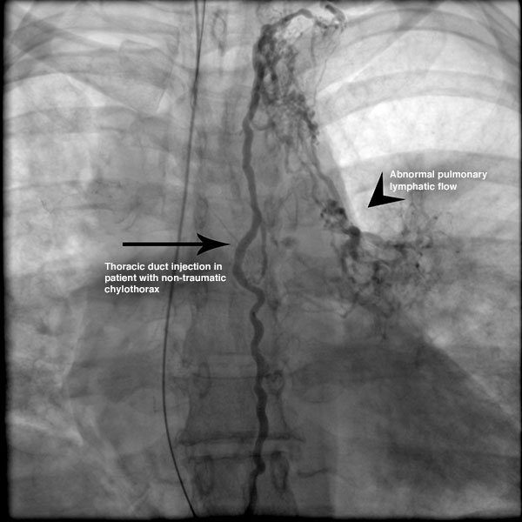
MRI

Slide 7
Management
CHEST TUBE
dietary modification,
pleurodesis, and
thoracic duct ligation.
somatostatin/octreotide, midodrine, and sirolimus to prevent chyle formation.
New surgical techniques - pleurovenous or pleuroperitoneal shunting
and thoracic duct embolization have been used with success

