Slide 1
LUNG HERNİA
(pneumonocele)
Ph.D Mahmudov Mahir
Azerbaijan Medical University
I Surgical Diseases Department

Slide 2
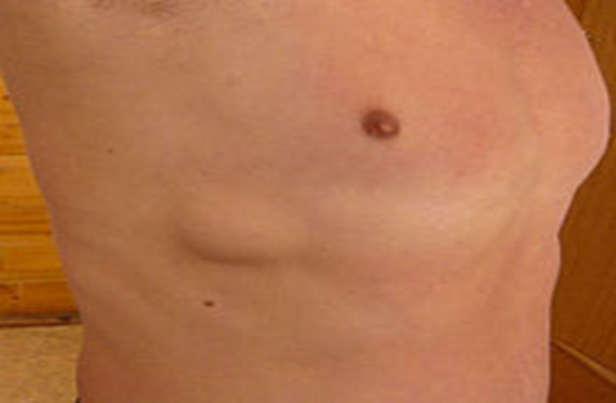
Definition
Lung hernia - is the subcutaneous protrusion of lung tissue from na-tural openings (upper aperture of the chest, diaphragm) or patholo-gical defects in the chest wall.

Slide 3
Classification
TƏSNİFATI
Spontaneous - congenital --20%
Acquired
Post surgery--operation
Post traumatic
After blunt trauma to the chest
After an injury that penetrates the thoracic cavity

Slide 4

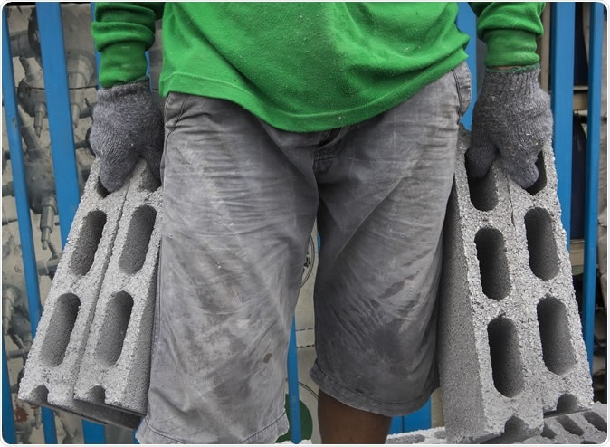
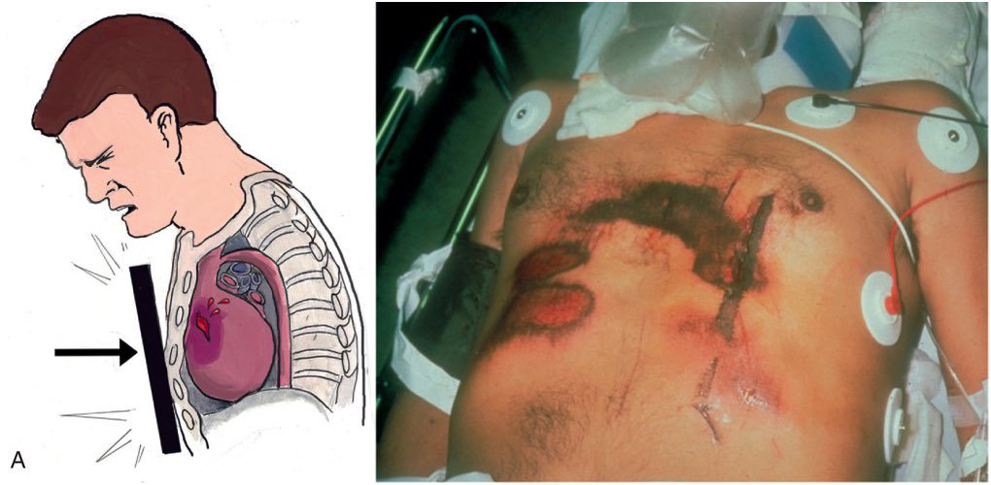
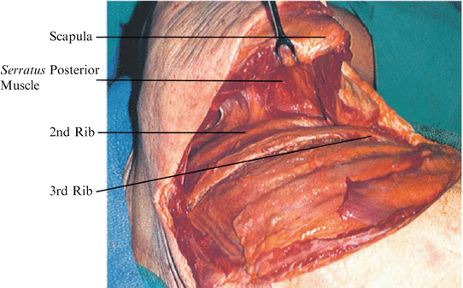
Risk factors
Factors such as:
chronic cough,
steroid use,
hard physical work,
chest trauma,
rib(s) resection contribute to the development of lung hernia.

Slide 5
Clinical presentation
Asymptomatic
Sensitivity in the relevant part of the chest wall
Swelling in the relevant part of the chest wall
Acute pain during inhalation, coughing and sneezing
Difficulty breathing and shortness of breath
Presence of fever
Sometimes fluid accumulates in the pleural cavity

Slide 6
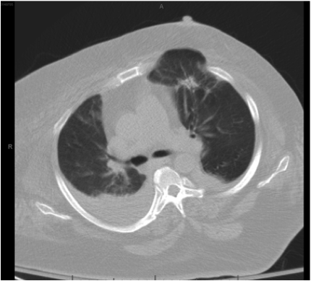
Investications
Clinical examination
Chest Xray
USG
CT

Slide 7
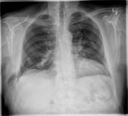
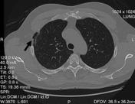
Investigation findings

Slide 8
Diagnostic criteria
the presence of swelling in the chest wall that changes in size with breathing movements or coughing
history of thoracic trauma or thoracic surgery
defect in the chest wall (CT)

Slide 9
The principle of treatment
Conservative treatment is recommended in asymptomatic and mild forms that do not disrupt breathing:
Compression bandage
Analgetic
Antcough medicine

Slide 10
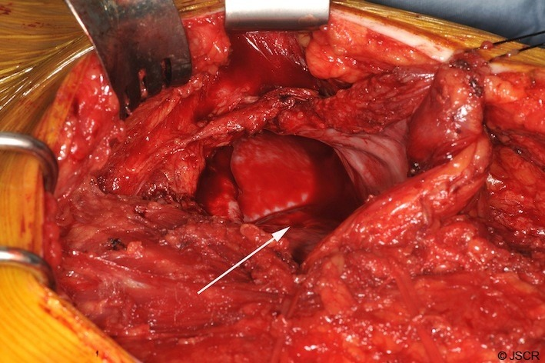
Surgery
Surgery is indicated for severe and large hernias that disrupt breathing.
STAGES:
Cutting of soft tissues up to parietal pleura
Opening of the parietal pleura
Separation of parietal pleura from lung
Application of auto in small defects, auto + alloplasty in large defects

Slide 11
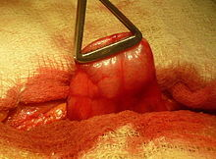
Surgery(hernia contents-lung parenchyma)

Slide 12
Prognosis
Recurrence after surgery is rare
https://youtu.be/NqxKa0dHK5M

Slide 13
Thank you for attention.

Slide 14


www.bck.az
Azərbaycan Tibb Universitetinin I-Cərrahi Xəstəliklər kafedrası

