Slide 1
Heart Transplantation
Heart Transplantation
Ph.D Ruslan Aydın oğlu Məmmədov
AMU, Department of Surgical Diseases I

Slide 2
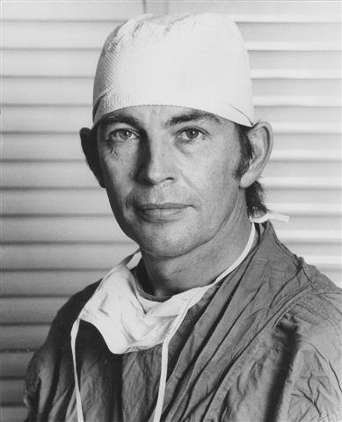
History
Heart Transplantation
The first successful heart transplantation was performed by Cristian Barnard in 1963.

Slide 3
Indications
Heart Transplantation
Most common causes of heart failure requiring transplantation
Dilatation cardiomyopathy 54%
İschemic cardiomyopathy45%
Congenital and others 1%

Slide 4
Contraindications for heart transplantation
Heart Transplantation
General contraindications for surgery and immunosuppression
Specific contraindication - Pulmonary hypertension

Slide 5
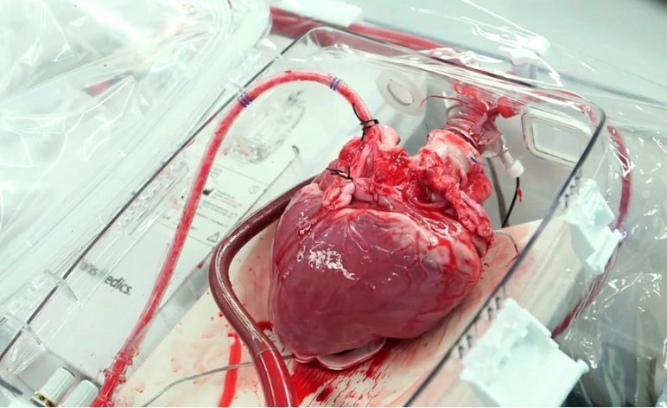
Organ sources
Heart Transplantation
Cadaveric
  Donor after brain death

Slide 6
Preoperative preparation
Heart Transplantation
Organ source of heart transplantation is brain-dead donors. Therefore, treatment methods called ‘bridge therapy’ are used for treatment of heart failure and management of complications during organ waiting time.
Artificial heart pumps
New groups of inotropic drugs

Slide 7
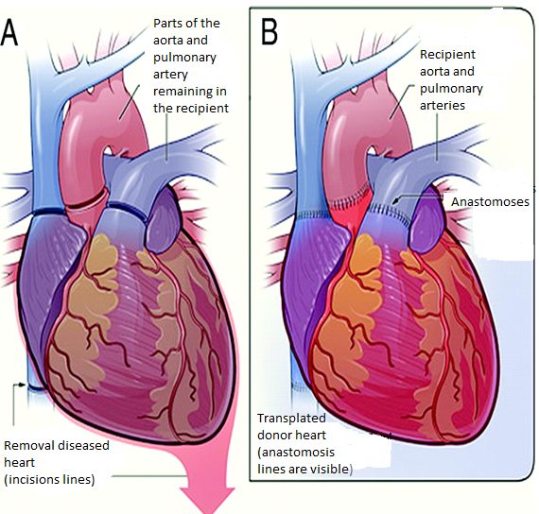
Operation technique
Heart Transplantation
heart is preserved in cardioplegic and heart preservation solutions in cold temperature
the donor heart is removed with the great vessels (aorta, pulmonary artery, superior and inferior vena cava, pulmonary vein)
recipient is connected to a heart-lung machine, and the native heart is removed
Heterotopic (auxiliary) heart transplantation can be used in pulmonary hypertension

Slide 8
Postoperative Treatments
Heart Transplantation
  Calcium levels are a major consideration, as the activity of graft is regulated not by the nervous system but by mechanical (Starling's law) and calcium levels.
  Vasopressors and energetic substances are used
  İnduction immunosuppression is used, and continuous immunosuppression should be started early

Slide 9
Postoperative complications
Heart Transplantation
Rejection
Bleeding from sutures
Infections (CMV, Pneumocyst carinii)
Psychiatric
Acute rejection (within 1 month)
Vascular miointimal hyperplasia in graft

Slide 10
Prognosis
Heart Transplantation
After heart transplantation the 1-year survival rate of patients is 81%, 5-year survival rate of patients is 70%

