Slide 1
Lung abscess
Lung abscess
Professor Saday Agalar oglu Aliyev
AMU, Department of Surgical Diseases I

Slide 2
Definition
Lung abscess
A limited purulent-necrotic process in the lungs is called an abscess, usually manifests itself as a complication of other diseases and, if untreated, has a high mortality rate

Slide 3
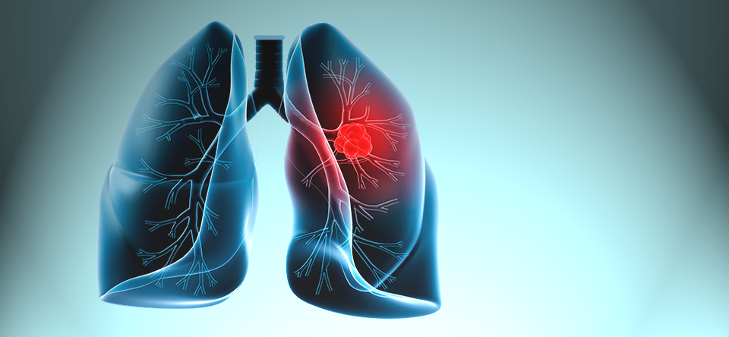
Etiology
Lung abscess
Diseases leading to lung abscess can be divided into 3 groups in accordance with the development mechanism:
Bronchogenic Aspiration
Postpneumonic
Postischemic necrotic
Parapneumonic
Traumatic
Aspiration and bronchial obstruction are the most common causes of lung abscess.

Slide 4
Etiology
Lung abscess
Most often in the formation of lung abscess
mixed microflora is involved
Aerobic Gram-Positive Coccus (S.aureus, Str.pyogenes),
Gram-negative rods (K.pneumoniae, E.coli, Pseudomonas)
Anaerobic microorganisms(Bacteriodes, Peptococci, Peptostreptococci və s.)
In immunosuppressive patients Candida albicans, Legionella, Pneumocystis carinii

Slide 5
Pathogenesis
Lung abscess
Pathogenesis
Necrosis
Progression-aggravation of purulent-necrotic process of the surrounding tissue
Limiting the necrotic area
Sequestration
Abscess
Gangrene

Slide 6
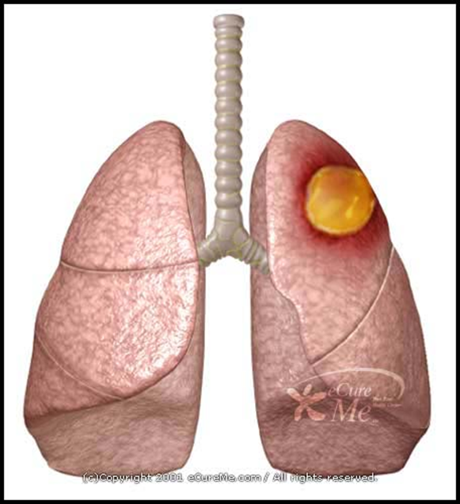
Pathogenesis
Lung abscess
In most cases, the disease is caused by the interaction of three main factors.
1. The presence of an acute inflammatory process in the lungs;
2. Violation of blood circulation and necrosis of the lung tissue;
3. Violation of bronchial conduction in the area of the inflammatory process and necrosis.

Slide 7
Pathogenesis
Lung abscess
A purulent focus can have several consequences:
An abscess can resolve with antibiotics (usually small abscesses)
An abscess can open in the bronchi and pleura
An abscess can cause complications.
A fibrous capsule may develop around the abscess, and a chronic abscess may occur.
Mortality is 5-20%, while in immunosuppressive ones it reaches 28%.

Slide 8
Complications
Lung abscess
The body's response to inflammation-SİRS, septic shock
Organ failure
In abscesses opening in the bronchi - aspiration pneumonia, (on that and the opposite side), bleeding
In abscesses opening into the pleural cavity - purulent pleuritis, pyopneumothorax
In chronic abscesses - malnutrition, cachexia, recurrent complications, amyloidosis
Bleeding

Slide 9
Lung abscess
Bronchogenic
Aspiration reasons
Pristemic and
Postnecrotic causes
Pneumonia
Necrosis and pneumonia
Joining purulent infection
Lung abscess
Resorption
antibiotic therapy
Fibrous wall
chronic abscess
Open into the bronchus
Open into the pleura
Purulent pleuritis
Pyopneumatic
Sepsis
Aspiration pneumonia
Bleeding
Sepsis
Cachexia
Malnutrition
Amyloidosis

Slide 10
Clinic
Lung abscess
Depending on the stage and phase of the pulmonary abscess, several clinical forms may occur:
-Pneumonia
-Signs of opening in the bronchi
-Open in a singer
-Chronic abscess

Slide 11
Diagnostics
Lung abscess
Suspicion
In all patients with pneumonia, purulent pleurisy, at the same time in the following diseases, accompanied by cough, shortness of breath, chest pain and signs of SİRS:
  Bronchogenic masses and lung cancer
  aspiration (foreign body, vomit, etc.)
  hematoptis
  Pulmonary infarction
  pulmonary contusion
  sepsis of other origin (hematogenous emboli)
  immunosuppressive patients
  other

Slide 12
Diagnostics
Lung abscess
Clarification
Diagnostic signs of lung abscesses:
Clinically Signs of Inflammation and SİRS
On CT, the characteristic signs of an abscess are:
Necrosis area
Air-liquid level
Forming cavity

Slide 13
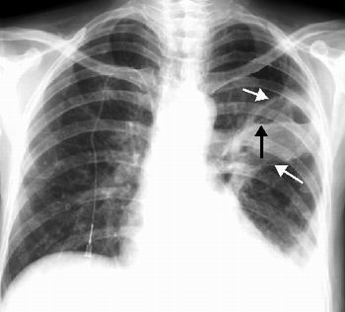
X-ray Abscess
Lung abscess
Front and side projection

Slide 14
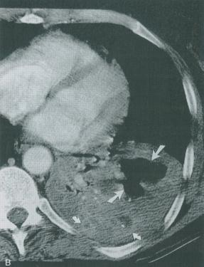
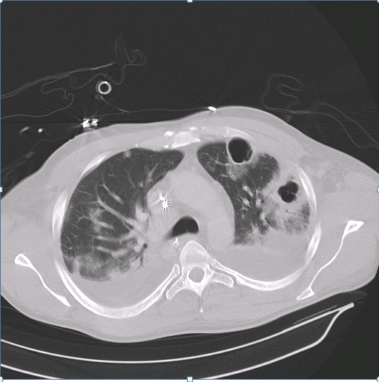
CТ
Lung abscess

Slide 15
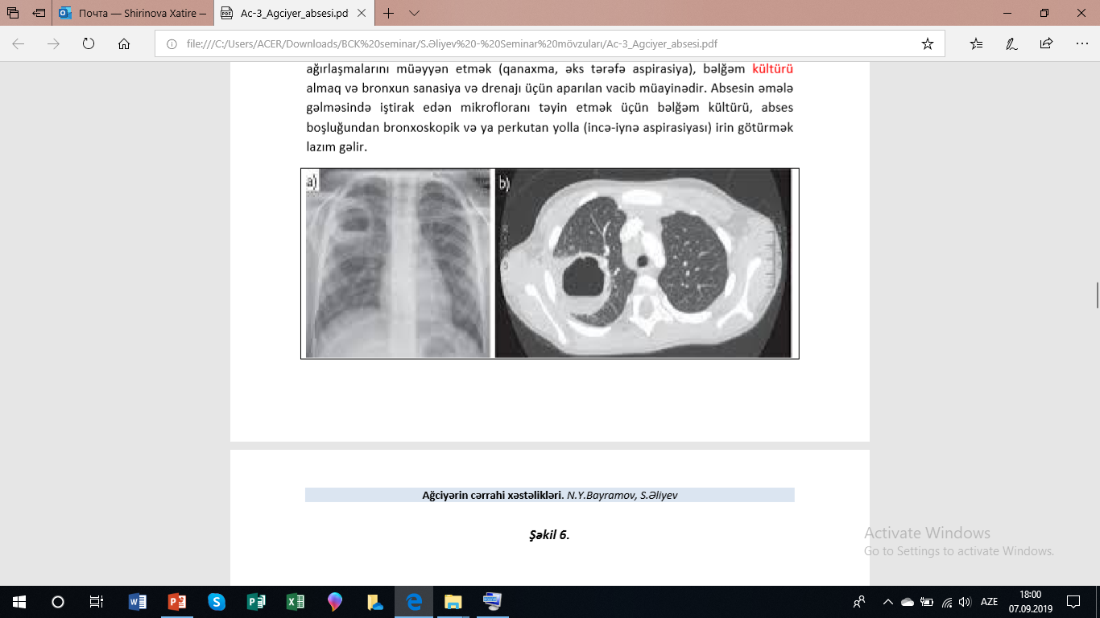
Lung abscess

Slide 16
Diagnostics
Lung abscess
Establishment of the cause and complications
-Clinical and anamnestic signs
-CT
-Bronchoscopy
-Bacteriological examination of sputum

Slide 17
Diagnostics
Lung abscess
Differential diagnosis
Lung gangrene
Pulmonary tuberculosis
Parasitic lung cysts
Lungs' cancer

Slide 18
Treatment
Lung abscess
Principle
“Classic 4 principles”
-Antibiotic therapy
-Maintenance therapy for sepsis
-Elimination of the cause
-Removal of purulent-necrotic tissue (sanation and drainage)

Slide 19
Treatment
Lung abscess
Treatment Methods - Conservative
-Antibiotic therapy
-Maintenance therapy for sepsis
-Bronchoscopic and percutaneous drainage

Slide 20
Treatment
Lung abscess
Treatment Methods – Surgical
When do they spend?
-Massive bleeding
-Abscess Resectable Cancer
-Purulent pleurisy, pyopneumatorax
-Conservative and non-draining abscess

Slide 21
Lung abscess
Lung abscess
Antibiotic therapy and maintenance therapy (48-72 hours)
Bronchoscopy, sanitation and culture
There is an improvement
No improvement
Continue 2 weeks
then 3-5 months orally
antibiotic
Percutaneous drainage
Percutaneous drainage is not effective
Pyopneumothorax
Massive bleeding
Resectable tumor
Lobectomy

