Slide 1
Pancreatic islests disease. Insulinoma. Gastrinoma.
Pancreatic diseases
PhD Taryel I.Omarov
Dr. Mehriban R. Huseynova
AMU, I surgical diseases department

Slide 2
Classification
Pancreatic diseases
Primary
Epithelial
Metastatic
Breast glands
Ductal adenocarcinomas
Acinar adenocarcinomas
Cystadenocarcinoma
Adenomas
Cystadenoma
Islet tumors
Malignant
Benign
Hormonally active
Hormonally inactive
Mesenchymal
Lymphoma
Lypoma
Lungs
Melanoma
Ovaries

Slide 3
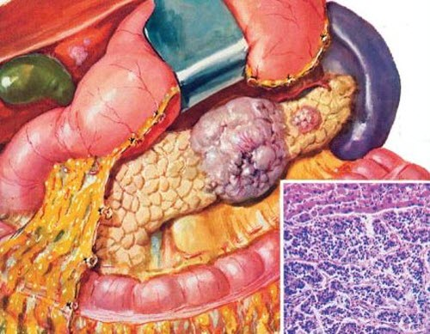
Anatomy, physiology
Pancreatic islets diseases
  Pancreatic islets are cells of neuroendocrine origin, located diffusely in parenchyme with total weight of 1 g.
  Islets are composed of these cells:
    A cells - glucagon.
    B cells - insulin.
    D cells - somatostatin.
    F cells – pancreatic polypeptide.
    D2 cells – vasoactive intestinal peptide.
    ЕC cells - sеrotonine.

Slide 4
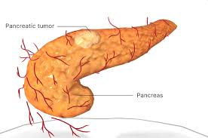
Morphology
Pancreatic islets diseases
Insulinoma
Gastrinoma
VIP-oma
Glucagonoma
Somatostatinoma
PP-oma
Islet tumors
Functional
Non-active
Metastasis?
Malignant
Active
Benign
Occurence
Sporadic
MEN1
Tumor
Pancreas
>50-60%
PP-oma (80%)
Gastrinoma (25%)
Insulinoma

Slide 5
Clinics
Pancreatic islets diseases
Insulinoma
hypoglycemia
Gastrinoma
ulcers, gastric hyposecretion, diarrhea
Glucagonoma
diabеtes, anеmia, nеcrolithic anеmia
Somatostatinoma
Diabеtes, gallbladder stones, steathorrea
VIP-oma
sеcrеtory diarrhea
Inactive tumors
Mass effect

Slide 6

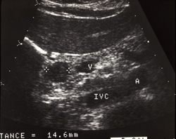
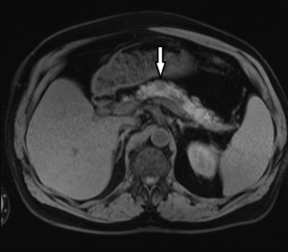
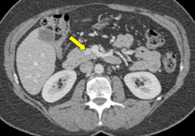
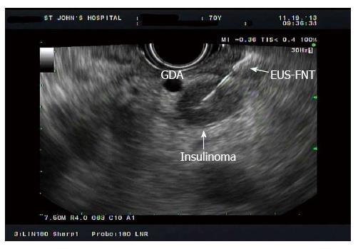
Diagnostics
Pancreatic islets diseases
Functional tumors
Type
Place
Blood hormone levels
Stimulation tests- sеcrеtin tеst, sеcrеtin+calcium tеst.
US
CT or MRI
еndoscopic US
angiography

Slide 7
Treatment
Pancreatic islets diseases
Main
Chemical therapy
Symptomatic
Radical operation
Mass-diminishing operation
Somatostatin
Diazoxyde (insulinomas)
Strеptazosin doksorubsin
İnterferon
In insulinomas – glucose,
Gastrinomas – proton pump inhibitors, nasogastric tube,
Glucagonomas – aminoacid,
VIP-omas– water-electric balance infusion

Slide 8
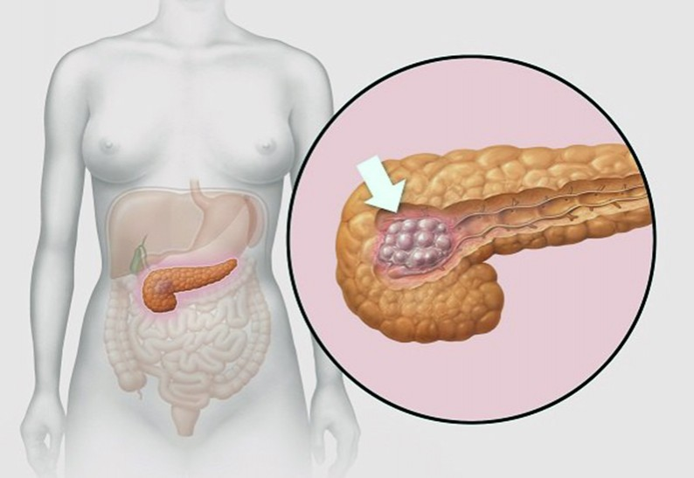
Abstract
Insulinoma
An insulinoma is a tumor of the pancreas that is derived from beta cells and secretes insulin. It is a rare form of a neuroendocrine tumor. Most insulinomas are benign in that they grow exclusively at their origin within the pancreas, but a minority metastasize. Insulinomas are one of the functional pancreatic neuroendocrine tumor (PNET) group ("functional" because it increases production of insulin). In the Medical Subject Headings classification, insulinoma is the only subtype of "islet cell adenoma“.
90%

Slide 9
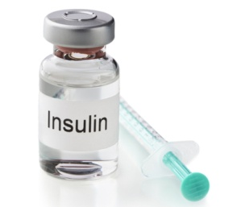
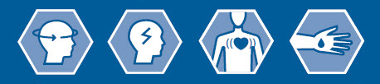

Pathophysiology
Insulinoma
Insulinoma
Insulin ⇧
Glycogen synthesis⇧
Hypoglycemia
Neuroglucopenia
Sympathetic hypertonus
Coma

Slide 10
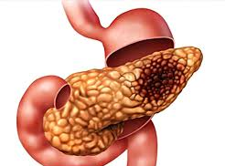
Morphology
İnsulinoma
80% Benign
10% Malignant
10%
MEN1

Slide 11

Clinics
Insulinoma
Cold sweat
Weakness
Dizziness
Nervousness
Hunger
Drowsiness

Slide 12
Diagnostics
Insulinoma
Exogenous insulin
Diabetic drugs–
Autoimmune non-insulinoma
Non – Insulinoma pancreatogenic hypoglycemia syndrome (islet hypertrophy)
Suspicion
Clarification
Differentiation
Localization
Hypoglycemic signs
Blood glucose <50 mg/dL
Contrast CT/MRI Endoscopic US
PET-CT
Portal vein catheterization
Octreotide scyncytography
Intraoperational palpation and US
Wipple triad
Insulin increase (before food >5 μTV/mL)
Denial of insulinemia and insulinomic hypoglycemia

Slide 13
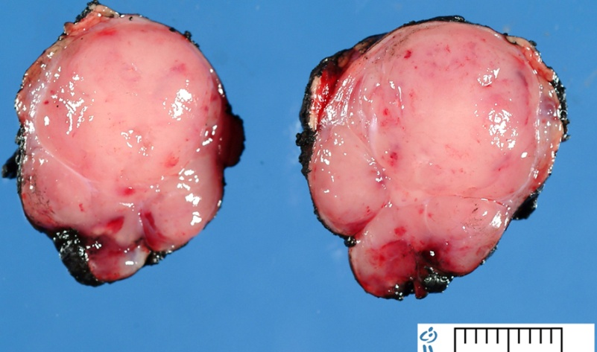
Treatment
Insulinoma
Prophylaxis
Main
Palliative
Frequent meal consumption
Glucose infusion
Enucleation
Resection
Diazooksid
Streptazosin
Somatostatin

Slide 14
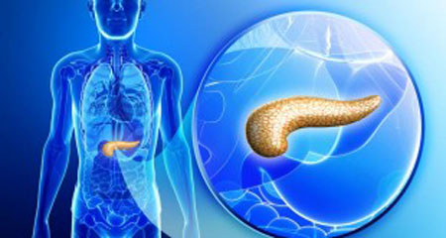
Abstract
Gastrinoma
A gastrinoma is a tumor derived from G cells in the duodenum, pancreas or less commonly stomach, that secretes the peptide hormone gastrin. There is hypersecretion of HCl acid into the duodenum, which causes the ulcers. Excessive HCl acid production also causes hyperperistalsis, and inhibits the activity of lipase, causing severe diarrhea.

Slide 15
Pathophysiology
Gastrinoma
G cells
Gastrin
Peptic ulcers in stomach, duodenum, proximal small intestine
Secretory diarrhea
Hypersecretion

Slide 16
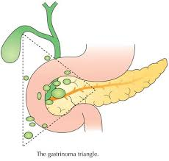
Pathomorphology
Gastrinoma
Small size (microadenoma) or more than 3 cm
Redness
Colored hard elactic tumor.
Localization – Whipple area
25% with MEN
⅔ of gastrinomas are malignant (metastasis)

Slide 17
Clinics
Gastrinoma
Pain
Duodenal ulcer
Hyperacidic gastritis
Secretory diarrhea

Slide 18
Diagnostics
Gastrinoma
Suspicion
- Non-curable and ulcer after treatment
Clarification
- Pain, duodenal ulcer, hyperacidic gastritis, secretory diarrhea
Localization
- Contrast CT,
- MRI,
- endoscopic US,
- isotope diagnostics with secretin receptor
- Intraoperational US
- Postbulbar ulcers
- Anastomotical ulcers
- Disobeying diarrhea
- Parathyroid adenoma (hypercalcemia)
- Stomach acid secretion(basal secretion >15 mEg/h)
- Hypergastrinemia (>100 pg/mL)

Slide 19
Treatment
Gastrinoma
Radical treatment
Chemotherapy
Mass diminishing surgery
Gastrectomy
Antisecretorial drugs

