Slide 1
Solitary pulmonary nodule
Solitary pulmonary nodule
Professor Saday Agalar oglu Aliyev
AMU, Department of Surgical Diseases I

Slide 2
Definition
Solitary pulmonary nodule
A chest disease, is a disease that is accidentally detected during an x-ray. These oval formations of 3 cm or less are easily distinguished from lung tissue

Slide 3
Classification
Solitary pulmonary nodule
Neoplasia | Inflammatory granuloma | Infectious nodes | Malformation
Hemangioma | Tuberculosis granuloma | Echinococcus granulosus | Bronchogenic cysts
Hamartoma | Histoplasma | Ascaris lumbricoides | Teratoma
Timoma | Mycetoma | Dirofilaria immitis | Vascular endothelioma
Myxoma | Massive fibrosis | Tuberculosis | Arteriovenous malformation
Myoblastoma | Lipoid pneumonia
Plasmacytoma | Cryptococcus
 | Rheumatoid arthritis
Prof.Dr. Saday Ağalar oğlu Əliyev

Slide 4
Clinic
Solitary pulmonary nodule
Patient age, smoking, and cancer in other organs are major risk factors
Asymptomatic disease. If there is a history of cancer of another organ, the risk of malignancy of the node increases
50-year-old women additionally undergo mammography, gynecological examination, CEA level; in men, prostate specific antigen and CEA level

Slide 5
Diagnostics
Solitary pulmonary nodule
Symptoms of malignant single node
More than 2cm
Increase over the last 2 years
rough edges
Lack of calcification
Signs of a benign single node
Less than 2 cm
No signs of increase over the past 2 years
The presence of calcification.
Symptom of the target, symptom of popcorn
Target Symptom

Slide 6
Diagnostics
Solitary pulmonary nodule
On CT localization and stage of calcification are revealed. Central calcification indicates good quality
Syringe
Biopsy needle
Outer matrix
Skin
PET –90% informative when determining benign or malignant process
Subcutaneous tissue
Muscle
rib
Parietal pleura
Visceral pleura
Biopsy - reliability with epithelial cells 90%, adenocarcinomas 70%, large cell carcinoma 50%, small cell carcinoma 100%
Biopsy needle
Lesion
Lung

Slide 7
Diagnostics
Solitary pulmonary nodule
X-Ray

Slide 8
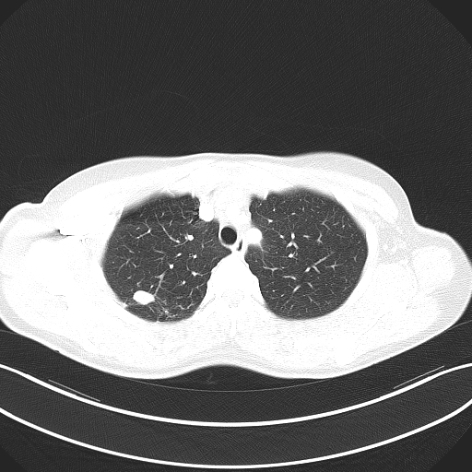
Diagnostics
Solitary pulmonary nodule
CT

Slide 9
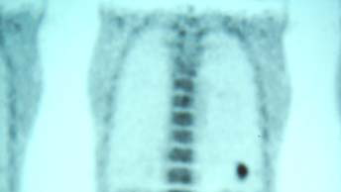
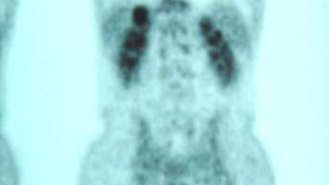
Diagnostics
Solitary pulmonary nodule
PET-CT

Slide 10
Treatment
Solitary pulmonary nodule
Treatment methods
Malignant
Benign
Segmental or lobar resection
Observation or resection

