Slide 1
Surgical diseases of Esophagus
Surgical diseases of
Esophagus
PhD. Mahir Mahmudov
Azerbaijan Medical University
I Surgical Diseases Department

Slide 2
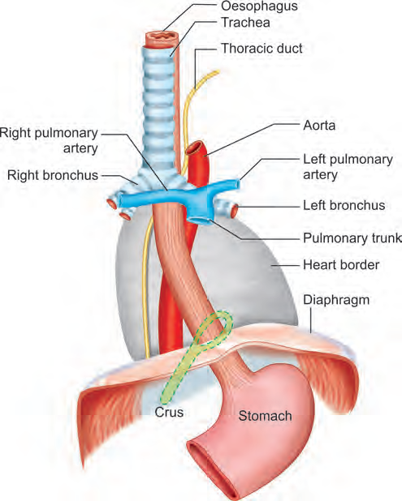
Anatomy
Surgical diseases of
Esophagus
The esophagus is a muscular tube that connects the pharynx (throat) with the stomach. The esophagus lies between the trachea (windpipe) and the spine (C₆-Th₁₁). It passes down the neck, pierces the diaphragm just to the left of the midline, and joins the cardiac (upper) end of the stomach. In an adult, the esophagus is about 25 centimeters (10 inches) long.
PhD. Mahir Mahmudov

Slide 3
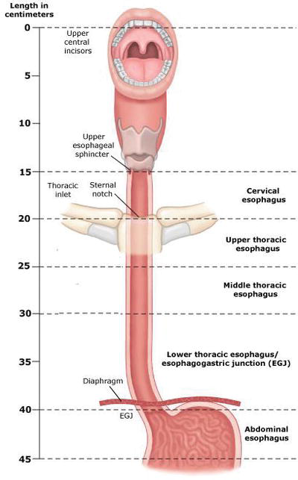
Anatomy
Surgical diseases of
Esophagus
Dimensions
From the anterior edges of the upper incisors to the upper esophageal sphincter 15-20 cm
up to gastroesophageal junction 40-45 cm
3 parts:
Cervical
Thoracic
Abdominal
PhD. Mahir Mahmudov

Slide 4
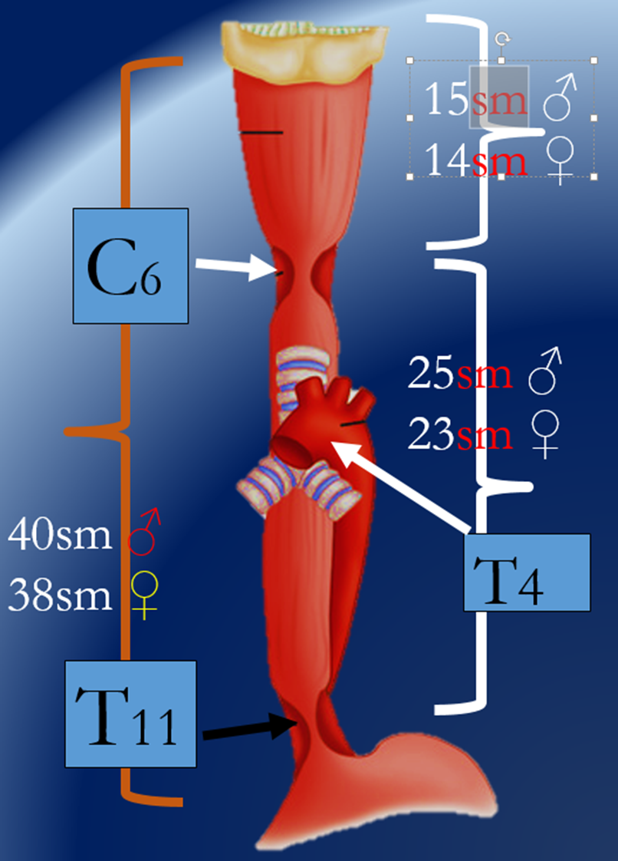
Anatomy
Surgical diseases of
Esophagus
3 physiological constrictions:
Upper
Medium
Lower
PhD. Mahir Mahmudov

Slide 5
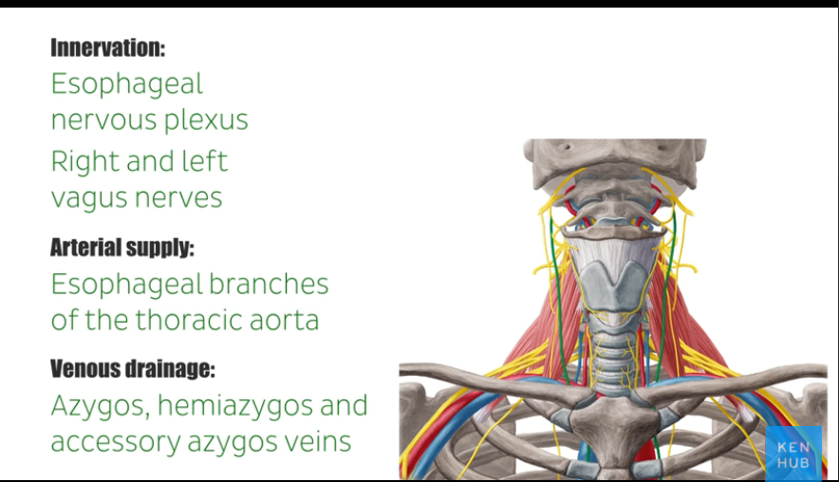
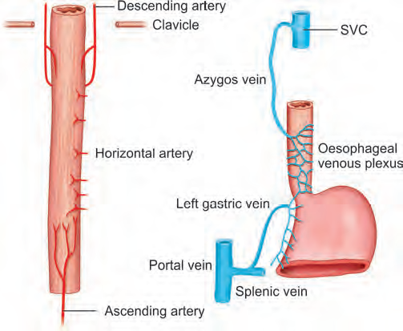
Anatomy
Surgical diseases of
Esophagus
PhD. Mahir Mahmudov

Slide 6
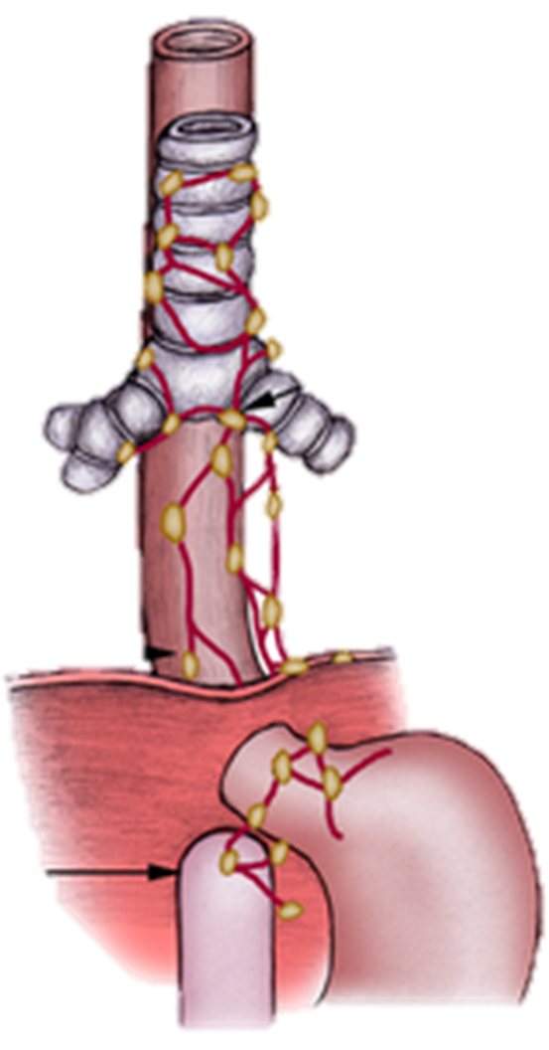
Anatomy
Surgical diseases of
Esophagus
Lymphatic drainage
Cervical part - paratracheal and deep cervical lymph nodes,
Upper chest - paratracheal lymph nodes,
Lower chest - to the lymph nodes around the bifurcation,
Abdominal part - flows to the lymph nodes of the upper stomach.
PhD. Mahir Mahmudov

Slide 7
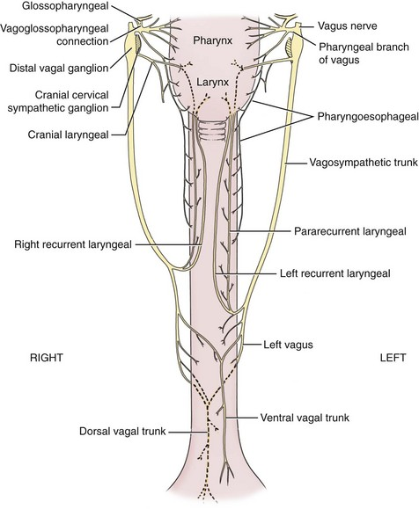
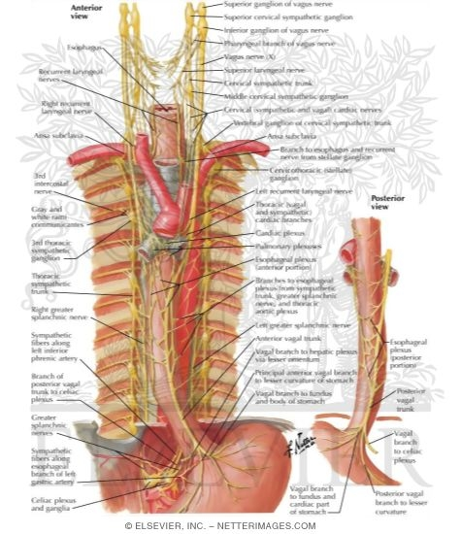
Innervation of esophagus
PhD. Mahir Mahmudov

Slide 8
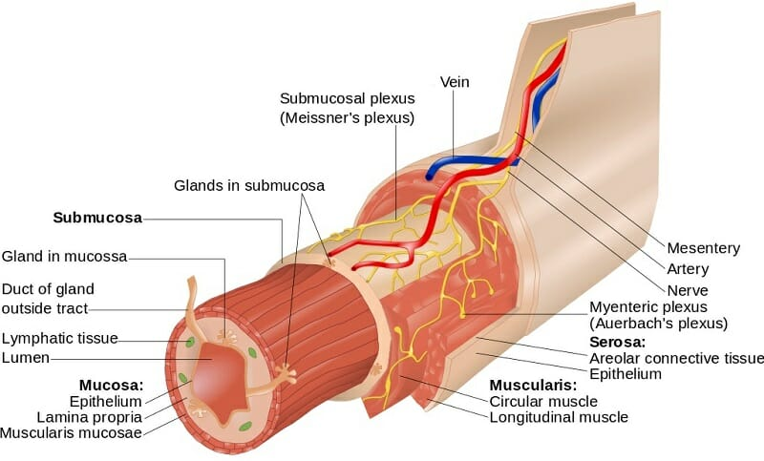
Layers
Surgical diseases of
Esophagus
Mucosa
Submucosa
Circular muscle layer
Longitudinal muscle layer
Adventitia.
PhD. Mahir Mahmudov

Slide 9
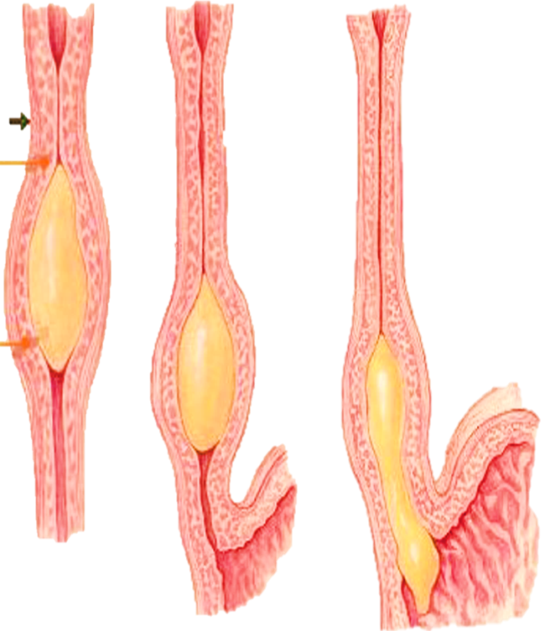
Phyziology
Surgical diseases of
Esophagus
functions:
Swallowing
Anti reflux
Secretion
PhD. Mahir Mahmudov

Slide 10
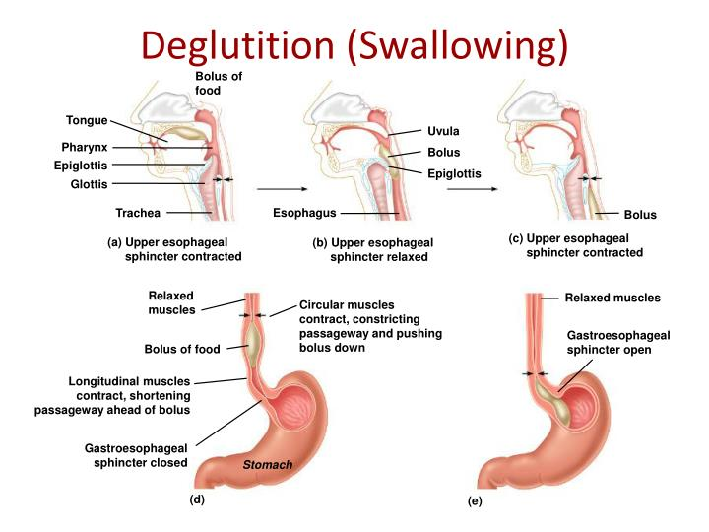
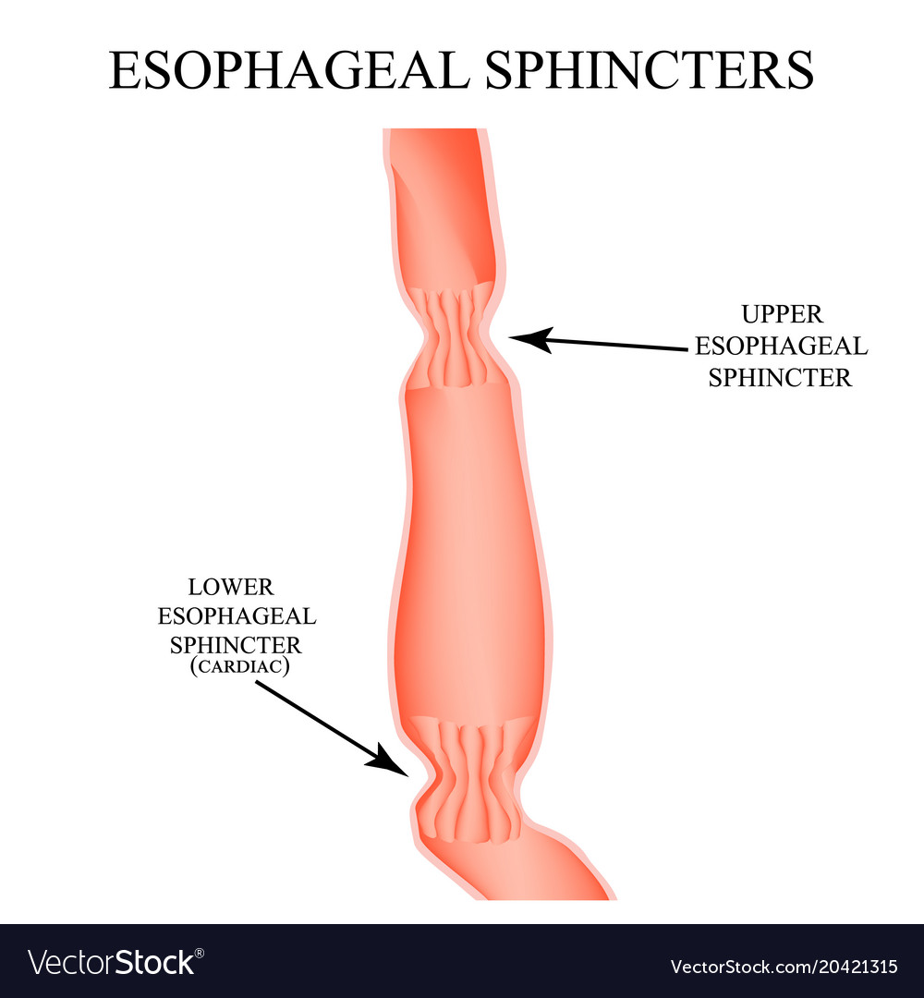
Esophageal sphincters
Surgical diseases of
Esophagus
PhD. Mahir Mahmudov

Slide 11
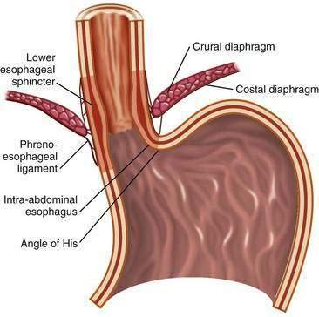
Anti-reflux mechanisms
Surgical diseases of
Esophagus
PhD. Mahir Mahmudov

Slide 12
Esophagus Secretion
Surgical diseases of
Esophagus
Mucus is the only secretion produced by the esophagus
Lubrication which facilitate passage of bolus along its length
PhD. Mahir Mahmudov

Slide 13
Examination methods
Surgical diseases of
Esophagus
Clinical examinations
Laboratory tests
Instrumental (visualization) methods
Biopsy
PhD. Mahir Mahmudov

Slide 14

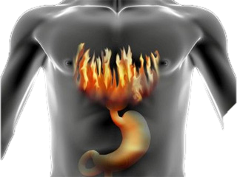
CLINICAL PRESENTATION AND SIGNS
Surgical diseases of
Esophagus
Dysphagia
Odinophagy
Heartburn
Regurgitation
Bleeding—bloody vomiting
Atypical symptoms (cough, chest pain, voice change)
PhD. Mahir Mahmudov

Slide 15

Diagnostic approach
Surgical diseases of
Esophagus
The basic principle
When diseases of esophagus are suspected, organic diseases should be investigated first, followed by functional diseases
PhD. Mahir Mahmudov

Slide 16
Principles of diagnostics
Surgical diseases of
Esophagus
  Dysphagia, heartburn, regurgitation, odino phagia, bloody vomiting, cough, chest pain
SUSPECTED OESOPHAGAL DISEASE
PRIMARY SURVEY METHODS
Extensive clinical examination, Endoscopy ± biopsy
I
II
III
IV
Emergency
disease
There are organic changes, the diagnosis is being clarified
There are organic changes, the diagnosis is not specified
No organic changes, there is a suspicion
PhD. Mahir Mahmudov

Slide 17
DIAGNOSTIC EVALUATION OF THE ESOPHAGUS
Surgical diseases of
Esophagus
Contrast rentgenography
Endoscopy
Endoscopic ultrasonography
CT
MRI
PET
Laparoscopy and thoracoscopy
Functional examinations (manometry, pH-meter, impedancemetry, biopsy, etc.)
PhD. Mahir Mahmudov

Slide 18
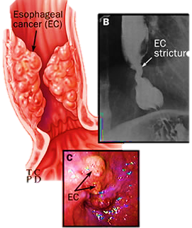
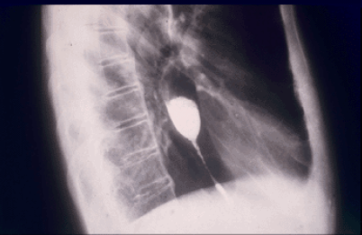
Kontrast X-ray
Surgical diseases of
Esophagus
PhD. Mahir Mahmudov

Slide 19
Esophageal manometry
Surgical diseases of
Esophagus
PhD. Mahir Mahmudov

Slide 20
24-Hour pH monitoring
Surgical diseases of
Esophagus
PhD. Mahir Mahmudov

Slide 21
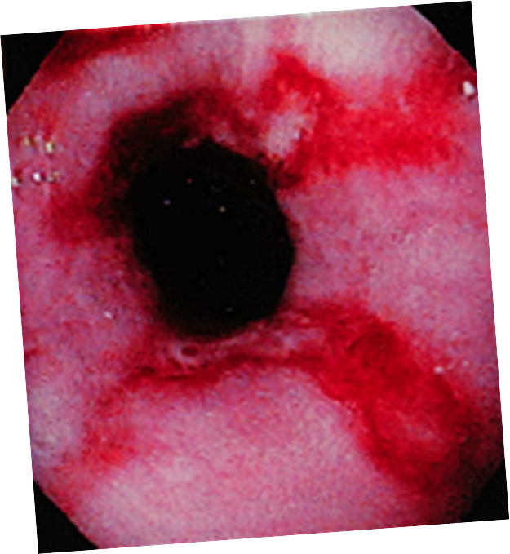
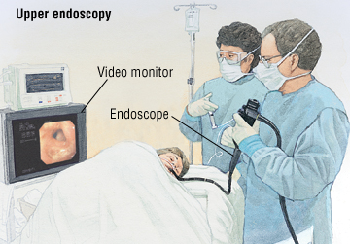
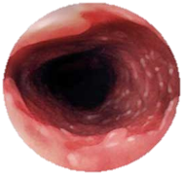
Endocopy
Surgical diseases of
Esophagus
Linear ulcers
Barret
PhD. Mahir Mahmudov

Slide 22
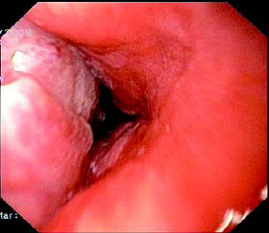
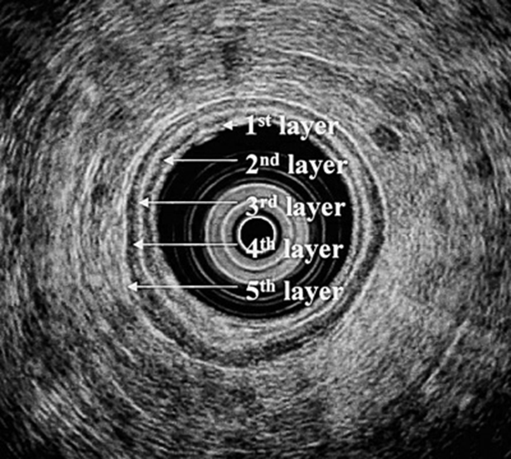
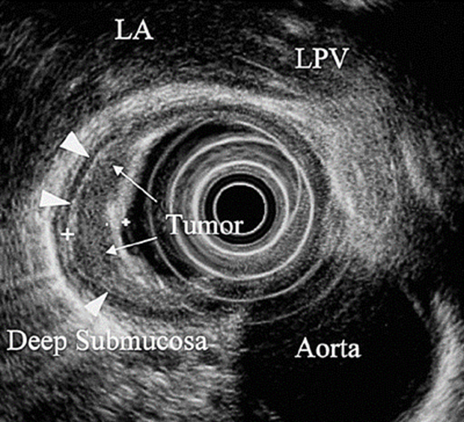
Endoscopic Ultrasound
Surgical diseases of
Esophagus
Assesses the degree of invasion into the wall and the composition of the tumors
Normal
Adenocarcinoma
PhD. Mahir Mahmudov

Slide 23
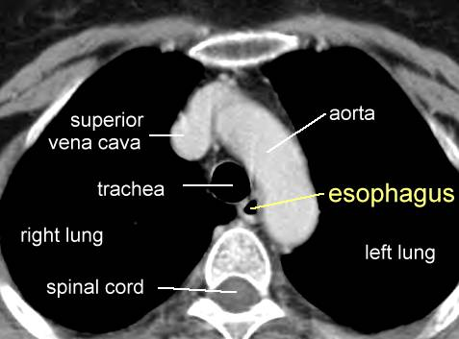
CT
Surgical diseases of
Esophagus
Conducted to assess the dissemination of tumors to surrounding organs, invasion, extravasation
PhD. Mahir Mahmudov

Slide 24
Surgical operations
Surgical diseases of
Esophagus
Balloon dilatation
Fundoplication
Endoscopic mucosectomy
Endoscopic application
Resection
Total esophageectomy and plastic surgery (Lewis and Herlock)
Diverticulectomy
Stenting
Banding of bleeding venous vessels
PhD. Mahir Mahmudov

Slide 25
Complications after surgery
Surgical diseases of
Esophagus
Bleeding
Anastomosis failure
Mediastinitis
Strictur (s)
Fistula (s)
PhD. Mahir Mahmudov

Slide 26
Surgical diseases of
Esophagus
THANK YOU FOR ATTENTION
PhD. Mahir Mahmudov

