Slide 1
Benign and malign neoplasms of stomach
Benign and malign
neoplasms of stomach
Ph.D
Mahir Gümrah oğlu Mahmudov
AMU, Departament of I Surgical Diseases

Slide 2
Classification
Benign and malign
neoplasms of stomach
Epithelial
Adenomas
Adenocarci-nomas
Lymphomas
Primary lymphoma (MALT lymphoma, diffuse B-lymphoma)
Secondary lymphoma
Mezenchymal
Leiomyoma
Gastrointestinal stromal tumors (GIST)
Leiomyosar-coma
on histologic features

Slide 3
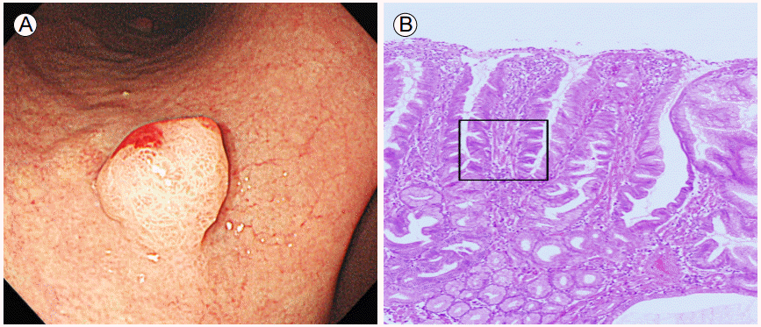
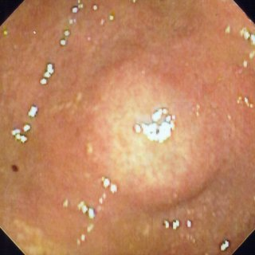
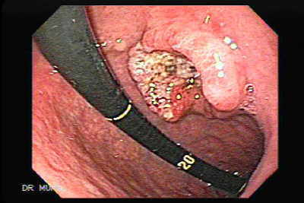
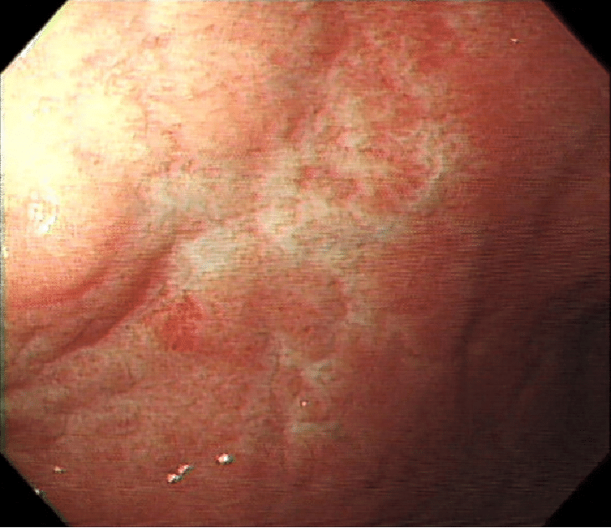
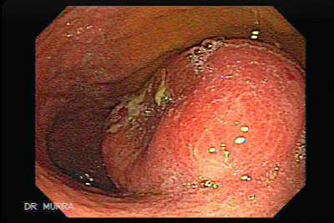
Classification
Benign and malign
neoplasms of stomach
According to progress
benign
Adenomatous polyps
lipoma
malign
Adenocarci-noma (95%)
intermediate
Lymphoma
(3-5%)
GIST (1-5%)
Leiomyosar-coma
Neuroendo-crinomas

Slide 4
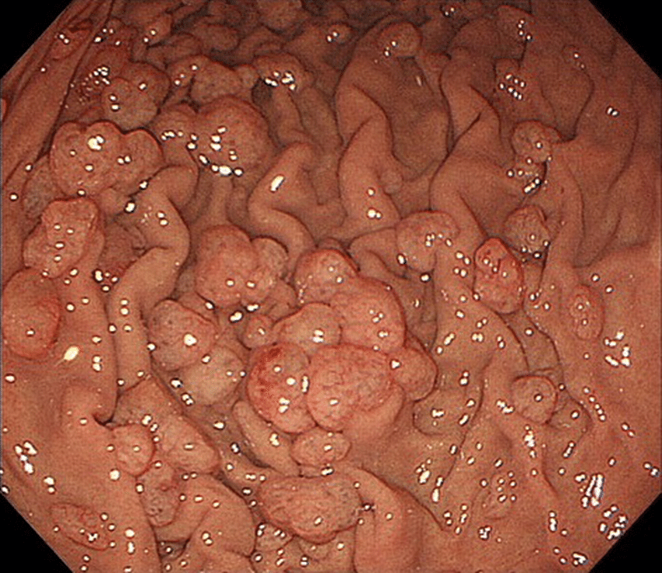
Gastric polyps
Benign and malign
neoplasms of stomach
Neoplastic and non-neoplastic derivatives, growing from the gastric wall.
Gastric polyps are found in approximately 2- 6 % of upper gastrointestinal endoscopic procedures.

Slide 5
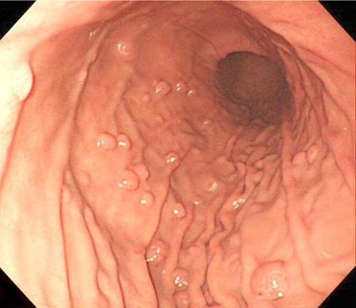
Classification
Benign and malign
neoplasms of stomach
Hyperplastic polyps –account for approximately 75% of gastric polyps in geographic areas where H. pylori is common. The risk of malignancy in hyperplastic polyps low, but is increased in polyps >1 cm and pedunculated in shape
Adenomas – are the most common (6-10%) of neoplastic polyp. It has high risk of malignancy. This probability increases as the size of polyp grows (> 2 cm risk is 25-30%).
Fundic gland polyps – where the HP infection has a low prevalence and PPI use is common, fundic gland polyps are the most commonly encountered. Hypertrophic polyp, no risk to malignancy.
Hamarthomatous – they are hamarthomas, no risk to malignancy.

Slide 6
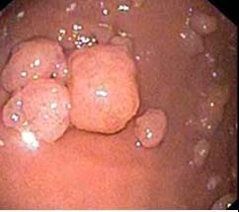
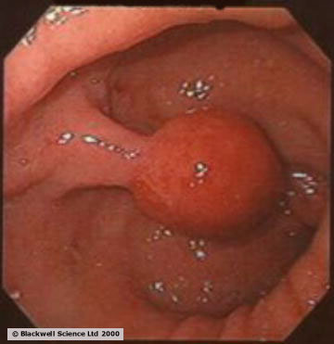
Clinical manifestation
Benign and malign
neoplasms of stomach
are usually asymptomatic and are discovered incidentally on upper endoscopy
rare polyps that cause symptoms are most likely to present with epigastric pain, GI bleeding, anemia. Bleeding is usually occult but occasionally overt .
In rare cases, intermittent obstruction may occur when pedunculated polyps in the antrum prolapse into or through the pylorus

Slide 7
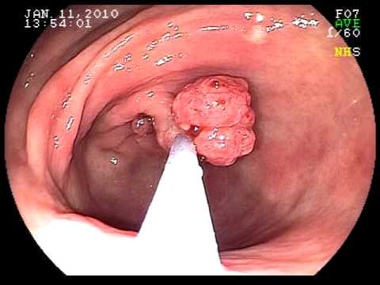
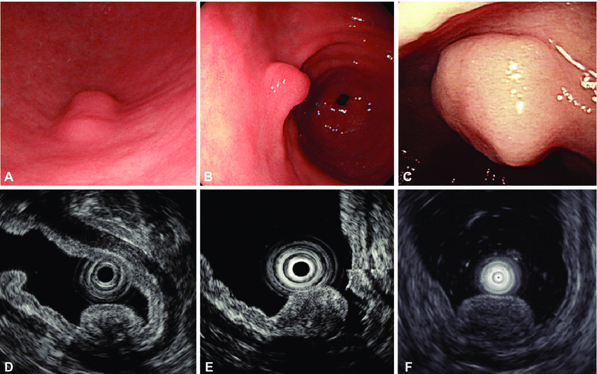
Diagnosis
Benign and malign
neoplasms of stomach
Endoscopy
Biopsy
Endoscopic USG

Slide 8
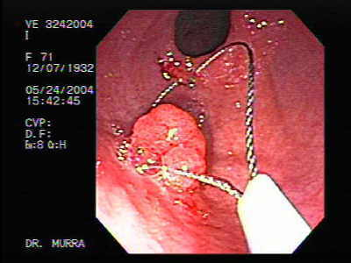
Management
Benign and malign
neoplasms of stomach
Endoscopic polypectomy and pathohistological examination – is first choice.
Surgery indication: if there are many and large polyps (wedge resection, gastric resection)

Slide 9
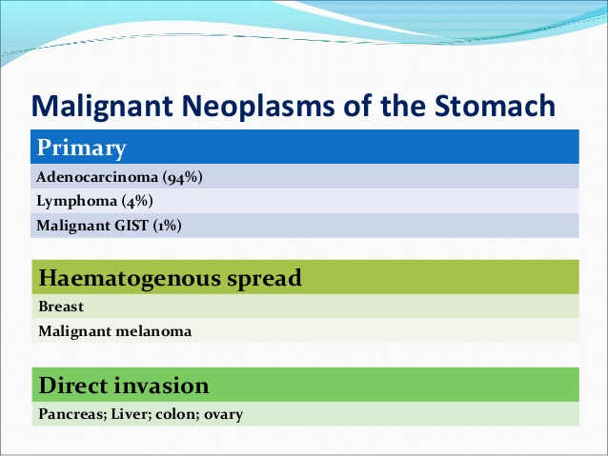
Benign and malign
neoplasms of stomach

Slide 10
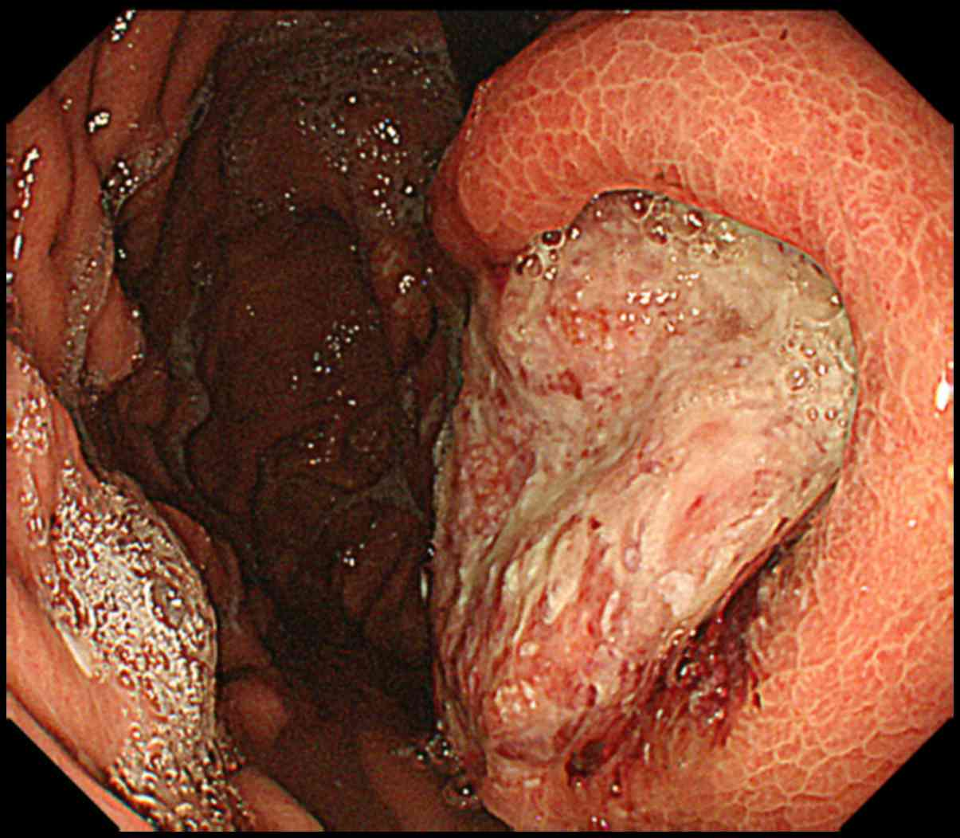
Gastric adenocarcinoma
Benign and malign
neoplasms of stomach
It is epithelial origin most common malignant tumor of the stomach

Slide 11
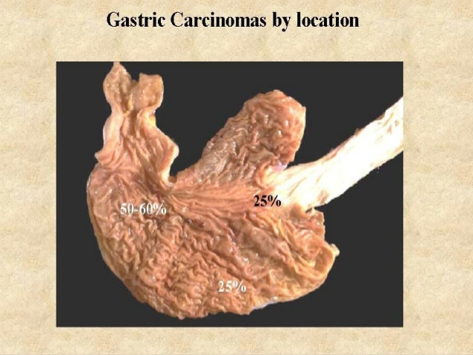
Benign and malign
neoplasms of stomach

Slide 12
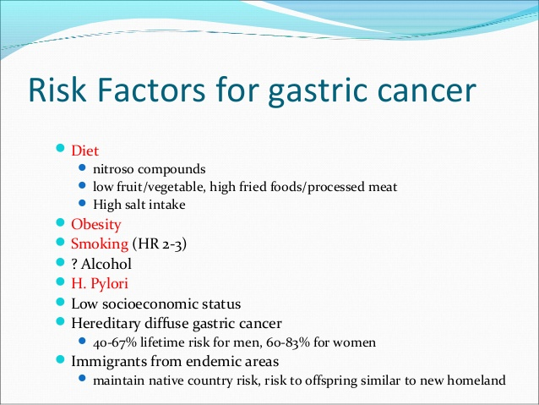
Risk factors
Benign and malign
neoplasms of stomach

Slide 13
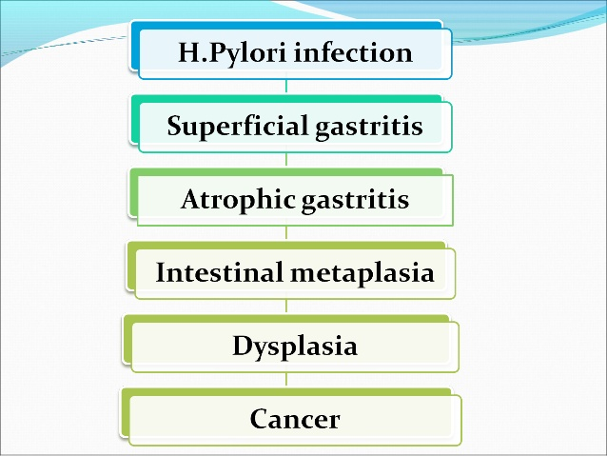
Benign and malign
neoplasms of stomach

Slide 14
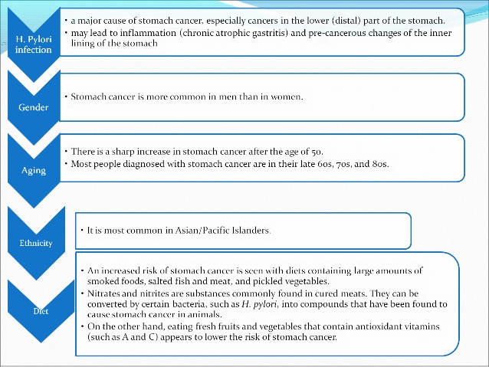
Benign and malign
neoplasms of stomach

Slide 15
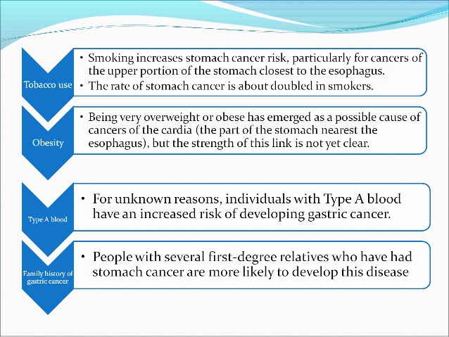
Benign and malign
neoplasms of stomach

Slide 16
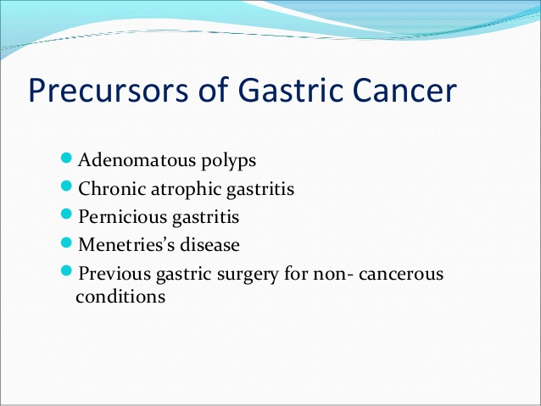
Benign and malign
neoplasms of stomach

Slide 17
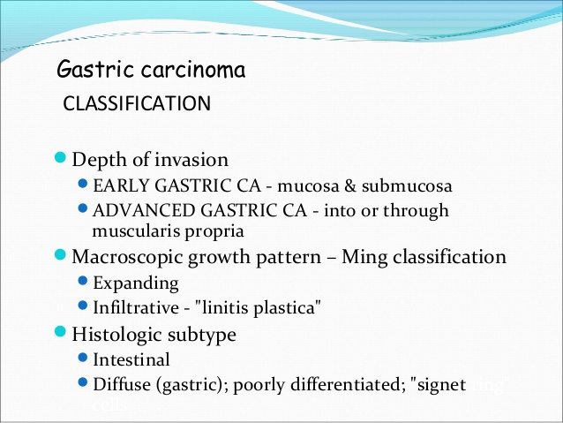
Classification
Benign and malign
neoplasms of stomach
According to morphology:
Looks like ulcer
polypoid
Superficial or early
Linitis plastica
Endstage (ekzo-endofit)
According to the surgical stage:
TNM classification (I-IV stages)
Japon classification
According to localisation:
In the antrum and lesser curvature
In the corpus and fundus
In the cardia
In the all part os stomach

Slide 18
Risk factors
Benign and malign
neoplasms of stomach
Life condition
dietary factors (salted foods ,low in fruits and vegetables)
Toxins - aflatoxin, alcohol, cigarette
radiation
A, C vitamin deficiency
Genetic
I group of blood
Family history
In men common
Precancerous conditions
H. pylori gastritis
Resected stomach
Chronic atrophic gastritis
Chronic hypertrophic gastritis
Adenomatous polyp

Slide 19
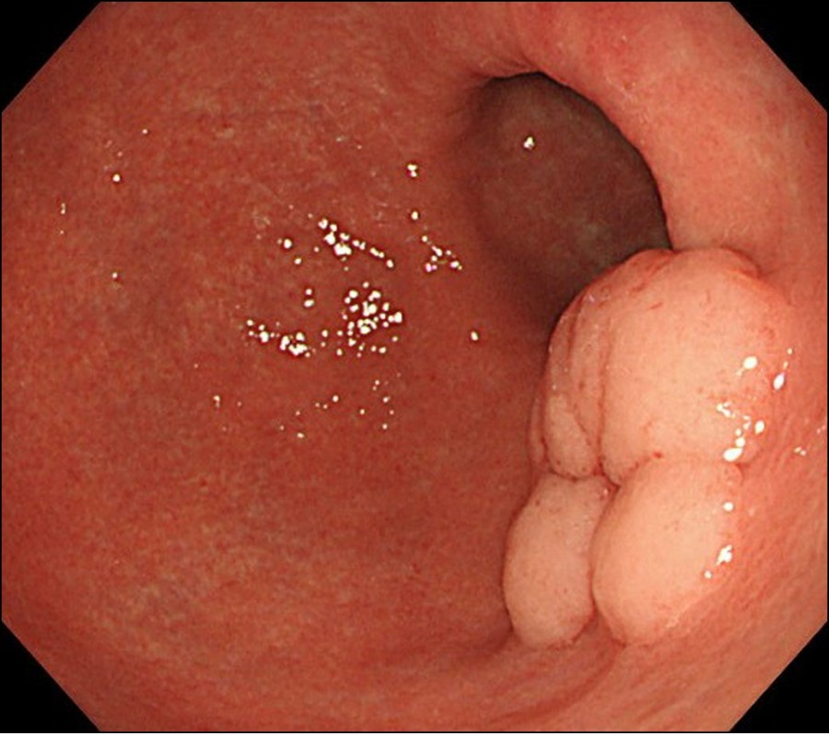
Pathogenesis
Benign and malign
neoplasms of stomach

Slide 20
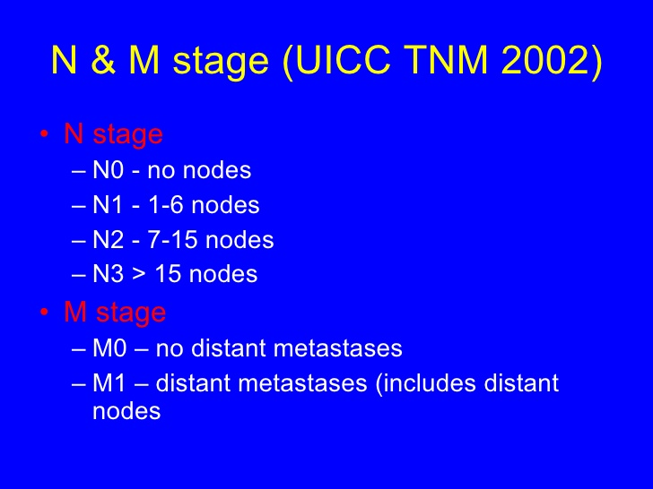
Stages
TNM
Benign and malign
neoplasms of stomach

Slide 21
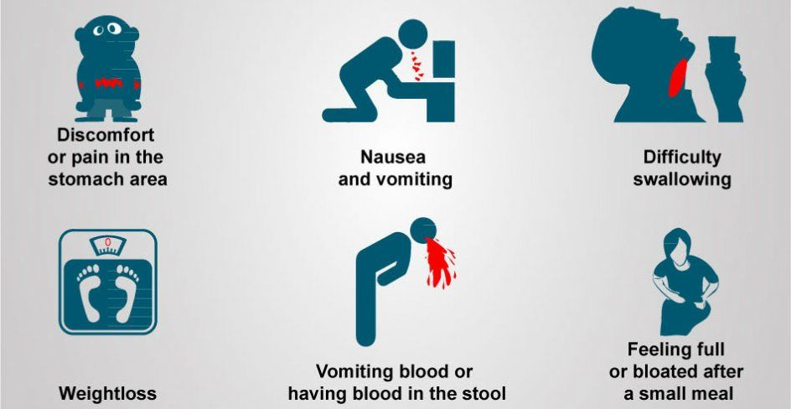
Clinical manifestation
Benign and malign
neoplasms of stomach

Slide 22
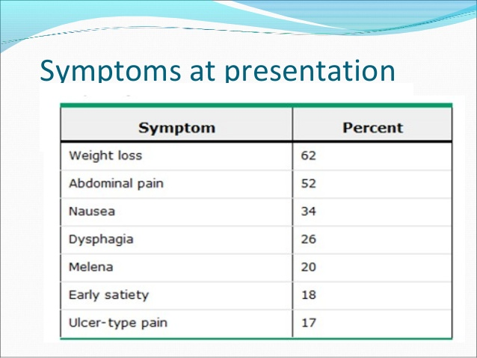
Benign and malign
neoplasms of stomach

Slide 23
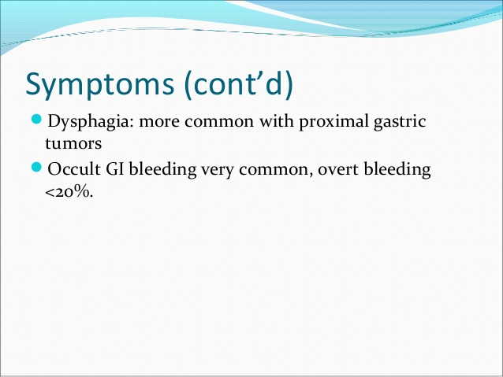
Benign and malign
neoplasms of stomach

Slide 24
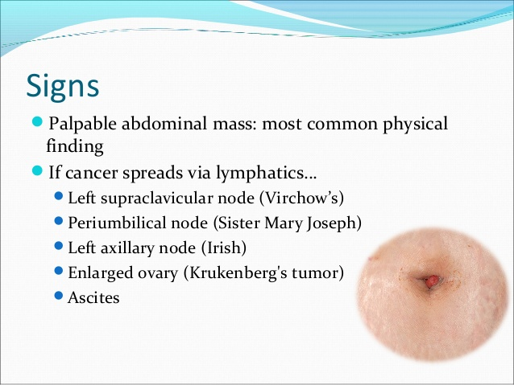
Benign and malign
neoplasms of stomach

Slide 25
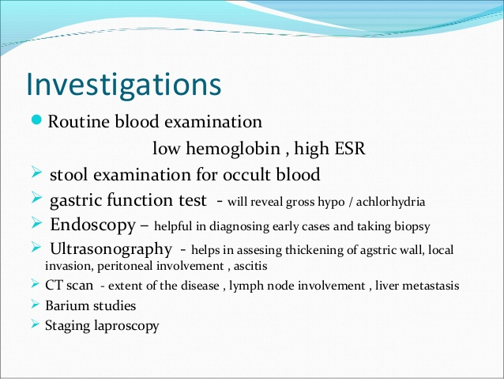
Benign and malign
neoplasms of stomach

Slide 26
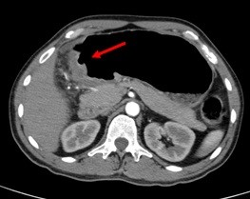
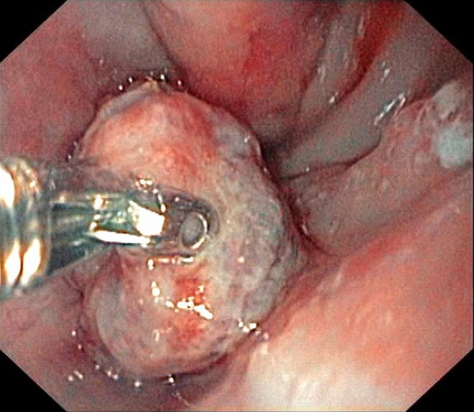

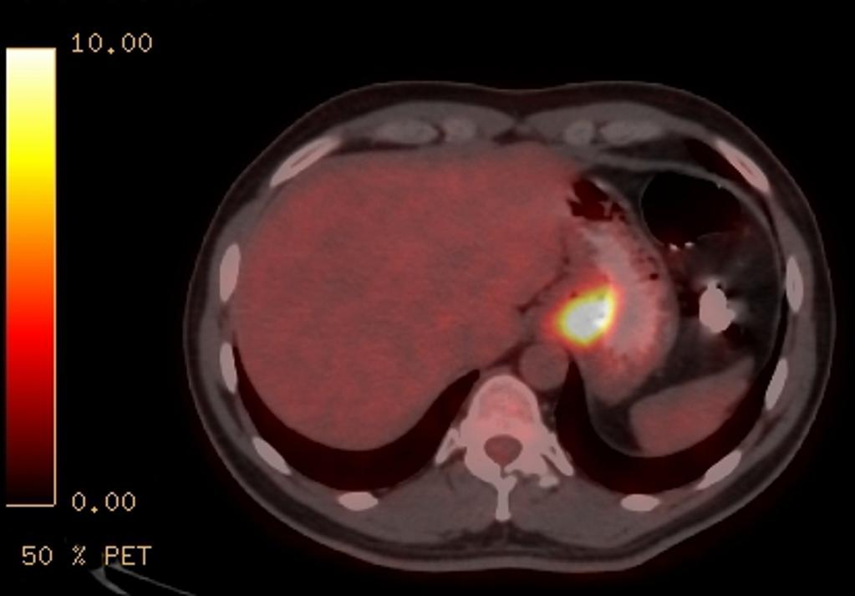
Diagnosis
Benign and malign
neoplasms of stomach
suspicion
confirmation
To chek the level of cancer
Decision

Slide 27
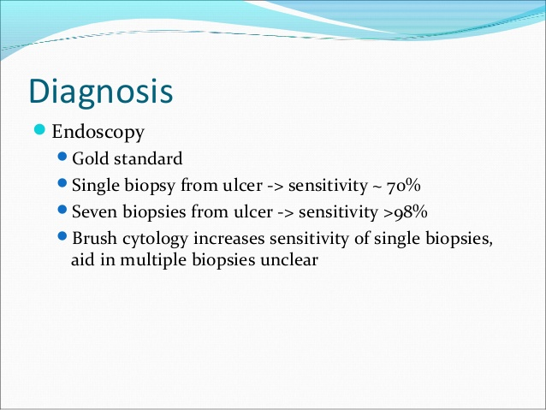
Benign and malign
neoplasms of stomach

Slide 28
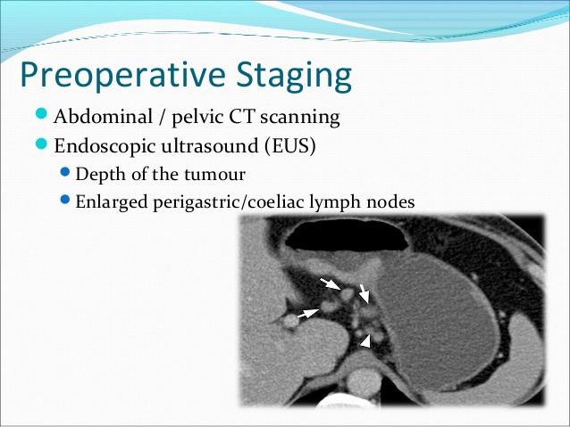
Benign and malign
neoplasms of stomach

Slide 29
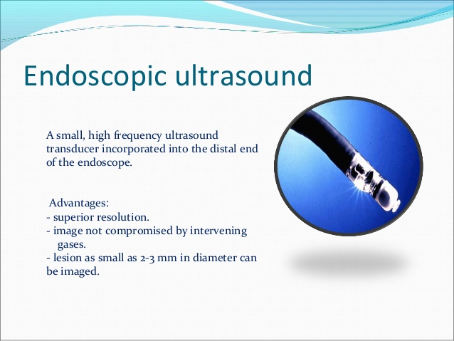
Benign and malign
neoplasms of stomach

Slide 30
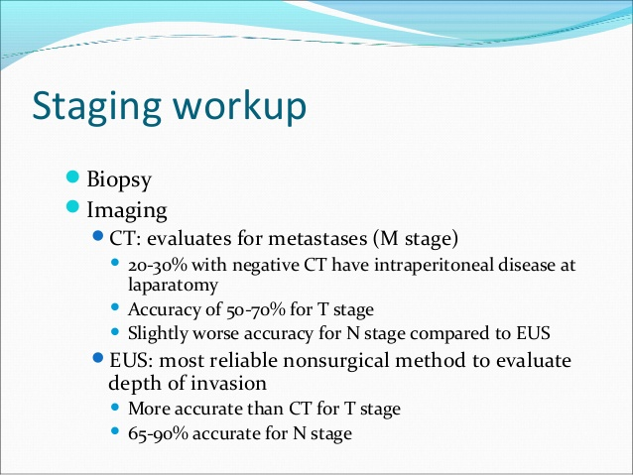
Benign and malign
neoplasms of stomach

Slide 31
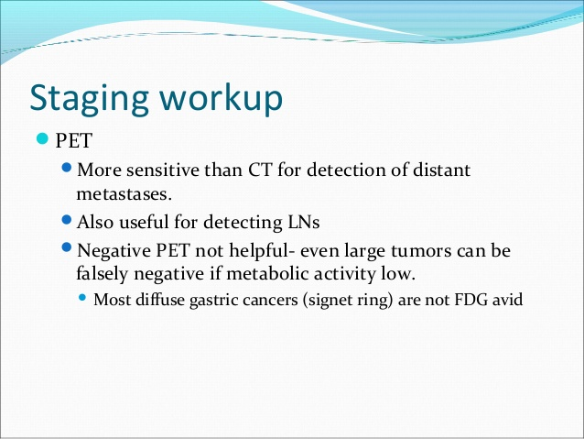
Benign and malign
neoplasms of stomach

Slide 32
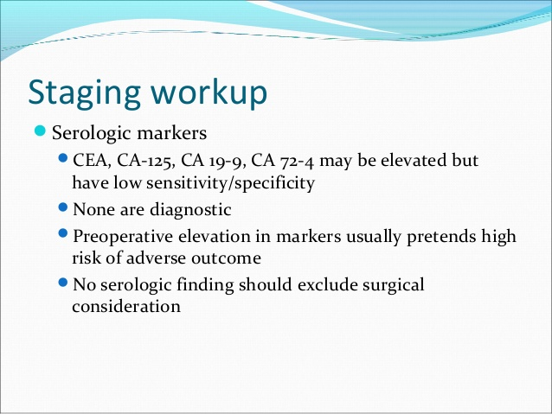
Benign and malign
neoplasms of stomach

Slide 33
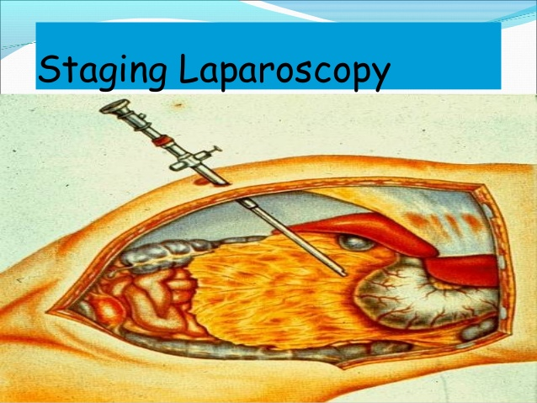
Benign and malign
neoplasms of stomach

Slide 34
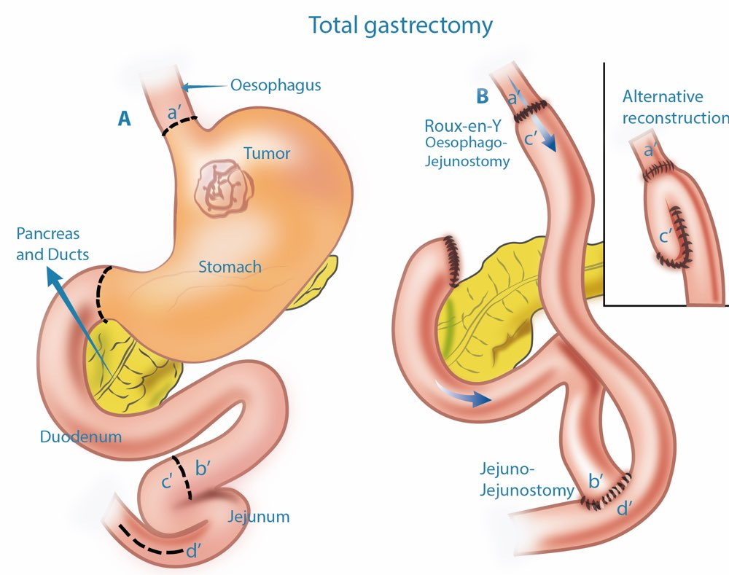
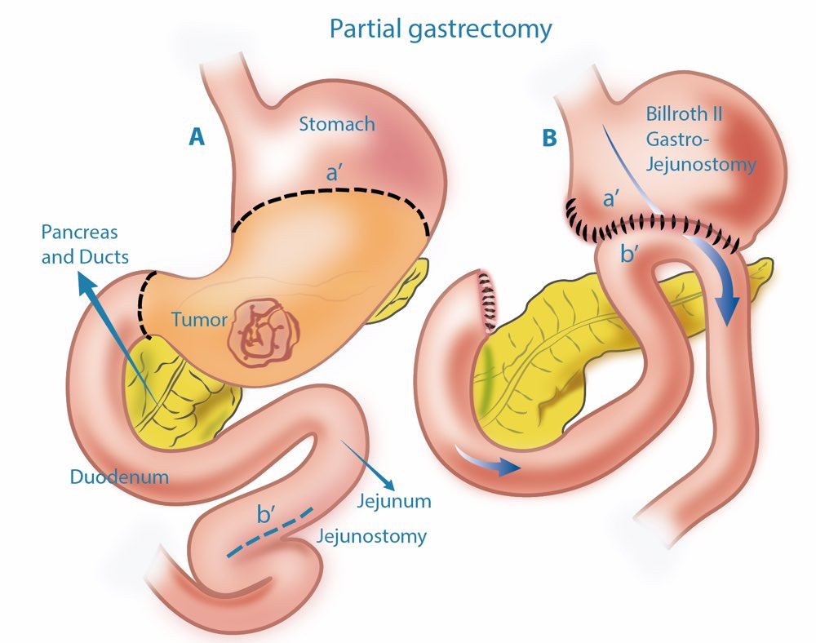
Management
Benign and malign
neoplasms of stomach
Radical metods
» Endoscopic mucosal resection
» Surgical resection (open or laparoscopic)
Assistive methods
» Chemotherapy
» Radiotherapy
Basic principles: Radical resection and to redice recurrence apply chemoradiotherapy!
Palliative methods
» anastomosis
» stent

Slide 35
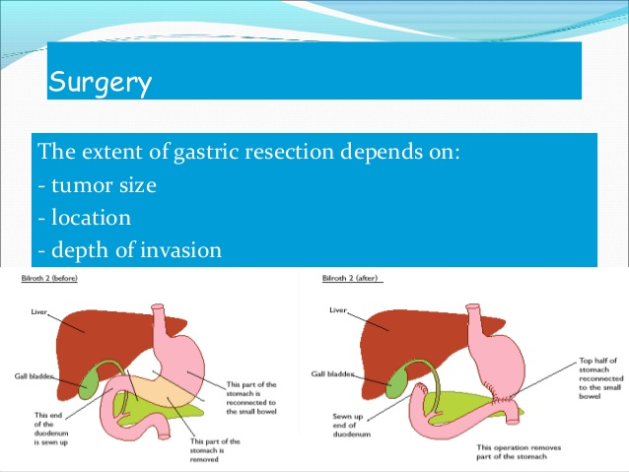
Benign and malign
neoplasms of stomach

Slide 36
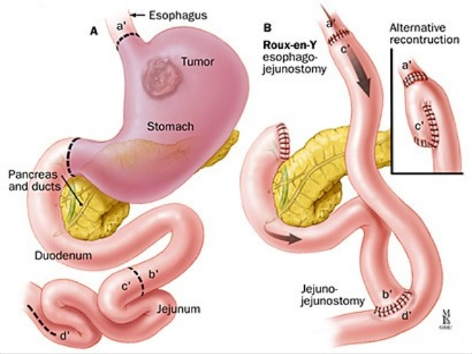
Benign and malign
neoplasms of stomach

Slide 37
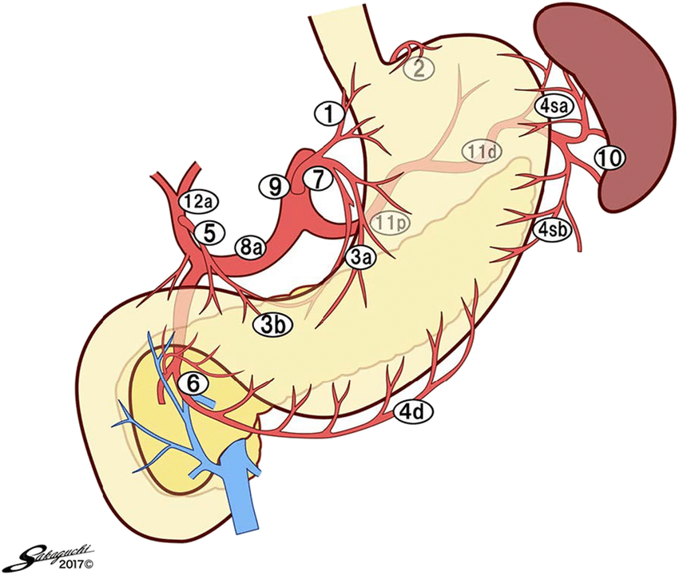
Management
Benign and malign
neoplasms of stomach
Lymphodissection
I level– perigastrikc limph nodes (D1 lymphodissection – 1,2,3,4,5,6 groups)
II level– limph nodes around : left gastric, celiac, common liver and splenic arteries and also splenic hilum (D2 lymphodissection – 7,8,9,10,11,12 groups).

Slide 38
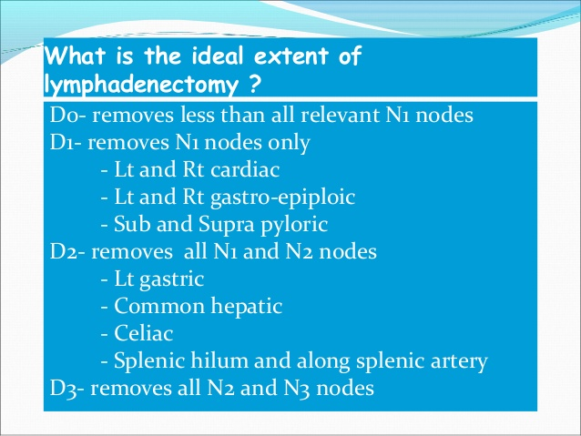
Benign and malign
neoplasms of stomach

Slide 39
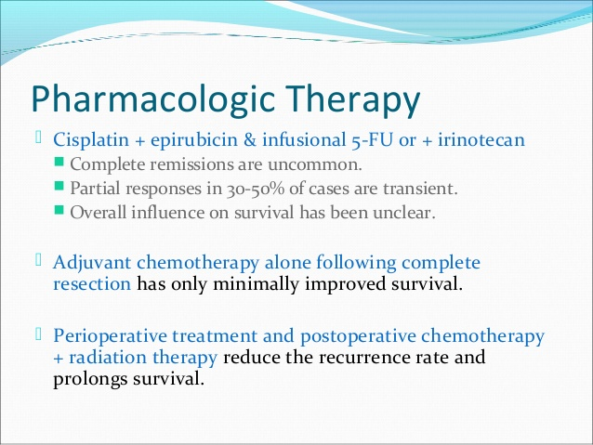
Benign and malign
neoplasms of stomach

Slide 40
Prognosis
Benign and malign
neoplasms of stomach
In general, the 5-year survival rate is 12% An important indicator that determines the stage forecast: :
In early stages after radical resection survive is high (5-year survival rate 90%).
5-year survival rate in II level - 30%, III level - 10%, IV level - 0%.

