Slide 1
Gastrointestinal bleeding
Gastrointestinal bleeding
Natavan Khidirova, MD, PhD
AMU I Department of Surgical Diseases
Chief of the department – prof. Nuru Bayramov

Slide 2
Definition
Gastrointestinal bleeding
Gastrointestinal bleeding is a complication of various diseases with bleeding into lumen of gastrointestinal tract
It may result in anemia, shock, and death

Slide 3
Classification according to location
Gastrointestinal bleeding
Upper bleeding – proximally to the ligament of Treitz
Lower bleeding – distally to the ligament of Treitz

Slide 4
Classification according to cause
Gastrointestinal bleeding
Bleeding of known cause
- diseases of esophagus
- diseases of stomach and duodenum
- diseases of hepatobiliary system
- diseases of small & large intestine and rectum
- combined diseases
- systemic diseases
Bleeding of unknown cause or location

Slide 5
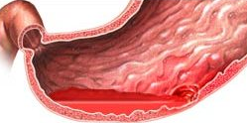
Classification of bleeding according to severity
Gastrointestinal bleeding
minor – no anemia or shock
mild – anemia is present
severe/massive – shock is present

Slide 6
Classification according to clinical progression
Gastrointestinal bleeding
Chronic
Acute
- continuing (15% cases)
- arrested (85% cases)
- repeated (25% cases)

Slide 7
Most often causes
Gastrointestinal bleeding
Esophagus
- varicose veins
- tumors
- ulcerative esophagitis
- burns, trauma
Stomach and duodenum
- peptic ulcer
- stress ulcers
- portal hypertensive gastropathy
- tumors
- diverticulum
- hemorrhagic gastritis
- trauma
- aorto-duodenal fistula
Liver and gallbladder
- tumors
- trauma
Lower bleedings
- Meckel’s diverticulum
- diverticulosis
- polyps
- cancer
- ulcerative colitis
- hemorrhoids, fissure
- dysentery
Combined
- systemic diseases
- blood diseases
- vascular diseases

Slide 8
Gastroduodenal bleeding
Gastrointestinal bleeding
Causes
Duodenal ulcer – 30%
Gastric ulcer – 20%
Varicose veins of esophagus – 20%
Erosive gastritis and duodenitis – 20%
Esophagitis – 5%
Mallory-Weiss syndrome (longitudinal tears of mucosa of cardia) – 5%
Gastric tumors – 1%
Dieulafoy’s ulcer (gastric ulcer above the artery)
Telangiectasia

Slide 9
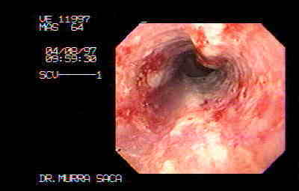
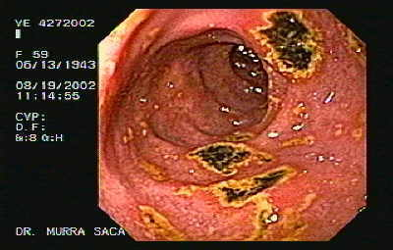
Esophagitis Duodenal Ulcer
Gastrointestinal bleeding

Slide 10
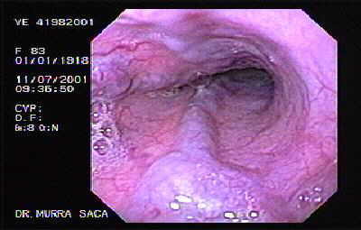
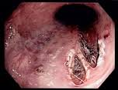
Esophageal varices Mallory-Weiss syndrome
Gastrointestinal bleeding

Slide 11
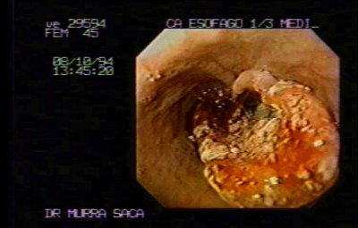
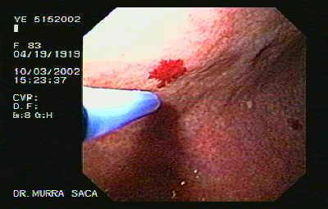
Esophageal tumor Angiodysplasia
Gastrointestinal bleeding

Slide 12
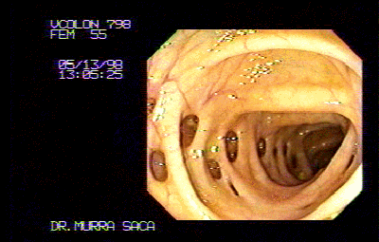
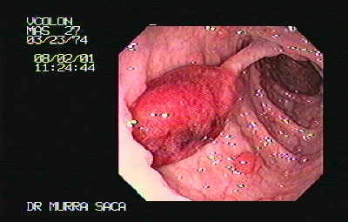
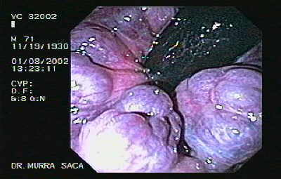
Diverticulosis Colon polyps Hemorrhoids
Gastrointestinal bleeding
Diverticulosis

Slide 13
Diagnostic signs
Gastrointestinal bleeding
Local signs: hematemesis, melena, hematochezia, fecal occult blood
General signs: shock or anemia
Endoscopy or angiography: signs of bleeding

Slide 14
Pathogenesis
Gastrointestinal bleeding
There are 3 main mechanisms:
I – bleeding from a vessel inside the gastrointestinal wall because of its damage (varices, ulcer, polyp, gastritis, tumor)
II – bleeding from biliary ducts to the gastrointestinal tract (hemobilia)
III – bleeding from outside the lumen due to destruction of wall of the organ (trauma and pancreatitis)

Slide 15
Progression
Gastrointestinal bleeding
Chronic – slowly progressing anemia
Acute – sudden large volume bleeding resulting in acute anemia and shock
Stages of hemorrhagic shock
- compensation
- decompensation
- terminal

Slide 16
BLEEDING INTO GASTRO-INTESTINAL LUMEN
Gastrointestinal bleeding
HYPOPERFUSION
(SHOCK)
COMPENSATION
DECOMPENSATION
REFRACTORY
Centralization
  Tachycardia
  Spasm of peripheral vessels
Normal BP
Partial hypoperfusion
Dilatation of vessels
Ischemia/reperfusion injury
Hypotension
General hypoperfusion
SIRS
Cellular injury
Refractory hypotension and hypoperfusion
Multiple organ failure
TREATMENT
TREATMENT
No response
Correction of centralization of blood circulation
Normal BP and perfusion
Ischemia/reperfusion injury
SIRS
Sequestration –edema
Recovery
Resolution of SIRS Retaining of water

Slide 17
Clinical presentation
Gastrointestinal bleeding
Local signs:
  Hematemesis – typical for upper bleedings, vomiting with blood and coffee grounds
  Melena – tarry black stool. Typical for upper bleedings
  Hematochezia – discharge of bright red blood from rectum. Typical for rectal and colon bleedings, sometimes occurs because of massive intestinal and upper bleedings

Slide 18
Clinical presentation
Gastrointestinal bleeding
General signs:
anemia
shock (hypoperfusion) – in case of intensive and massive (more than 500 ml) bleedings: tachycardia, hypotension, cold pale skin, orthostatic hypotension, oliguria etc.

Slide 19
Principle of diagnostic approach
Gastrointestinal bleeding
Diagnostic planning is targeted to 4 questions:
is there a bleeding?
degree of severity (volume and speed of blood loss)
location and cause
continuing or arrested

Slide 20
Is there a bleeding?
Gastrointestinal bleeding
hematemesis
melena confirms the bleeding
shock
acute anemia indicates the severe blood loss
fecal occult blood in clinically asymptomatic or suspicious cases

Slide 21
Degree of severity of bleeding
Gastrointestinal bleeding
minor bleeding – no anemia and hypovolemia
mild bleeding – anemia is present, hemodynamics is stable
severe bleeding – signs of anemia and shock are present

Slide 22
Classification of bleeding according to American College of Surgeons
Gastrointestinal bleeding
Degree | Estimated loss of circulating blood volume | Clinical signs
I degree | Less than 15% | No clinical signs, orthostatic tachycardia (pulse increases 20 beats and more when standing up)
II degree | 20-25% | Orthostatic hypotension. Systolic pressure decreases 15 mm Hg and more. Urine output is normal
III degree | 30-40% | Hypotension and oliguria (less than 400 ml/day)
IV degree | Over 40% | Deterioration of consciousness and coma

Slide 23
Location and cause of bleeding
Gastrointestinal bleeding
Endoscopy
If location is not found
- capsule endoscopy
- angiography
- scintigraphy
- intraoperative endoscopy
- ileostomy

Slide 24
Gastrointestinal bleeding
SOURCE OF BLEEDING ?
Colonoscopy
Gastroduodenoscopy
Not found
Enteroscopy
Capsule endoscopy
Ileostomy and control
Not found
Not found
Angiography
Scintigraphy
Intraoperative panendoscopy
Not found

Slide 25
Location and cause of bleeding
Gastrointestinal bleeding
Radioisotope labeled erythrocytes in minor and repeated bleedings 0.1 ml/min intensity
Angiography in bleedings 0.5 – 1.0 ml/min intensity

Slide 26
SOURCE OF BLEEDING ?
Gastrointestinal bleeding
Upper bleeding
Hematemesis
Melena
Lower bleeding
Melena
Rectal bleeding
Colonoscopy
Gastroduodenoscopy
Gastroduodenoscopy
Location and cause of bleeding is found
Location of bleeding is not found
Endoscopic hemostasis
Conservative hemostasis
Surgical hemostasis
Other investigations

Slide 27
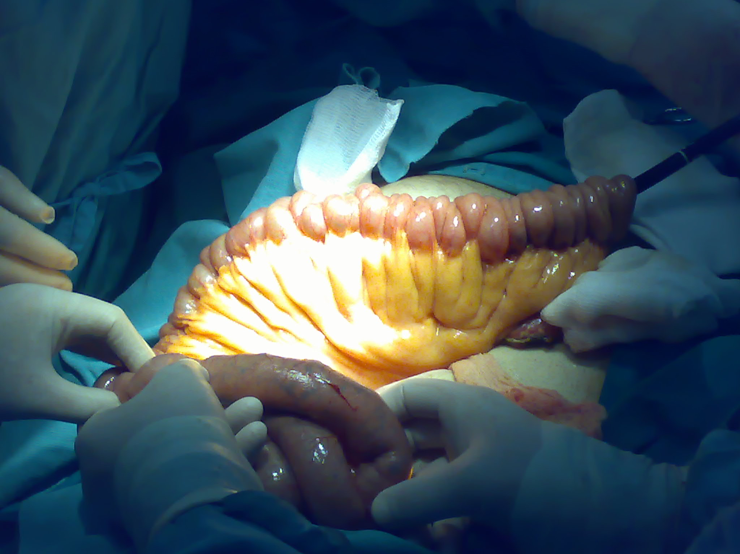
Intraoperative endoscopy
Gastrointestinal bleeding

Slide 28
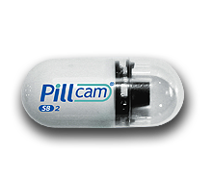

PillCam SB Latest Generation
Gastrointestinal bleeding
  11 mm x 26 mm
  1 camera
  2 frames per second
  Std optics / 1 lens
  Standard lighting control
  Standard angle of view (AOV) 140°
  Depth of field 0-30 mm
  11 mm x 26 mm
  1 camera
  2 frames per second
  New optics / 3 lenses
  Advanced Automatic Light Control
  Extra wide angle of view (AOV) 156°
  Depth of field 0-30 mm

Slide 29
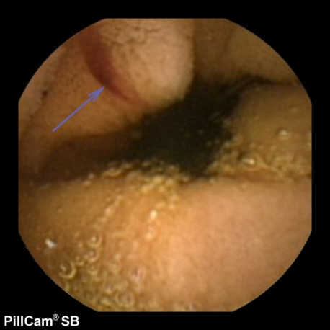
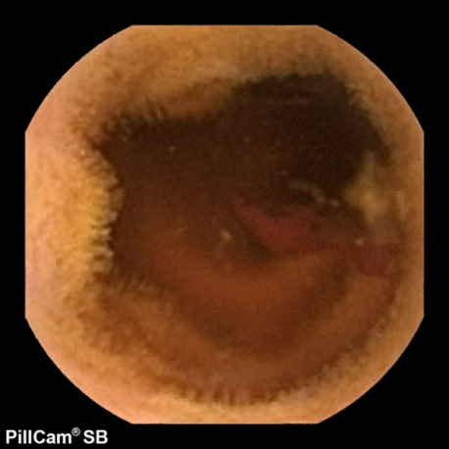
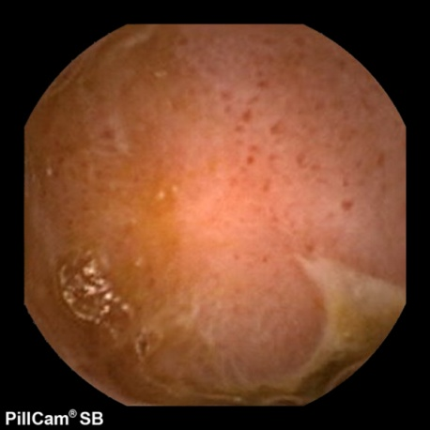
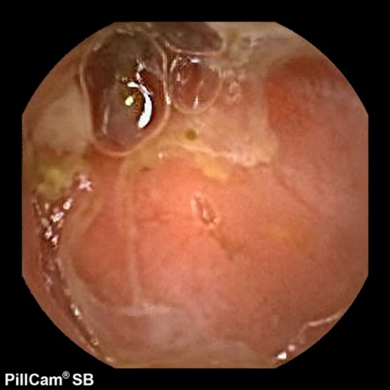
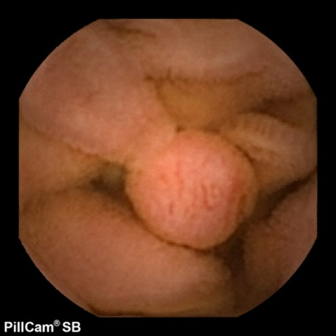
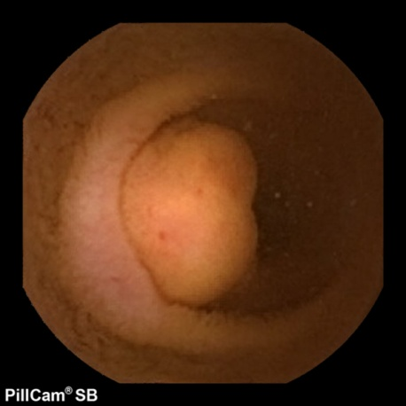
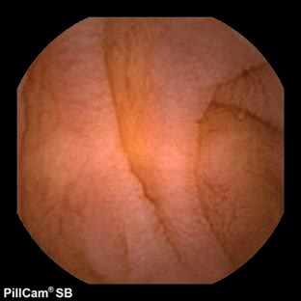
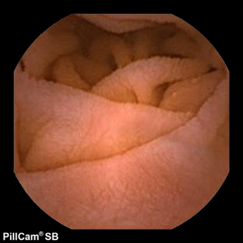
Image Spectrum:
PillCam Capsule Endoscopy
Gastrointestinal bleeding
Bleeding
Suspected Crohn’s disease
Tumors
Celiac Disease

Slide 30
Continuing or arrested bleeding?
Gastrointestinal bleeding
The next signs indicate if bleeding is continuing or arrested:
clinical – melena, hematemesis, discharge of blood from nasogastric tube
laboratory – blood Hb and Ht, lactate, oxygenation
parameters of hemodynamics – pulse, pressure
endoscopic signs – blood clot, oozing etc.
No bleeding at the moment, stable Ht and stabilization of hemodynamics indicate the arrest of bleeding

Slide 31
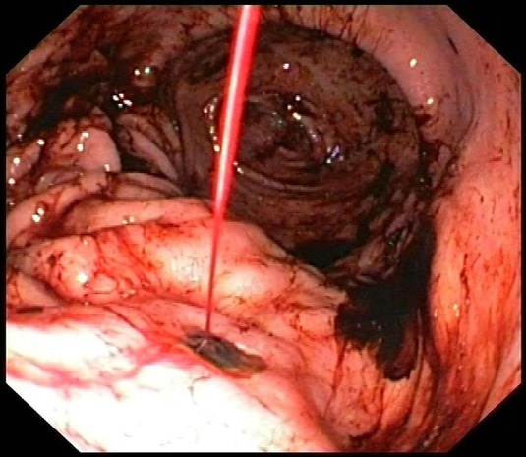
Diagnosis of bleeding and Forrest classification
Gastrointestinal bleeding
  Forrest I: active bleeding from ulcer
  Forrest I a: spurting hemorrhage
  Forrest I b: oozing hemorrhage
  Forrest, JA.; Finlayson, ND.; Shearman, DJ. (Aug 1974). "Endoscopy in gastrointestinal bleeding.". Lancet 2 (7877): 394–7.

Slide 32
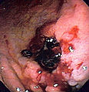
Diagnosis of bleeding and Forrest classification
Gastrointestinal bleeding
  Forrest II: recent hemorrhage, arrested
  Forrest II a: visible vessel in the ulcer (risk of repeated bleeding 50%)
  Forrest II b: clot adherent to the ulcer (risk of repeated bleeding is low)
  Forrest II c: haematin pigment in the ulcer base (risk of repeated bleeding is low)

Slide 33
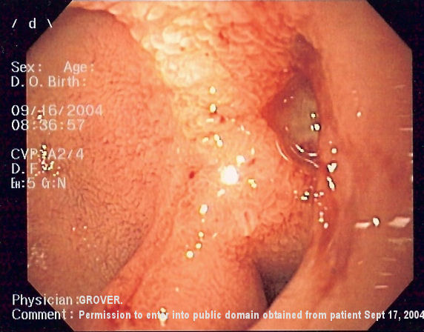
Diagnosis of bleeding and Forrest classification
Gastrointestinal bleeding
  Forrest III: no signs of hemorrhage

Slide 34
Treatment
Gastrointestinal bleeding
Hemostasis
Supportive treatment
Etiologic treatment

Slide 35
Methods of hemostasis
Gastrointestinal bleeding
drug therapy – anti-secretory, vasospastic, anti-fibrinolytic
endoscopic methods – injection of sclerosing agent, coagulation, application of clips, ligation, injection of adrenalin
endovascular approach – embolization (coil, thrombin etc.)
surgery – ligation of vessel, resection, portosystemic bypass and other specific operations

Slide 36
Management
Gastrointestinal bleeding
First steps
in-patient facility
stabilization
endoscopic diagnosis
hemostasis by drugs or endoscopy
other modalities

Slide 37
In-patient facility
Gastrointestinal bleeding
• Patient must be placed directly in the intensive care unit and managed by a team of surgeon, intensive care specialist and endoscopist

Slide 38
Control over vital functions and stabilization
Gastrointestinal bleeding
Continuous monitoring (oxygen saturation, BP, pulse etc.)
Airway is checked to provide its patency. Urgent intubation in case of uninterrupted bleeding and encephalopathy
IV infusion in case of hypovolemia (tachycardia, hypotension, orthostatic hypotension)

Slide 39
Control over vital functions and stabilization
Gastrointestinal bleeding
Gastrointestinal bleeding
Patients with shock: IV infusion of Ringer solution 1000 ml bolus and colloid solutions (plasma, albumin, gelatin, dextran)
Central venous line is maintained, tests are done (full blood count, PTT, aPTT, bleeding and clotting time, glucose, ALT, AST, urea, creatinine, albumin, bilirubin, electrolytes, HBsAg, Anti-HCV)
Catheterization of urinary bladder

Slide 40
Arrest of bleeding by drugs + endoscopic procedure
Gastrointestinal bleeding
Management with Sandostatin (first dose 250 mkg, 250 mkg/hour infusion rate) or Octreotide (first dose 50 mkg, 50 mkg/hour infusion rate) or Terlipressin (2 mg every 4 hours) for up to 5 days
PPI infusion (pantoprazole or esomeprazole)
Urgent (within 12 hours) endoscopy and hemostasis as soon as hemodynamics become stable

Slide 41
Arrest of bleeding by drugs + endoscopic procedure
Gastrointestinal bleeding
In case of bleeding from esophageal varices: endoscopic ligation or sclerotherapy. If not effective: TIPS, metallic stent application or surgery
In case of non-variceal bleeding: endoscopic injection of adrenalin, coagulation, clip application. If not effective: application of local hemostatic agent, or surgery
If patient can not be stabilized and bleeding can not be controlled endoscopically then:
  In case of variceal bleeding: application of Blakemore-Sengstaken tube and preparation to surgery
  In case of non-variceal bleeding: urgent surgery
  Intraoperative endoscopy is important

Slide 42
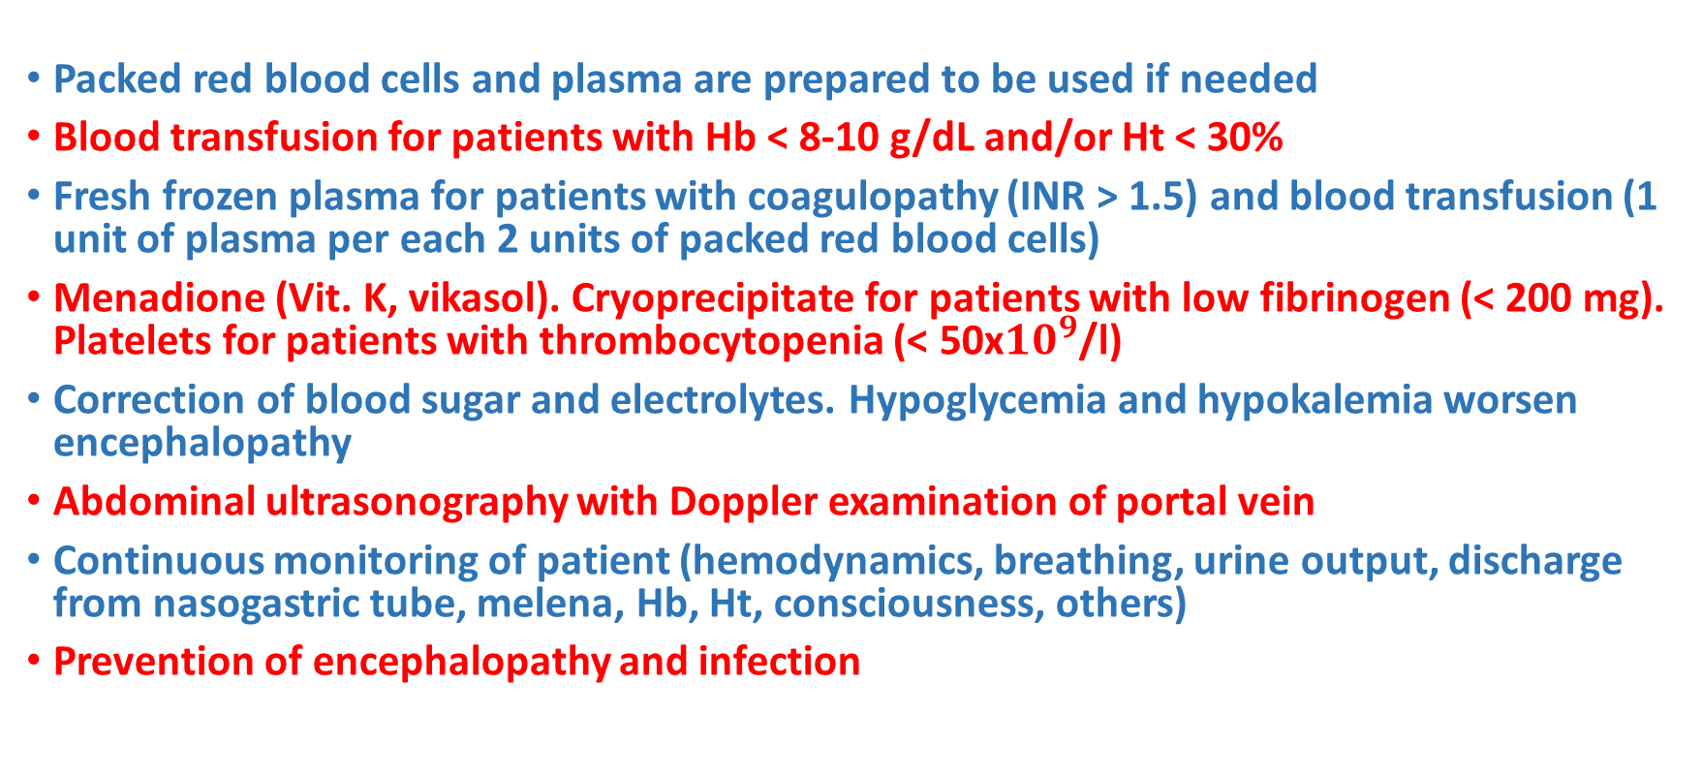
Other actions
Gastrointestinal bleeding
Packed red blood cells and plasma are prepared to be used if needed
Blood transfusion for patients with Hb < 8-10 g/dL and/or Ht < 30%
Fresh frozen plasma for patients with coagulopathy (INR > 1.5) and blood transfusion (1 unit of plasma per each 2 units of packed red blood cells)
Menadione (Vit. K, vikasol). Cryoprecipitate for patients with low fibrinogen (< 200 mg). Platelets for patients with thrombocytopenia (< 50x${10}^{9}$/l)
Correction of blood sugar and electrolytes. Hypoglycemia and hypokalemia worsen encephalopathy
Abdominal ultrasonography with Doppler examination of portal vein
Continuous monitoring of patient (hemodynamics, breathing, urine output, discharge from nasogastric tube, melena, Hb, Ht, consciousness, others)
Prevention of encephalopathy and infection

Slide 43
Approach to upper GI bleeding
Gastrointestinal bleeding
UPPER GASTROINTESTINAL BLEEDING
First steps
Stabilization – infusion, oxygenation
Drug hemostasis – vasopressors, PPI
VARICEAL BLEEDING
NON-VARICEAL BLEEDING
Endoscopic adrenalin injection
Coagulation
Clip application
Endoscopic ligation or sclerotherapy
No effect
No effect
Blakemore-Sengstaken tube
TIPS
Metallic stent
Surgery
Local hemostatic agents
Surgery

Slide 44
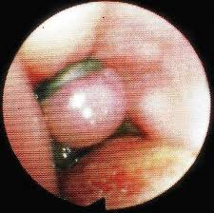
Etiologic treatment
Gastrointestinal bleeding
Variceal bleeding: endoscopic ligation or sclerotherapy
If no effect: Blakemore-Sengstaken tube
Stent application, TIPS or surgery to be considered

Slide 45
Etiologic treatment
Gastrointestinal bleeding
In case of gastroduodenal ulcer endoscopic hemostasis is the first approach (within 12-24 hours)
Forrest I – if double treatment does not work, then local thrombotic agents are applied
Forrest II – double hemostasis: injection of adrenalin, coagulation, clip application
Forrest III – observation or double hemostasis
If endoscopic management is effective: start antiulcer treatment
If endoscopic management is not effective in continuing or repeated bleeding: surgery is indicated. Resection is the first choice

Slide 46
Etiologic treatment
Gastrointestinal bleeding
In acute bleeding related to anticoagulants or aspirin
- aspirin or anticoagulant is stopped
- coating mucosa protectors are given
- platelets or
- plasma is transfused
If bleeding stops: antiulcer treatment to be continued for 1 month
If bleeding does not stop: urgent surgery – total gastrectomy or ligation of gastric arteries

Slide 47
Etiologic treatment
Gastrointestinal bleeding
In stress ulcers related to sepsis: in addition to initial management
- coating mucosa protectors
- anti-enzyme treatment
- plasma transfusion
- coagulation factor VII
If bleeding is not possible to be controlled because of multiple gastric erosions and there are no intestinal erosions, gastrectomy may be considered
In Mallory-Weiss syndrome if endoscopic treatment is not effective then surgery (suturing of ruptures) is applied

Slide 48
Etiologic treatment
Gastrointestinal bleeding
In bleeding from gastric tumor surgery is the main choice
In biliary hemorrhage if initial management is not effective then angiography and embolization should be considered
In bleeding from intestinal/colon tumor surgery is the main choice
In bleeding from diverticulum its excision (open or laparoscopic) is the first choice
In angiodysplasia endoscopic coagulation is the first choice. If it is not effective and bleeding continues resection should be considered

Slide 49
Etiologic treatment
Gastrointestinal bleeding
In colon ulcers (ulcerative colitis, bacterial/ischemic colitis) conservative treatment is effective in most cases. Specific management is administered as well
In Meckel’s diverticulum diagnosis is specified by CT with oral contrast medium and laparoscopy. Urgent excision of diverticulum is indicated to stop the hemorrhage
In uncontrolled bleeding from hemorrhoids hemorrhoidectomy is the radical treatment modality
In bleeding after chemotherapy initial management of bleeding is applied. Coatings (sucralfate) and vitamin B15 (Bepanthen) are also administered

Slide 50
Indications to surgery
Gastrointestinal bleeding
Bleeding of known location not arrested by other treatment modalities
Massive bleeding (demanding more than 3 units of packed red blood cells for stabilization / or 6 units of packed red blood cells have already been transfused) repeated in short time
10-15% of patients need surgery

Slide 51
Mortality
Gastrointestinal bleeding
Overall ~ 10%
60-80 years old patients – 15%
Over 80 years old patients – 25%
In continuing hemorrhage – 30%
Risk factors for increased mortality
Age over 60
Transfusion of more than 5 units of packed red blood cells

