Slide 1
Purulent pleuritis
Purulent pleuritis
Ph.D Mahmudov Mahir
Azerbaijan Medical University
I Surgical Diseases Department

Slide 2
Definition
It is a purulent inflammation of the pleura, also called pyothorax or empyema. If not treated immediately, it can be fatal.
https://www.youtube.com/watch?v=cJlDaZoNXUI

Slide 3
Definition
Mondor's disease

Slide 4
Pleural space
The function of the pleura is to allow optimal expansion and contraction of the lungs during breathing. The pleural fluid acts as a lubricant, allowing the parietal and visceral pleura to glide over each other friction free. This fluid is produced by the pleural layers themselves.

Slide 5
Physiology of the pleura
The pleural cavity always maintains a negative pressure. During inspiration, its volume expands, and the intrapleural pressure drops. This pressure drop decreases the intrapulmonary pressure as well, expanding the lungs and pulling more air into them. During expiration, this process reverses.

Slide 6
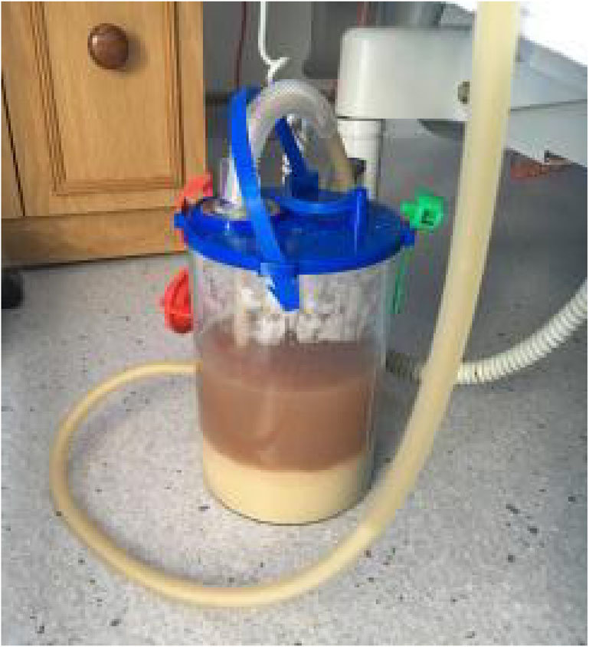
Pleural fluid
Transudate –
Exudate –
Pyothorax–
Chyilotorax –
Pneumothorax -
Hemothorax –
Bilothorax-

Slide 7
Causes
10%
-not related to previous pneumonia
intervention
Cervical infection
Esophageal rupture
Trauma
Post-thoracic surgery
Primary
Secondary
Pneumonia - 60%
Surgery- 20%
Trauma - 10%

Slide 8
Infection
community-acquired empyema: gram-positive (es. Streptococcus
hospital-acquired empyema: Staphylococcus aureus (MRSA) and Pseudomonas (also in trauma and surgery )

Slide 9
Risk factors
Diabetes mellitus
IV drug abuse
Immunosuppression
Gastric acid reflux (GERD)
Alcohol abuse

Slide 10
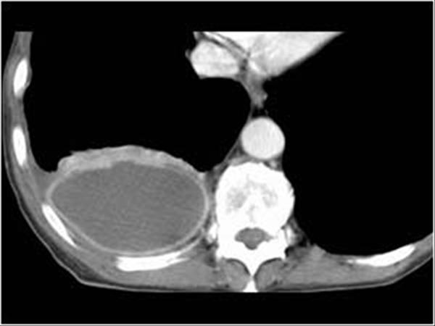
Classification
According to the stage
Acute serous
Acute fibrinopurulent
Chronic (fibrinous-fibrous stage, organizing)
Location
Diffuse
Lokal
https://mmcts.org/tutorial/1002

Slide 11
Course
3 phases are classically distinguished:
• the serous phase covers the first 24-48 hours, the exudate is serous and can be cleaned by drainage.
• the fibrinous-purulent phase covers 3-7 days, is characterized by purulent exudation, and fibrinolytics are also needed for complete cleansing of pus.
• chronic phase includes days 7-28, thickened fibrous tissue develops in the areas surrounding the pus, in the pleural cavity, in the visceral and parietal pleura. Spontaneous resolution of the cavity is less likely and it is necessary to remove the fibrous tissue (decortication).

Slide 12
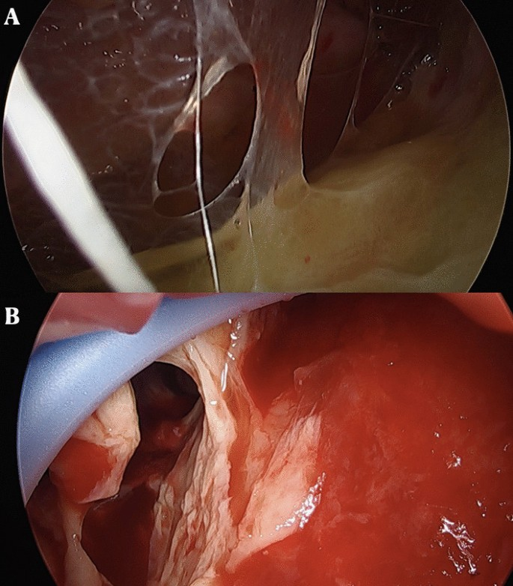
Clinical features
In most cases, purulent pleuritis is manifested by three groups of symptoms:
signs of local inflammation - Chest pain which worsens when breathe in deeply, dullness, decreased lung sounds, dry cough
signs of general inflammation (SIRS-sepsis symptoms) - Fever and chills, Excessive sweating, especially night sweats, General discomfort, ill feeling, tachycardia, leukocytosis,
signs of respiratory failure - shortness of breath, cyanosis, tachypnea

Slide 13
Complication
• sepsis
• pulmonary insufficiency
• pleural fistula
• amyloidosis

Slide 14
Diagnosis-doubt
empyema should be suspected if any of the following symptoms are present:
Chest pain, shortness of breath and signs of sepsis
Symptoms of sepsis in those with a history of pneumonia, surgery, trauma
Signs of sepsis in a patient with pleural fluid
In cases where exudate and turbid fluid are found in pleural punctate

Slide 15
Evaluation-Diagnosis
Chest X-ray
USG
CT
Thoracentesis -Gram stain and culture

Slide 16
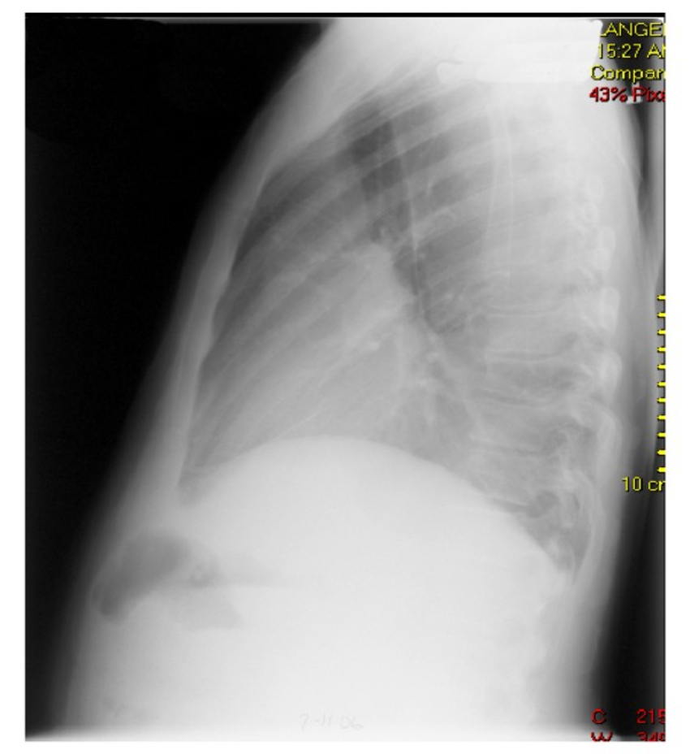
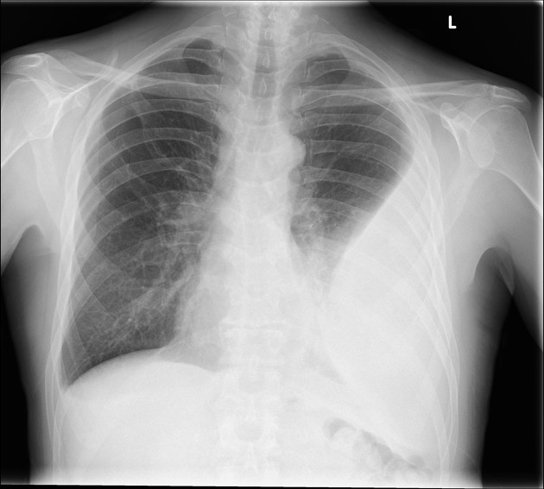
Chest X-ray

Slide 17
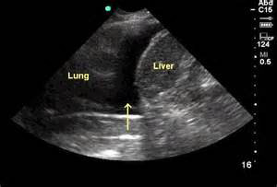
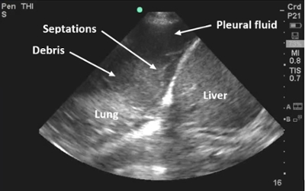
USG

Slide 18
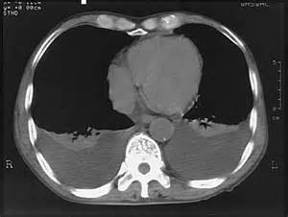
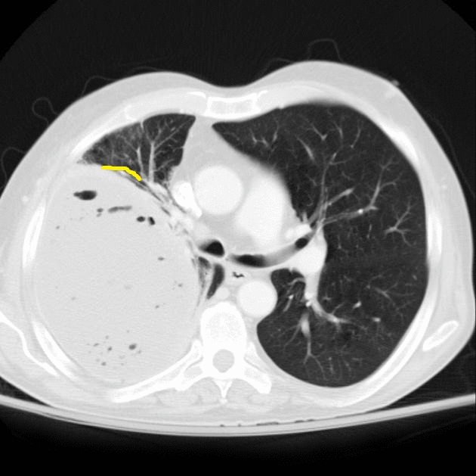
CT

Slide 19
Chest tube
https://www.youtube.com/watch?v=RKYpjvfK48U

Slide 20
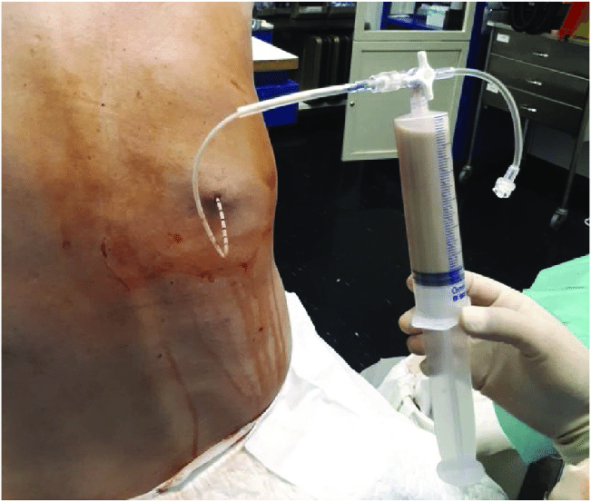
Confirmation
CT
puncture
Butt clinical, imaging and bacteriological analysis results are evaluated together.

Slide 21
Diagnostic criteria
• signs of sepsis
• CT or USG fluid in pleural cavity
• - pus, protein>3 q/dl, pH<7, glucose<40 mq/dl, anaerobic or aerobic microbes.

Slide 22
Management
Removal of pleural pus – drainage
Antibiotic therapy – should cover aerobes and anaerobes
Supportive therapies for sepsis
source control
obliteration of the empyema cavity– lung expansion (early drainage, decortication), thoracoplasty

Slide 23
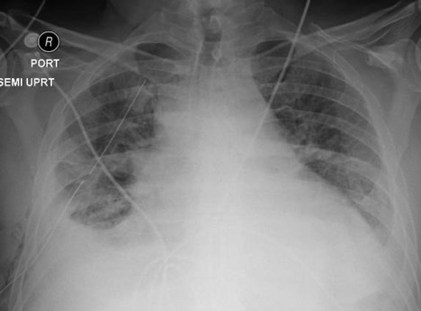
Tube thoracostomy
https://www.youtube.com/watch?v=U618Jte_1Uk
https://www.youtube.com/watch?v=P5kWpZo2yvA

Slide 24
Antibiotics
Community-acquired empyema
3rd or 4th generation of cephalosporin + metronidazole
Or ampicillin +beta lactamase inhibitor
(clavulonic acid, tozobactam, sulbactam)
Hospital-acquired or trauma related and surgery related
Vancomycin, cefepime and metronidazole or piperacillin-tazobactam
Should given for 2- 6 weeks, depending on response, source control and organism

Slide 25
VATS
https://www.youtube.com/watch?v=MEhLZREiKFY
https://www.youtube.com/watch?v=LQSBNZctrOg
https://www.youtube.com/watch?v=cJlDaZoNXUI

Slide 26
Thank you for attention

Slide 27


www.bck.az
Azərbaycan Tibb Universitetinin I-Cərrahi Xəstəliklər kafedrası

