Slide 1
Mondor's disease
Mondor's disease
Ph.D Mahmudov Mahir
Azerbaijan Medical University
I Surgical Diseases Department

Slide 2
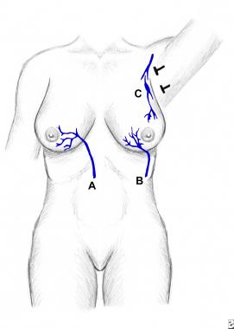
Definition
Mondor's disease
Mondor's disease--- superficial venous thrombophlebitis of the mammary gland and breast wall.
These veins are: lateral thoracic (C), toracoepi-gastric (B), superior epigastric (A).
It is more common in women aged 30-60 years (75%).
12% are found to have breast cancer

Slide 3
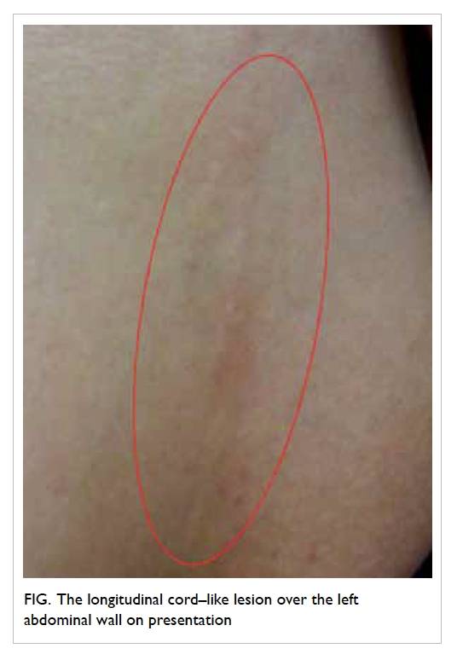
Etiopathogenesis
Mondor's disease
The exact etiology is unknown.
Factors creating conditions: local trauma, breast surgery, breast biopsy, breast cancer, tight clothing, lymphangitis, radiation, mastectomy
The disease is mostly unilateral, less common in men. The most common vein for thrombophlebitis is the thoracoepigastric vein. This disease never causes complications such as thromboembolism.

Slide 4
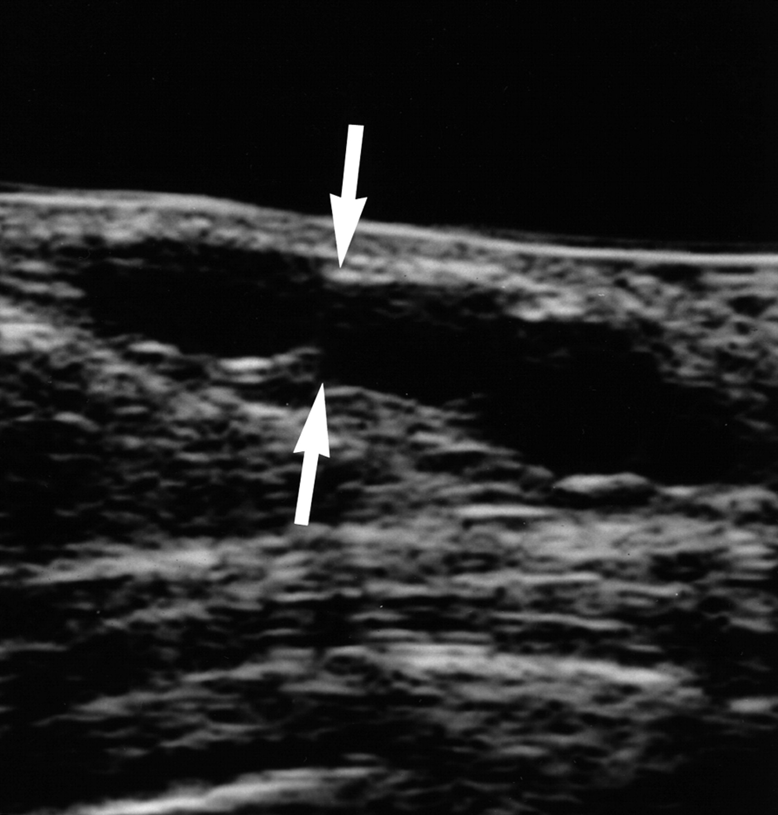
Clinical presentation
Mondor's disease
Painful swelling, redness and local fever are observed in the area of thrombophlebitis.
Histologically, there are 4 stages in the course:
Thrombus formation
Thrombus organization
Thrombus recanalization
Formation of fibrosis

Slide 5
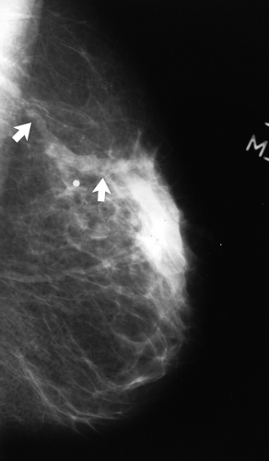
Diagnosis
Mondor's disease
Anamnesis
Local examination
USM (Doppler)
Mammography
Biopsy
Oncomarkers
Breast cancer should be ruled out first.

Slide 6
Treatment
Mondor's disease
It is conservative
Hot compress
Antibiotics
Analgetic
anticoagulant?
The process shuts down within 6 weeks

Slide 7
Thank you for attention

Slide 8


www.bck.az
Azərbaycan Tibb Universitetinin I-Cərrahi Xəstəliklər kafedrası

