Slide 1
Diagnostic approach to chest wall diseases
Ph.D Mahmudov Mahir
Azerbaijan Medical University
I Surgical Diseases Department

Slide 2
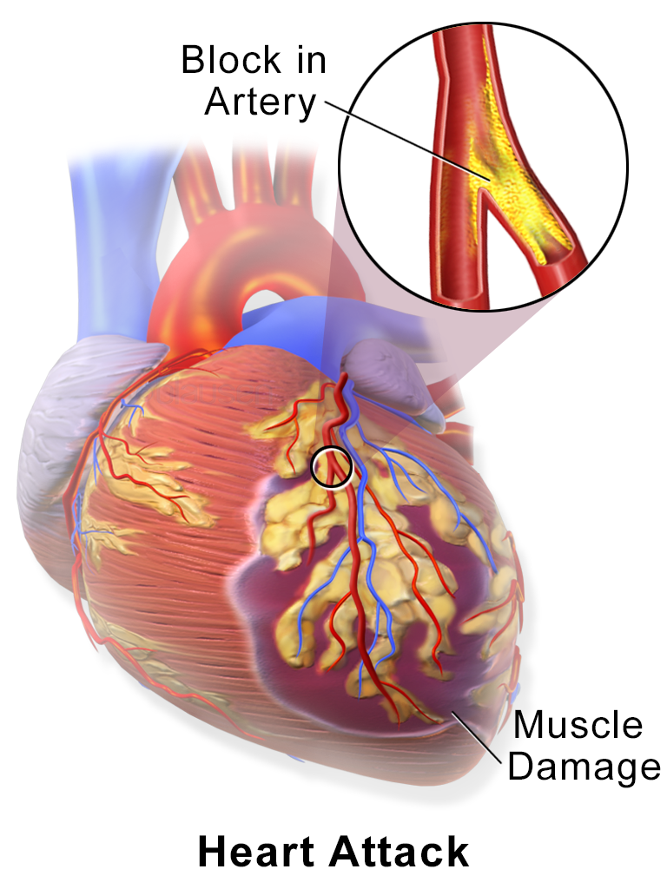
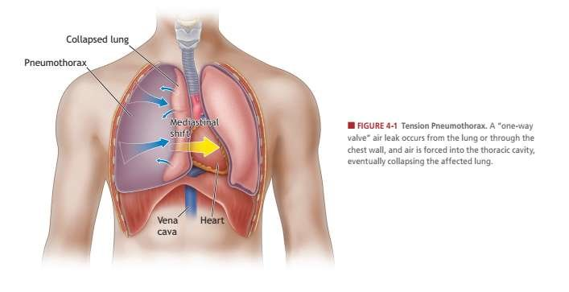
Principle
Diagnostic approach to surgical diseases of chest wall
To deny life-threatening diseases of the intrathoracic organs (myocardial infarction, tension pneumothorax, etc.), to conduct consistent examination and treatment of pathologies directly related to the chest wall

Slide 3
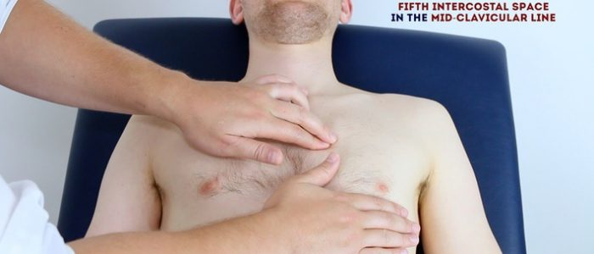
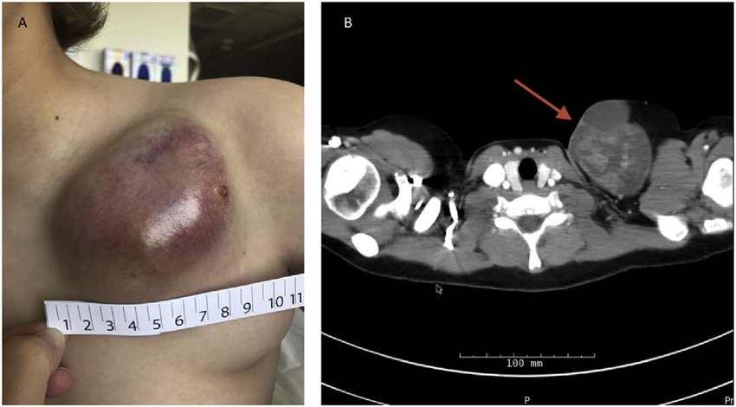
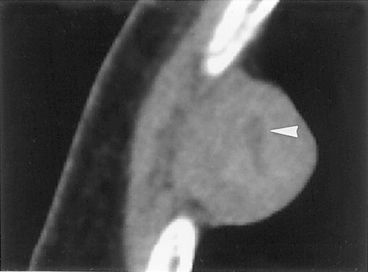
Investigations
Diagnostic approach to surgical diseases of chest wall
• Clinical examinations (anamnesis, palpation, etc.)
• Laboratory tests (hemogram, oncomarkers, etc.)
• Instrumental (visualization) methods (Xray, CT, MRI, PET)
• Biopsy

Slide 4
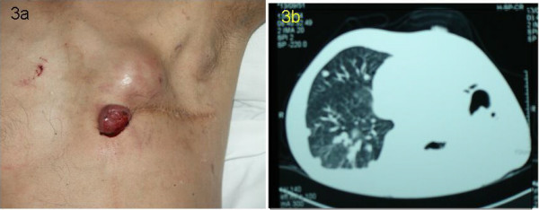
Clinical examinations-suspicion
Diagnostic approach to surgical diseases of chest wall
pain
swelling
hyperemia
excretion of mucus, pus, bloody fluid..
atypical symptoms (shortness of breath, cough, fever)

Slide 5
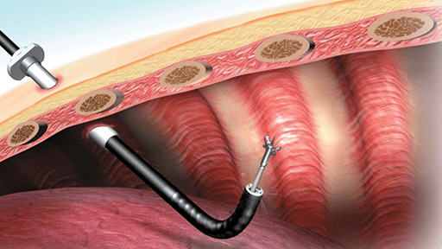
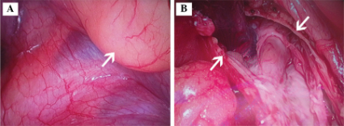
Instrumental examinations
Diagnostic approach to surgical diseases of chest wall
Xray
USG
CT
MRI
PET
Thoracoscopy

Slide 6
Diagnostic approach
Diagnostic approach to surgical diseases of chest wall
Clinical, laboratory, Xray
First step
examinations
CT, MRI
Second step
examination
PET, toracoscopy
Third step
examination

Slide 7
Thank you for attention

Slide 8


www.bck.az
Azərbaycan Tibb Universitetinin I-Cərrahi Xəstəliklər kafedrası

