Slide 1
Surgical diseases of esophagus
Achalasia
Surgical diseases
of esophagus
PhD. Salahova Sevinj
Azerbaijan Medical Univercity
I surgical diseases department

Slide 2
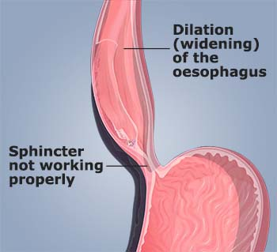
Surgical diseases
of esophagus
Definition
Achalasia is an uncommon disease of esophageal motility disorder
It is characterized by degeneration of the myenteric neurons that innervate LES and esophageal body

Slide 3
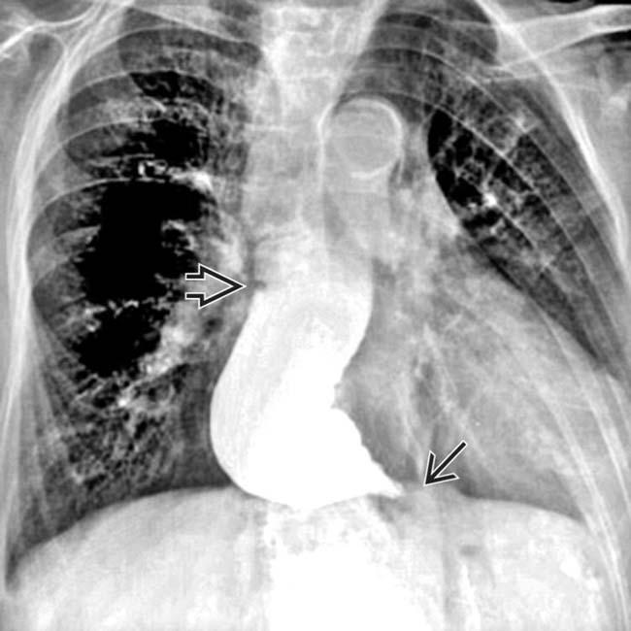
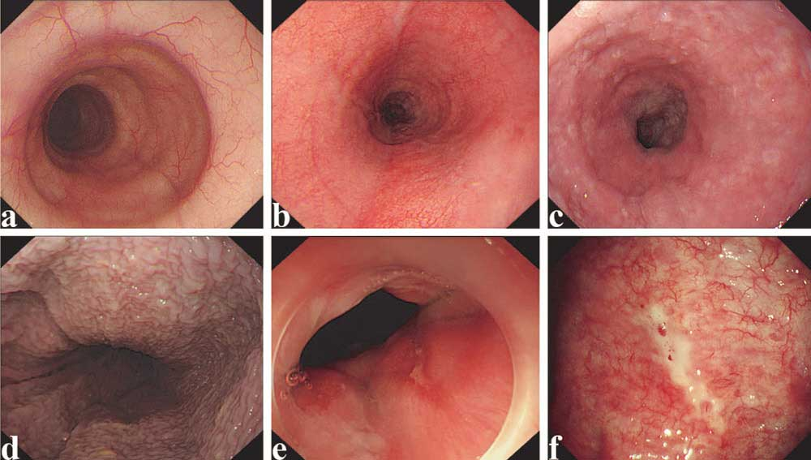
Achalasia

Slide 4
Aetiology and pathogenesis
Surgical diseases
of esophagus
Autoimmune ?
Viral?
Familial?
There are 2 theories:
Neuron degeneration
Injury of neurons by infection

Slide 5
Frequency
Surgical diseases
of esophagus
1/100 000: 6/1000, it is more common among people aged 30-50.
Frequency of gender; 3:2

Slide 6
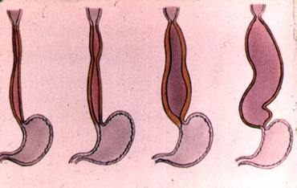
Classification
Surgical diseases
of esophagus
Radiology | Stage I - There is no dilation in the Esophagus Stage II - There is a longitudinal dilation in the Esophagus Stage III - There is one “knee” in the Esophagus Stage IV - There are several “knees” in the QB (takes the form as Sigmoid colon).
Təsnifatı

Slide 7
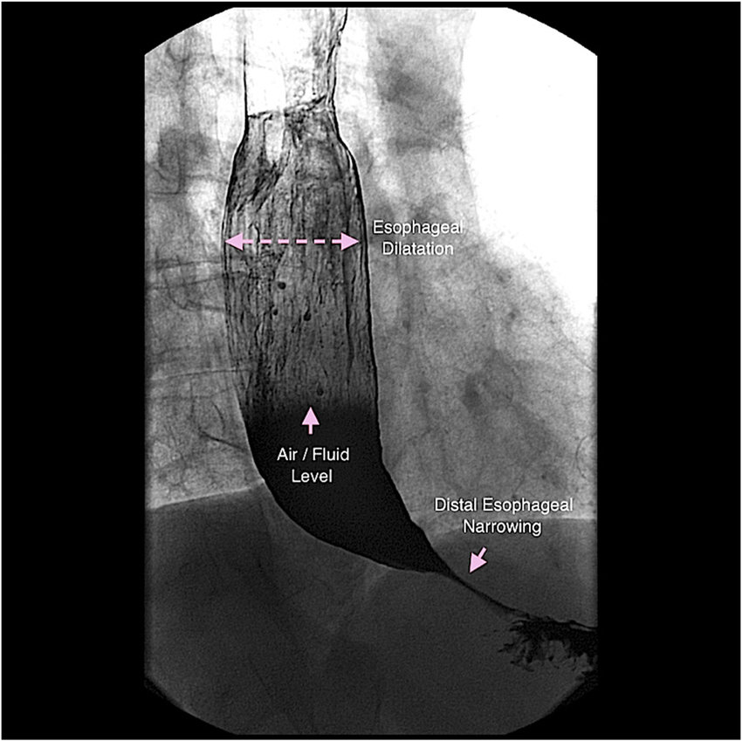
Classification
Surgical diseases
of esophagus
Manometric | Type I (classic type) - no LES relaxation, no peristalsis in the Esophagus. Type II (compression type) - no LES relaxation, low amplitude peristalsis in the Esophagus (pressure less than 30 mm Hg st). Type III (spastic type) - no LES relaxation, total spasms in the Esophagus (amplitudes 70 mm Hg and more).

Slide 8
Clinical Features
Surgical diseases
of esophagus
Dysphagia | - Occurs after ingestion of both liquid and solid foods. Initially, it occurs more often after eating liquid food (paradoxical dysphagia).
Regurgitation | - It usually occurs in a supine position, sometimes caused to aspiration.
Heartburn | - Not due to reflux, but due to the enzymatic fermentation of stagnant foods in the esophagus
Chest pains | - Usually appears with meals. It gets heavier at first. As the CB dilation increases, the pain intensity decreases.

Slide 9
Course of diseases and complications
Surgical diseases
of esophagus
Sigmoid colon image
distal narrowing
of esofagus
diffuse enlargement
of esophagus
Aspiration pneumonia
Candida esophagitis
Cancer (risk increases by 7 times)
Complications

Slide 10
Diagnosis
Surgical diseases
of esophagus
Suspicion
Dysphagia
Chest pain
Patients who loss weight and with stable weight for a long time despite dysphagia
Thickening in the distal sphincter region on CT
Paradoksal dysfagia
Bad smell in the mouth
Regurgitation
Narrowing of the distal part of the GB on radiological and endoscopic examinations
Heartburn

Slide 11
Diagnosis
Surgical diseases
of esophagus
the confirmation
Organic diseases of the gastrointestinal tract should be denial
Peristalsis of the Esophagus and tonus of the lower sphincter should be assessed by functional examination
The diagnosis is mainly confirmed by manometry

Slide 12
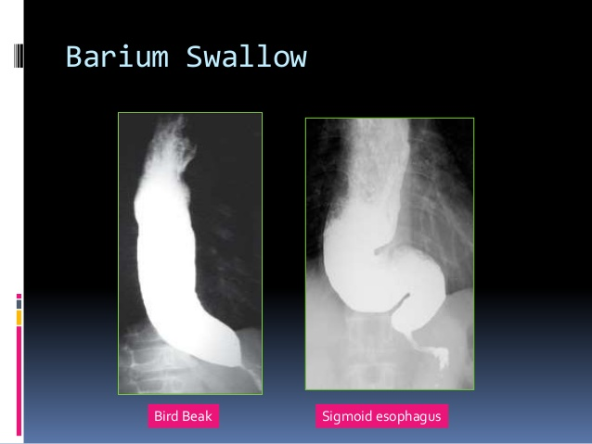
Diagnosis
Surgical diseases
of esophagus
Barium Esophagogram
Classical “bird’s beak” appearance
Dilated esophageal body

Slide 13
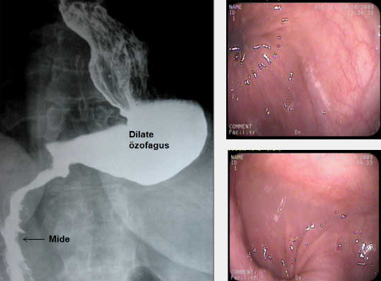
Diagnosis
Surgical diseases
of esophagus
Endoscopy
Enlarged Esophagus, old food scraps, candidal esophagitis, narrowing of the lower sphincter level

Slide 14
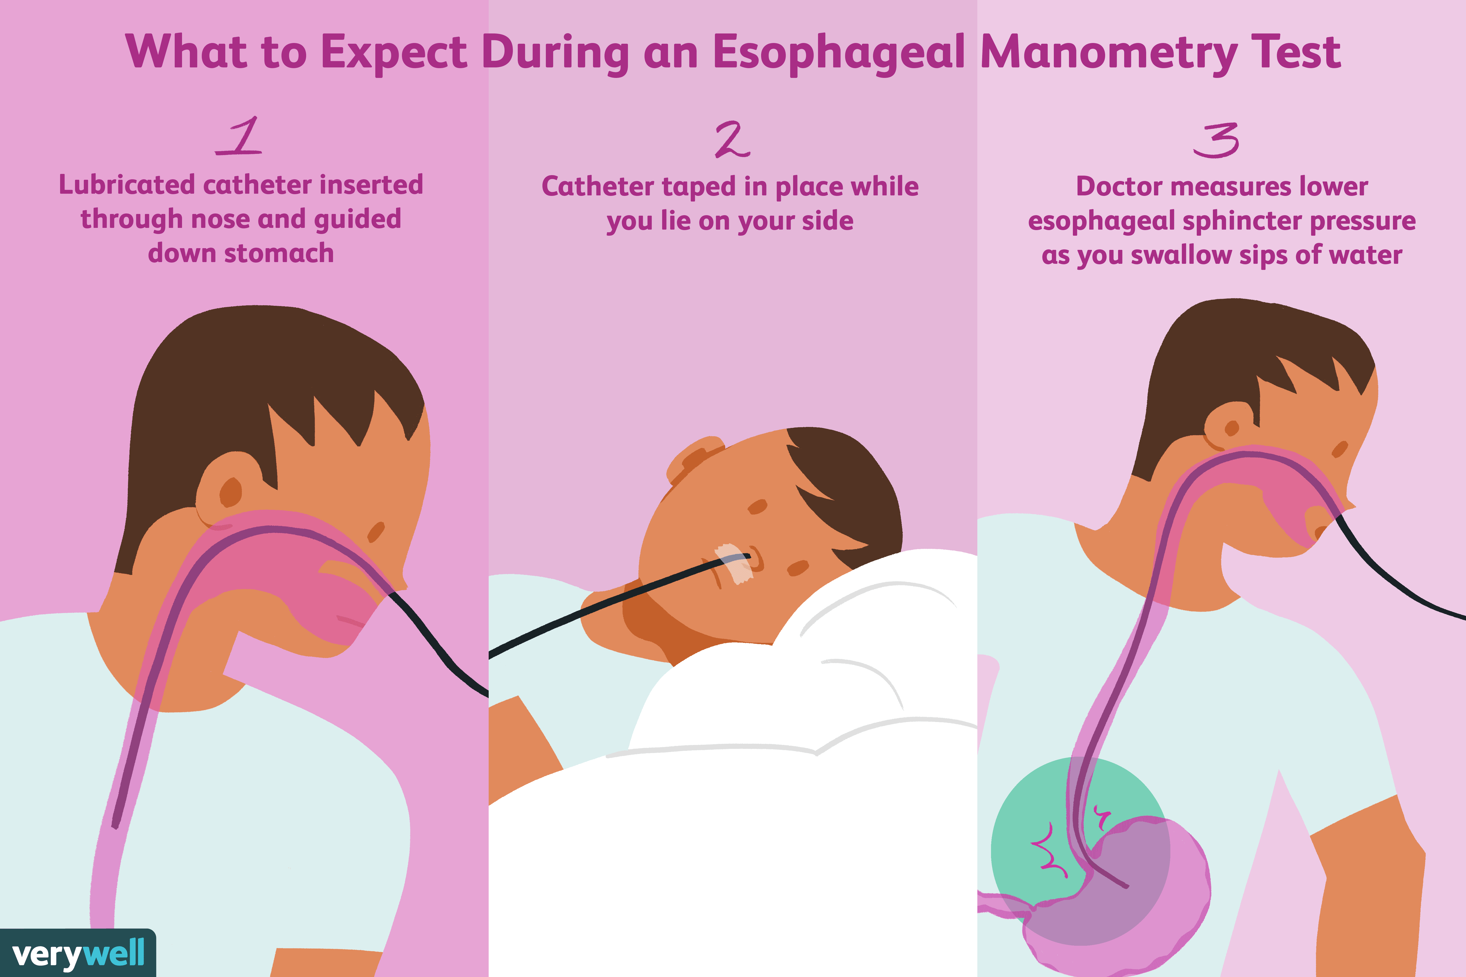
Diagnosis
Surgical diseases
of esophagus
High Resolution Manometry

Slide 15
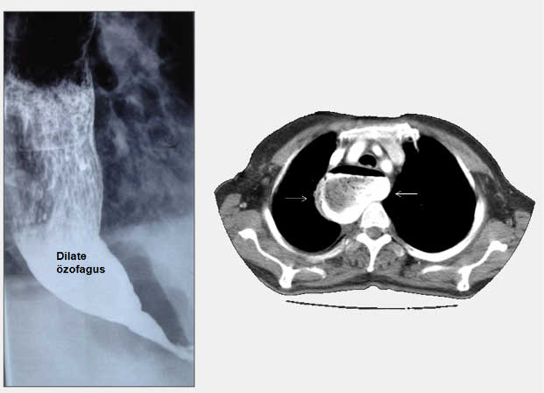
Diagnosis
Surgical diseases
of esophagus
CT and Endoscopic Ultrasound
Carried out for differentiation with tumors

Slide 16
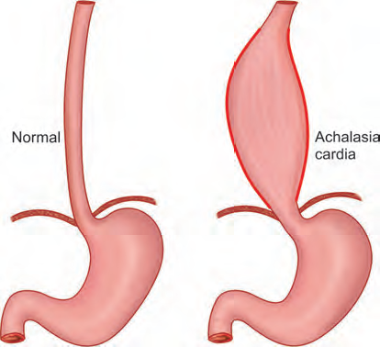
Diagnostic criteria
Surgical diseases
of esophagus
dysphagia
narrowing of the distal esophagus on imaging and dilation of the Esophagus before narrowing
manometry (the main diagnostic test) is the absence of emptying of the lower sphincter at the time of ingestion (more than 10 mm Hg st.)
high pressure of the lower sphincter (> 40 mm Hg st)
uncordinated peristalsis
absence of mass (derivative) on endoscopic USG or CT

Slide 17
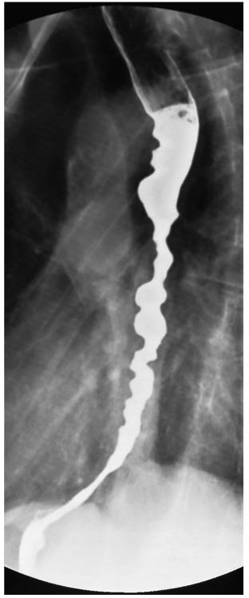
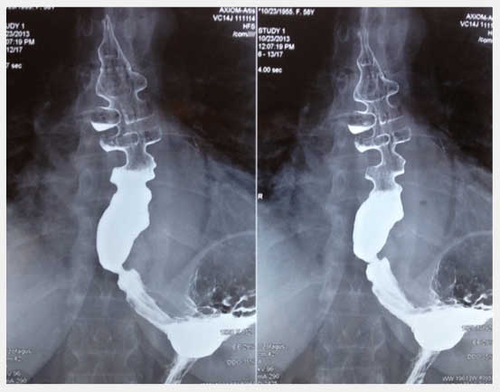
Differential diagnostics
Surgical diseases
of esophagus
Diffuse and segmental esophageal spasm
“Nut Crcker" esophagus
Qatroesophageal reflux disease
Striktures
Distal tumors (especially dysphagia in recent months in elderly patients)
Cardiological diseases

Slide 18
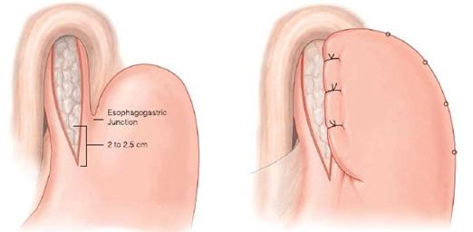
The principle of treatment
Surgical diseases
of esophagus
Calcium channel blockers
Endoscopic botulinum injection
Endoscopic dilatation
Laparoscopic myotomy and fundoplication
Surgical treatment
Esophageectomy

Slide 19
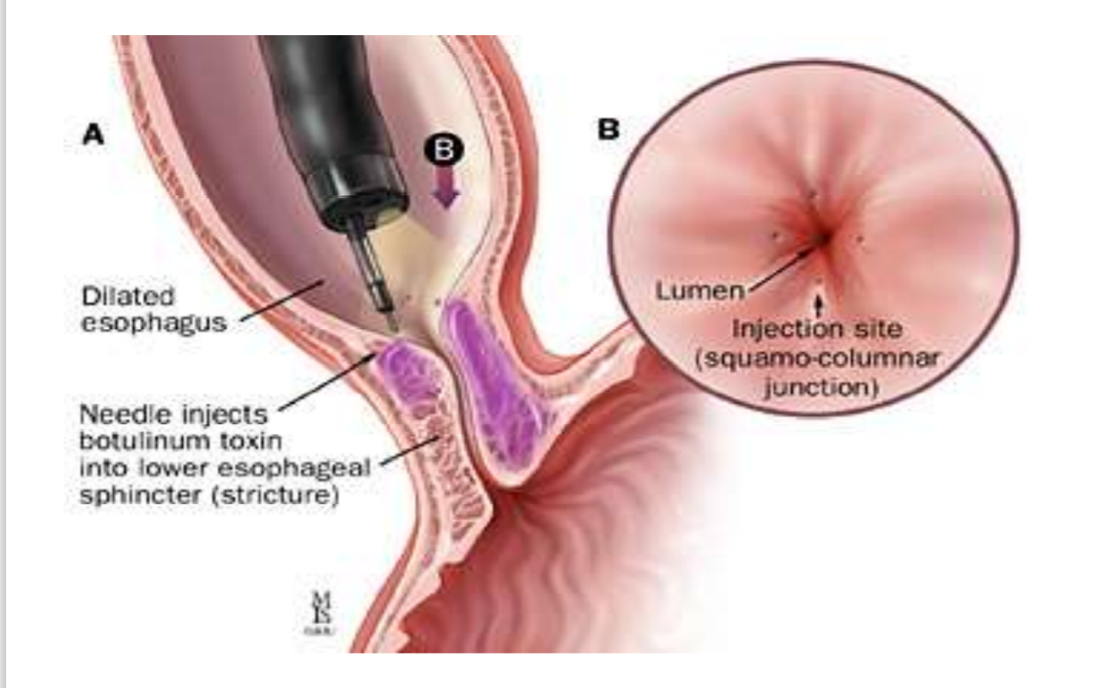
Surgical diseases
of esophagus

Slide 20
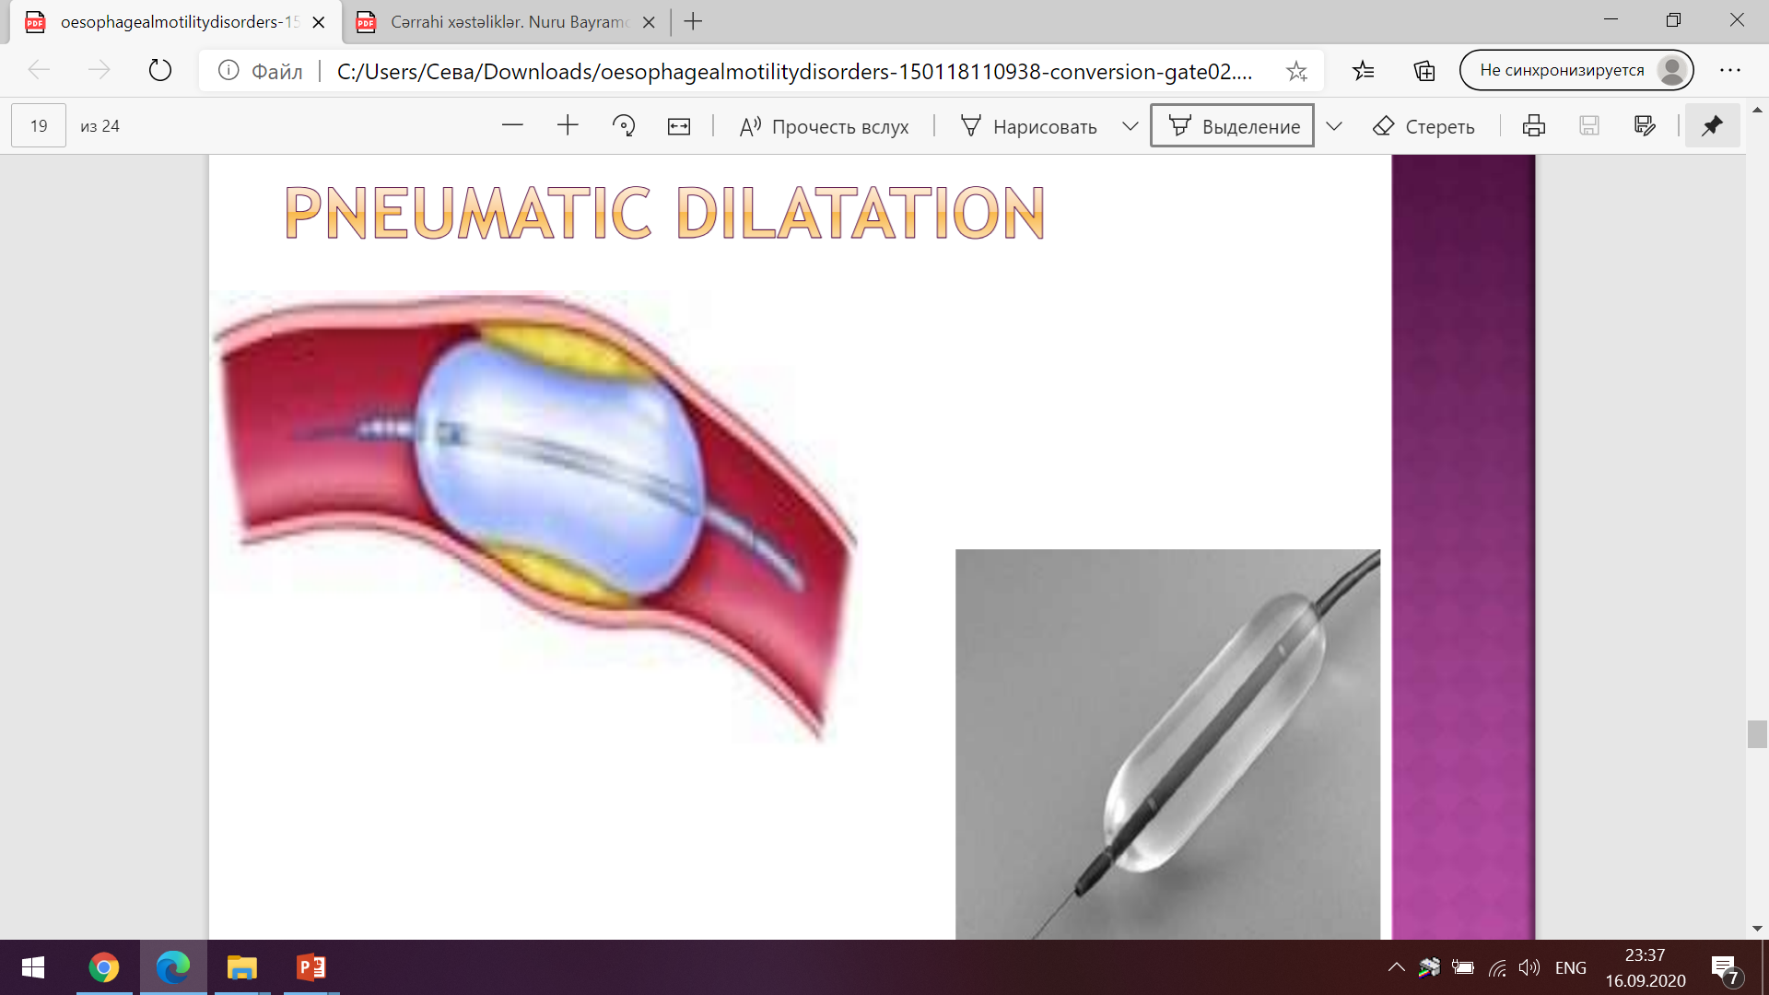
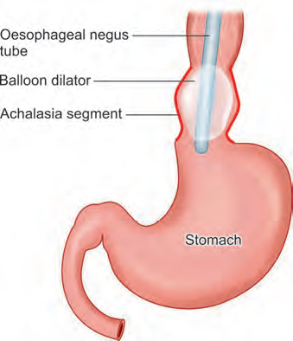
Surgical diseases
of esophagus

Slide 21
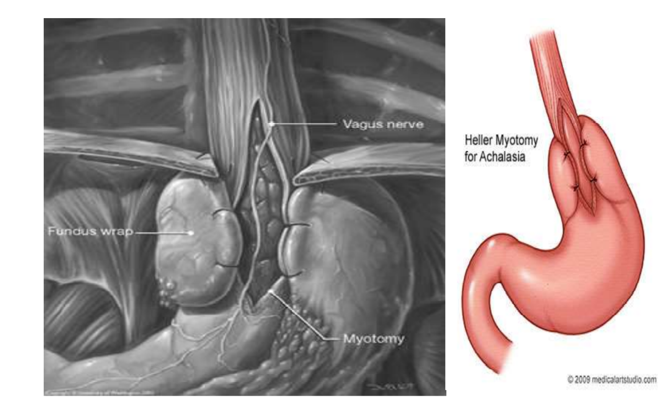
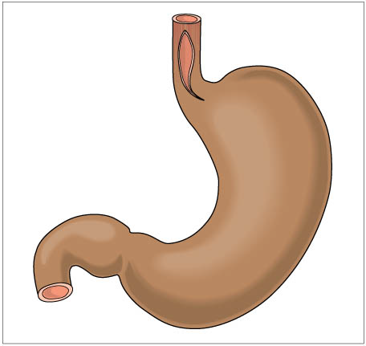
Surgical diseases
of esophagus

