Slide 1
Ulcerative colitis
Ulcerative colitis
Prof.Dr. Eldar Aliyev
Phd. Parvana Aydınova
AMU, department of I surgical diseases

Slide 2
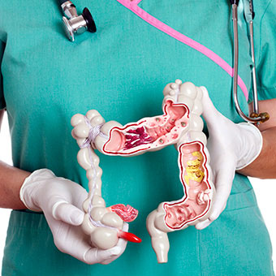
Definition
Ulcerative colitis
Non-specific ulcerative colitis or short ulcerative colitis (HK) is a chronic inflammation of the mucous membrane of the colon, starting from rectum and spreading directly to the proxima.
Tension and remission are characteristic and sometimes cause complications (bleeding, toxic dilatation, etc.)

Slide 3

Confirmation
Ulcerative colitis
50-150/100000
Mostly 15-40 and 50-80 years
2:1

Slide 4
Etiology
Ulcerative colitis
The cause and mechanism of ulcerative colitis, such as Crohn's disease, remains unknown.
The following factors are likely to play a role.
Some factors, particularly appendectomy, have been reported to reduce the frequency of smoking of HC.
Genetic
İmmun
Infection
Other external factors
Diet

Slide 5
PATHOGENESIS
Ulcerative colitis
The pathogenesis of HC is not known.
It is assumed that immune, infection, alimentary, and other damaging factors cause persistent inflammatory processes in mucosa (which usually does not go beyond mucous membrane and mucous membrane).
As the inflammatory process continues, pathological changes in the mucous membrane are exacerbated. Initially, colitis and cryptic abscesses occur in the mucous membrane. Then the pseudopoly image appears as a result of edema of the mucous membrane and deepening of the ulcers.
In the late stages, the final stage changes occur in the mucous membrane: The mucous membrane collapses, wrinkles are lost, severe dysplasia is seen, and the image of the intestinal forms as a tube. Profit is usually not narrowed, but sometimes there can be strictures. Inflammatory changes and ulcers in the mucous membrane cause diarrhea and bleeding.
Prolonged dysplasia increases the risk of cancer.

Slide 6
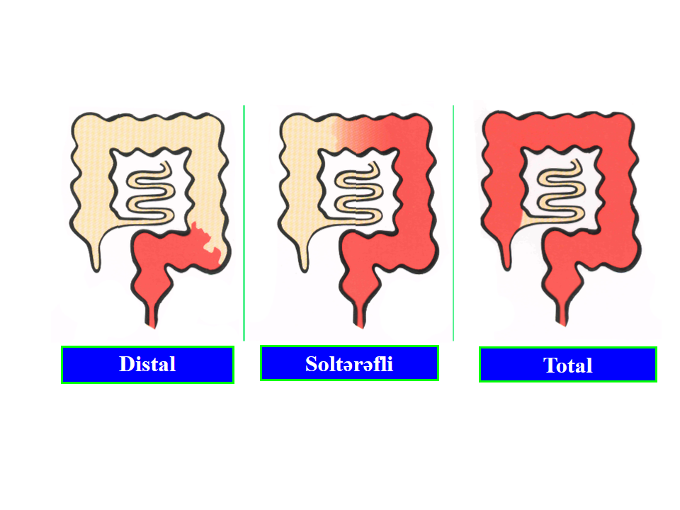
Classification
Ulcerative colitis
According to localization
Pancolitis (from the curvature of the spleen to the proximal) - 20%
Proctite or proctosigmoidite - 30-50%
Left colon (up to the curvature of the spleen) - 20-30%

Slide 7
Classification
Ulcerative colitis
According to the number and severity of diarrhea, common symptoms and the amount of EPS the acute phase of ulcerative colitis is divided into 3 severity levels (Montreal Classification):
Light degree
Daily diarrhea is less than 4 times, less bloody or bloodless, no general symptoms (anemia, tachycardia, fever, weight loss), EPS is normal. It occurs in 25-30% of cases.
Middle degree
There is bloody diarrhea 4-6 times daily, the pain is mild but permanent, there are some general symptoms (temperature ˂ 37.5ºC, weak anemia, weight loss) - (25-30%)
Severe degree
Daily diarrhea is more than 6 times and bloody, persistent severe pain, severe systemic symptoms: temperature ≥37.5ºC, tachycardia ≥90, anemia (hemoglobin ˂10.5 g / dL) and EPS ≥30 mm / h

Slide 8
Morphogenesis
Ulcerative colitis
In the HF, the bowel is inflamed in all patients and moves towards the proximal portions.
Unlike Crohn's disease, the spread of inflammatory process in ulcerative colitis is uninterrupted and there is no perianal pathology.
In ulcerative colitis, there may be reflux ileitis, also an inflammation caused by the return of the ileum , which is rich in inflammatory mediators.

Slide 9
PROGRESSING
Ulcerative colitis
Cholelithiasis is a chronic illness with aggravation and remission phases
After aggravation, approximately 60% of patients enter the remission phase under conservative treatment, 15% improves with long-term treatment, 25% require an emergency colostomy for non-adherence or complications.
Approximately 67% of remission patients occur severe revision within 10 years. As the rate of spread increasing disobeying and complication to the conservative treatment is increasing.
The probability of surgery of proctitis is 1% in 10 years and 25% in left colitis.
Although inflammatory processes are often at the level of mucous membrane and submucous membrane in ulcerative colitis, in 10–15% of cases the progression can spread to the entire wall and proximal parts of the intestine, causing complications.

Slide 10
PROGRESSING
Ulcerative colitis
Sharp phase of ulcerative colitis
Emission with conservative treatment (75%)
Not responding to conservative treatment or complications (25%)
Recidive
67% in a year
Surgical treatment
Letality 1-6%

Slide 11
Complications
Ulcerative colitis
Local complicatios
General complications
Skin and mucosal complications
Uveit
Bone and articulation
Hepatobiliary
Anemia
Malnutrition
Pericarditis
Perforation
Toxic meccolone
Massive bleeding
Stricture
Colon Cancer

Slide 12
CLINICAL
Ulcerative colitis
Symptoms, bleeding, pain and exerting are characteristic symptoms of ulcerative colitis.
Diarrhea is usually numerous and lasts more than 1 month.
Intestinal bleeding can be in the form of blood mixed with stool or in the form of bloody secretions.
Pain can be stinging and tolerant in simple cases, but in severe cases is permanent and unbearable.
Tensity are very common in ulcerative colitis as a characteristic feature of proctitis.

Slide 13
Suspicion
Ulcerative colitis
Should be suspected of ulcerative colitis in the following cases:
People with diarrhea, especially those that last for more than 4 weeks and have been diagnosed with bloody diarrhea, fever, abdominal pain and fever.
Family anamnesis
In colonoscopy, inflammation, erosion, ulcers, and so on are present in the rectum and proximal to it.
Intestinal wall thickening in USM / CT / MRT
Colitis symptoms in biopsy

Slide 14
Initial tests
Ulcerative colitis
Clinical tests
Laboratory tests may show signs of inflammation, malabsorption, anemia: Increased EPS, steatorrea, albumin reduction, etc. None of these signs are specific.
Stool analysis is an important examination, performed for the rejection of infectious diarrhea (bacterial, parasitic, etc.).
USM – There is no importance
CT is used in the diagnosis of complications and differential diagnosis of ulcerative colitis. Usually, diffuse thickening and edema of the intestinal wall may appear, which is not specific.
Irrigoscopy is not widely used today.

Slide 15
DIAGNOSTIC CRITERIAS
Ulcerative colitis
Anamnesis
Diarrhea can be bloody for more than 4 weeks
There may be toxic symptoms of pain, fever, weight loss, anemia, etc.
REVIEW
Proctitis and colitis in colonoscopy
Biopsy
  Symptoms of inflammation
  Other colitis rejection

Slide 16
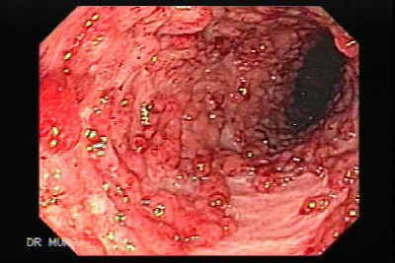
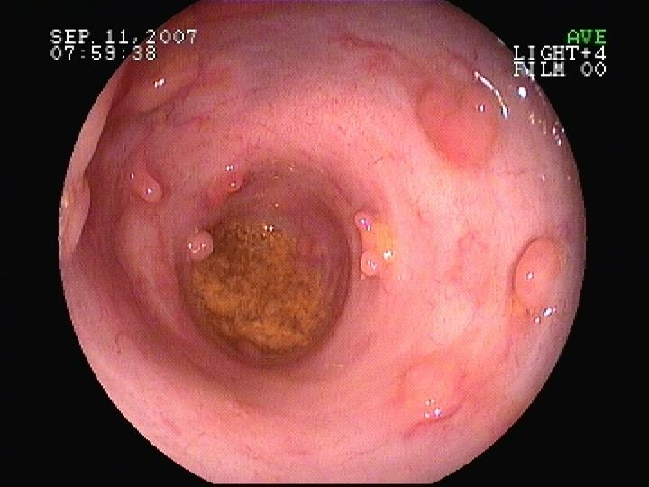
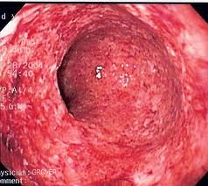
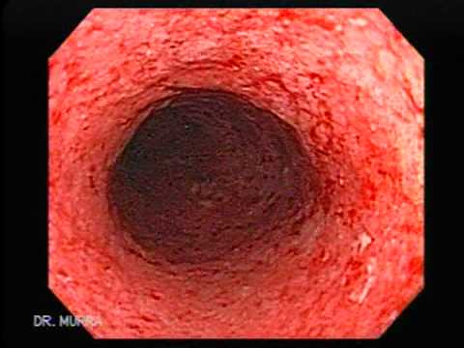
DIAGNOSTIC CRITERIAS
Ulcerative colitis
Colonoscopy and biopsy is an absolute test for the diagnosis of ulcerative colitis, is able to assess inflammation, prevalence, degree of alteration in mucous membrane, and biopsy. Colonoscopy may show different degrees of mucous membrane: erythematic, superficial erosions, deep ulcers, pseudoplasts, mucous membranes, strictures, etc. Given that colonoscopy can be perforated in the acute phase, especially in the dilated, recto sigmoid region is limited in these cases and biopsy is obtained. Full examination of the intestine is done after the acute phase is extinguished.

Slide 17
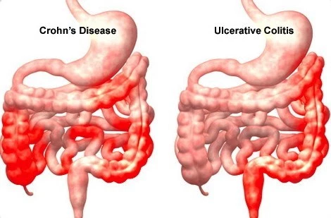
Differential diagnostics
Ulcerative colitis
The following are characteristic of Crohn's disease:
transmural injury
Inflammatory transmural granulomatosis in granulomas and biopsy
wall thickening
segmental damage
large mucosal ulcers and cracks
normal view of the rectum
perianal pathologies
diarreyanın
qansız olması
night sweats and temperature

Slide 18
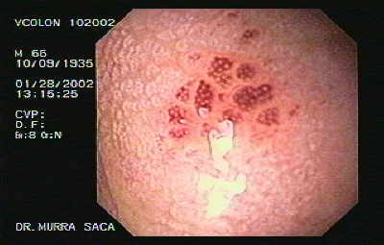
Differential diagnostics
Ulcerative colitis
Infection diarrhea is usually acute, and
patients’ ilness may develop rapidly.
Stool staining, culture, microscopy, and
Gram staining and biopsy should be performed.

Slide 19
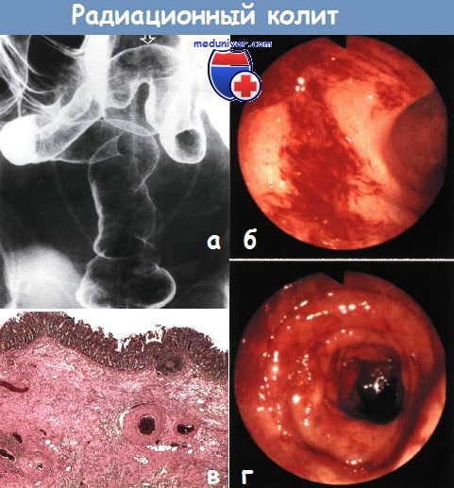
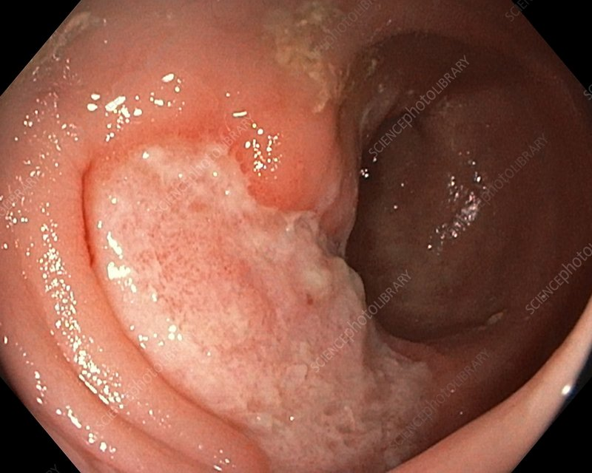
Differential diagnostics
Ulcerative colitis
Radiation colitis occurs after abdominal and pelvic radiotherapy and endoscopically resembles ulcerative colitis.
In anamnesis – radiotherapy
In Biopsy - eosinophilic infiltrates, epithelialatipia,
fibrosis and capillary telenagioectasia
Differentiation of solitary rectal ulcers from
ulcerative colitis is possible by location and
usually biopsy.

Slide 20
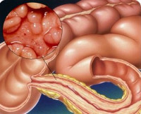
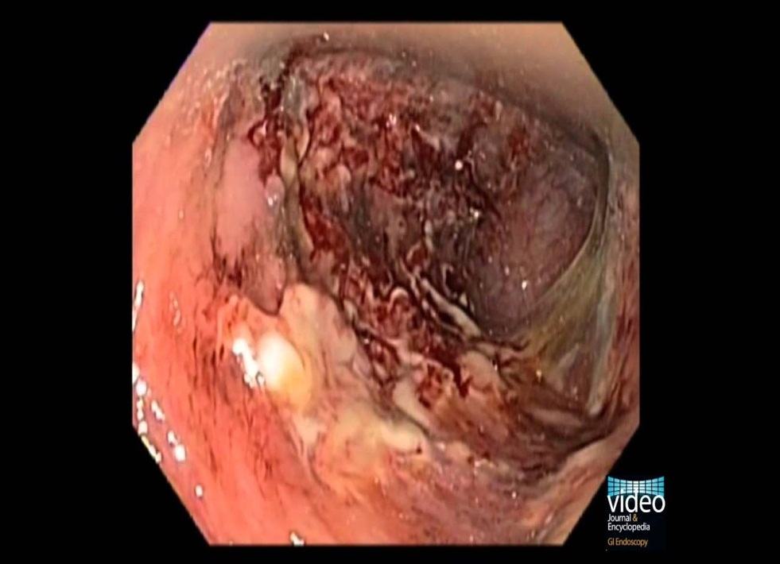
Differential diagnostics
Ulcerative colitis
Characteristic features of diverticular colitis are
Diverticula inflammation of the interstitial region,
while diverticulum penetration it is free from
inflammation.
Diversion occurs in the distal intestine without
distal colitis.

Slide 21
PRINCIPLE OF THE TREATMENT
Ulcerative colitis
The main target is to extinguish the acute phase
Provide long-term remission

Slide 22
DETERMINATION OF COMPLICATION DEGREE
Ulcerative colitis
Used in clinical and endoscopic classifications.
The most recommended classification is the Montreal clinical classification

Slide 23
Therapeutic approach
Ulcerative colitis
Ulcerative colitis
Conservative treatment: for acute phase exacerbation and relapse prevention
Immunosuppressors
Steroids
Cyclosporine
Anti - TNF
Diet
Anti-inflammatory (local or oral)
5-aminosalicylates
sulfosalazine (2–4 g / day)
mesalamine (2–5 g / day)
osalazine (1–3 g / day)
balsalazid (6.7 g / day)
Antibiotics
Symptomatic
Spasmolytic
Painkiller
Antidiarrhea
Vitamin therapy
Probiotics

Slide 24
Therapeutic approach
Ulcerative colitis
Surgical treatments - for the treatment of complications
Operating Instructions:
Complications
There is no response to conservative treatment
Massive bleeding
Perforation
Toxic meccolone
Stricture and impermanence
Cancer or suspicion

Slide 25
The choice of tratment
Ulcerative colitis
Light and moderate ulcerative colitis
Proctite or proctosigmoidite
Left Colitis or Pancolitis
Combination:
Topical + oral 5-ASA
Topical 5-ASA (cone + processing / foam)
No answer
No answer
Topical Steroid
Supplements Topical Steroids or Oral 5-ASA
No answer
Topical and oal steroid
There is answer
There is answer
Continuous treatment
Topical 5-ASA
Continuous treatment
Topical +oral5-ASA

Slide 26
The choice of tratment
Ulcerative colitis
Severe ulcerative colitis
Hospitalization
Support treatments
Intravenous Steroids or Oral Steroids (+) (-) oral and topical 5-ASA
(3-4 days)
No answer
Cyclosporine or Infliximab (3-4 days)
No answer
There is answer
Urgent operation
Toxic meccolone
Perforation
Massive bleeding
Continuous treatment
Oral steroid or 5-ASA, Azatioprin, etc.

Slide 27
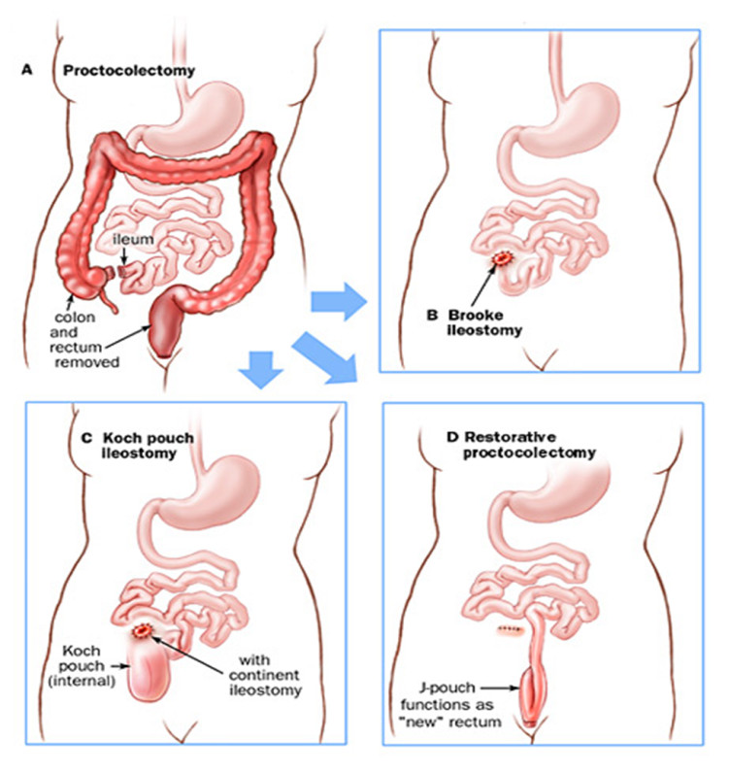
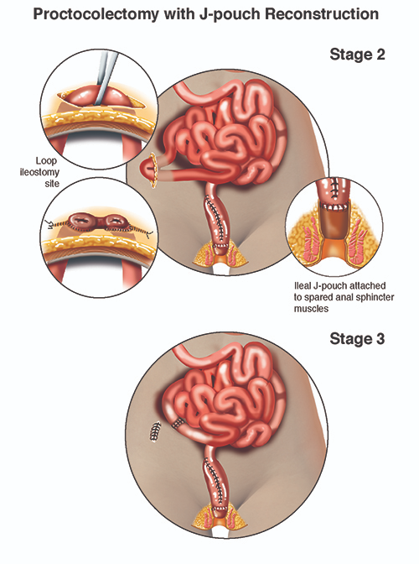
Surgical treatment
Ulcerative colitis
Proctocolectomy + ileoanal anastomosis (İPAA)
Proctocolectomy + ileostomy
Two staged operation: kolektomi + ileostomy, then proktektomiya + ileoanal anastomosis

Slide 28
Summary
Ulcerative colitis
The main treatment for ulcerative colitis is conservative, and surgical treatment is performed.
Conservative treatment is performed to relieve tension (induction) and prophylaxis of residive (continued treatment), and surgery is usually performed to treat complications.
The treatment method is based on the severity of the disease and the incidence of the colon.
Light and moderately topical and oral 5-ASA, if not answer, steroids.
Severe steroids, cyclosporine or infilicab or surgical if no response.
Surgery if there are surgical complications.

